Slide 1

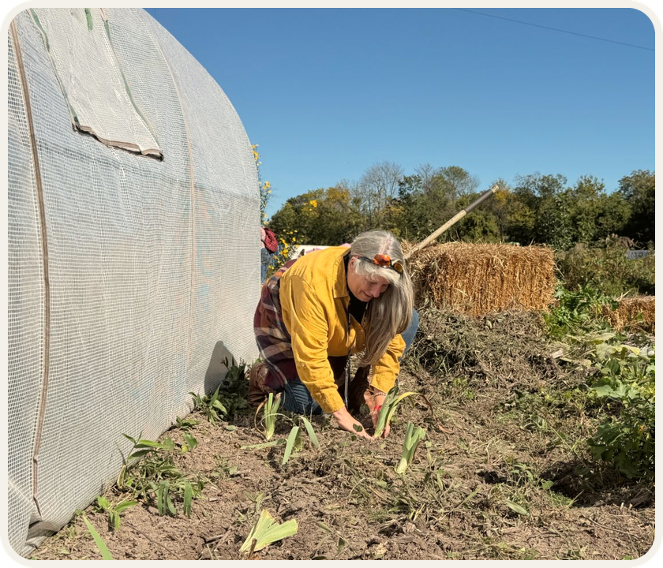


Farmer Veteran Coalition
Veteran farmers
building living soil
With Soil Food Web Consultant
Suzanne Shea

Slide 2

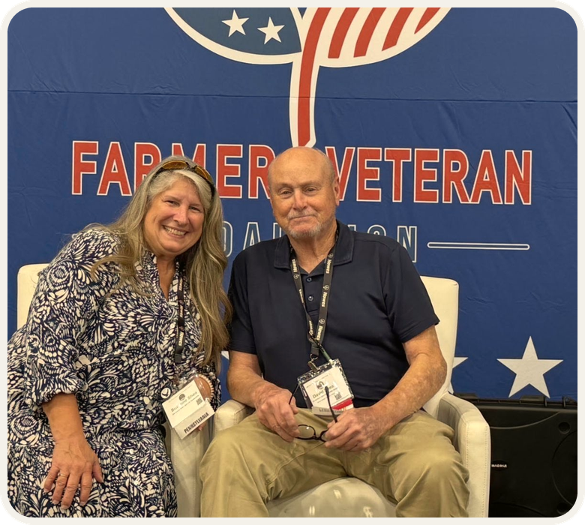

Stakeholders Conference
“Scaling Sustainably”
Suzanne Shea’s talk at the
Farmer Veteran Coalition

Slide 3

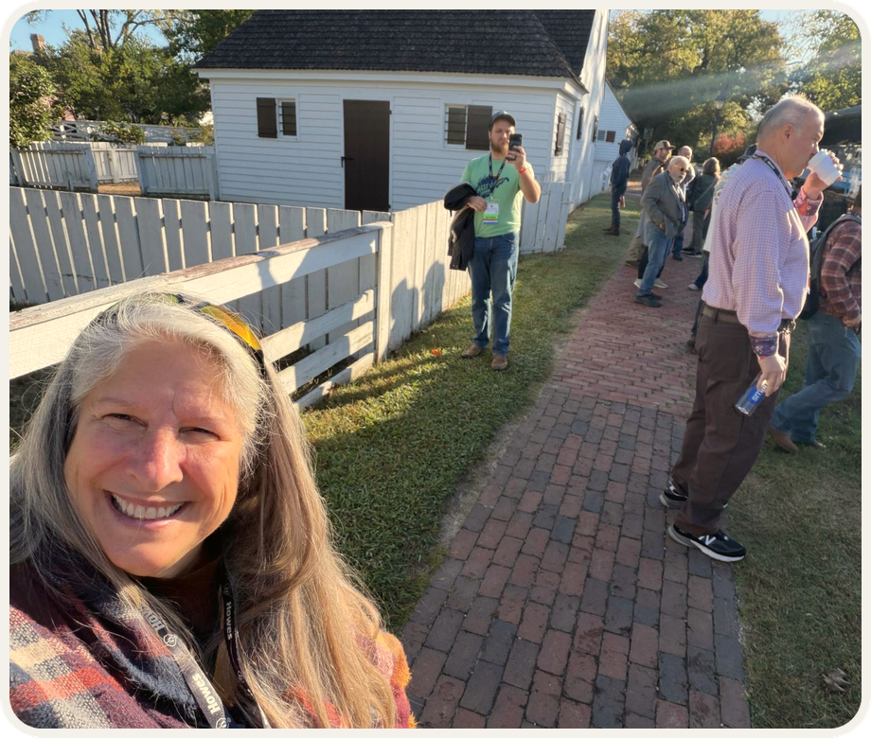

Soil Food Web Consultants
Find one
near you

