Slide 1

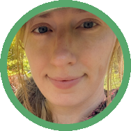
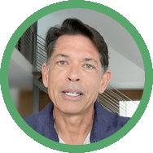
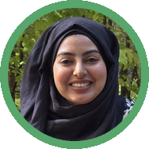
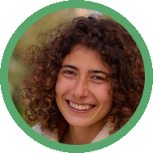

From our students
Foundation Courses + Compost Intensive
Fall Enrollment Special
Until 2 December.

Slide 2

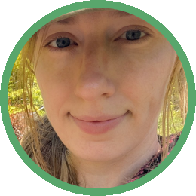
Zoë Unruh
Canada
“I recently completed my Foundation Courses. I had so much fun learning about regenerative agriculture, creating compost and liquid amendments, and all the little creatures that help our soils to thrive. I am super excited to put all these ideas into practice and to continue learning!”

Slide 3

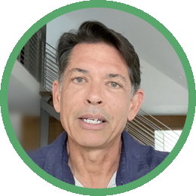
Rob Mosier
United States
“I am overwhelmed by the depth and thoroughness of these courses... I am still amazed at the amount of content! The classes are absolutely fabulous!”

Slide 4

Emmanuel Morales
United States
“I've taken classes on microbiology before but this course really makes a difference in the way that a story is put together that unveils a relationship between plants and all those beneficial microoragnisms that we just cannot see without a microscope.”

Slide 5

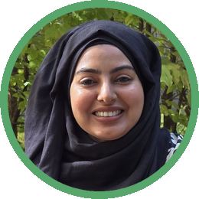
Anusha Fatima
Pakistan
“I want to help repair broken food systems by rebuilding life in the soil. Through this program, I hope to help farmers understand and work with nature's biology to regenerate land, improve resilience, and grow healthier food.”

Slide 6

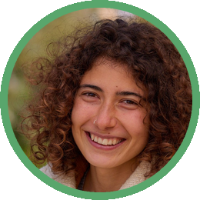
Clara Santiago
Portugal
“The extraordinary body of knowledge Soil Food Web's Foundation Courses has to offer can certainly empower me with the required knowledge and experience to drive the work I have been developing further. As a land steward and within the projects I am developing and taking part in, I hope to have a positive impact and a considerable contribution towards soil health, land regeneration, awareness raising and ecological literacy.”

Slide 7

Foundation Courses + Compost Intensive
4 Foundation Courses
Self-paced, 63 lectures and about 150 hours of study.
A seat in a 2027 Compost Intensive cohort
Ten weeks online, with a 90-minute live session with a mentor every week.
Hundreds of hours of webinars
Our legacy webinar archive, recorded live with Dr. Elaine Ingham.

Slide 8

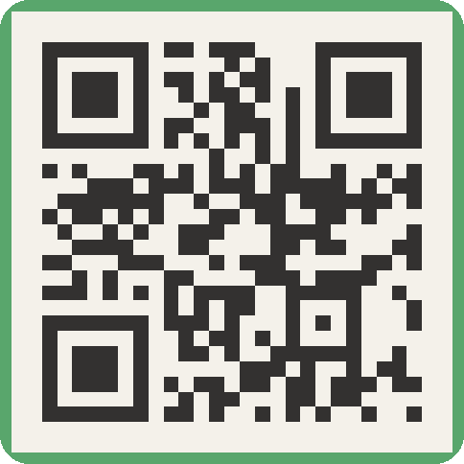
Foundation Courses + Compost Intensive
Fall Enrollment Special
Until 2 December.

