Slide 1
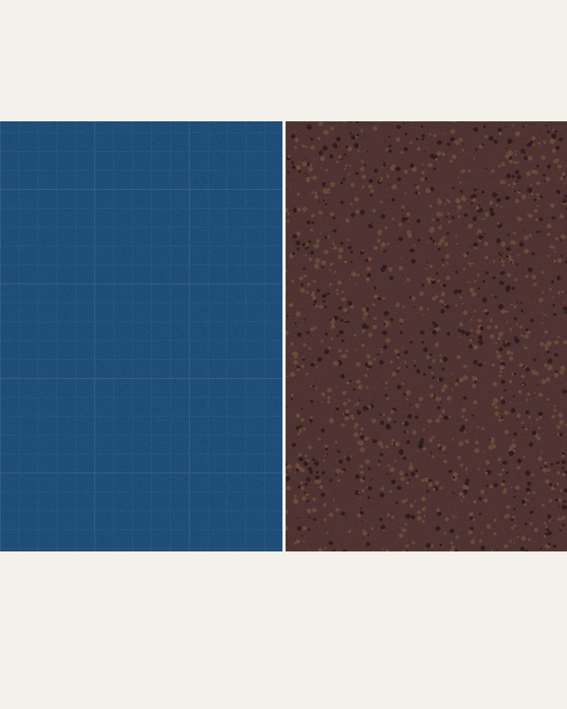



Two courses, one bundle
Foundation Courses
Compost Intensive
Fall Enrollment Special,
until 2 December.
Link in bio.

Slide 2



The Foundation Courses teach you to work out what your soil needs.
63 lectures and about 150 hours of study, with 40+ years of Dr. Elaine's knowledge.

Slide 3


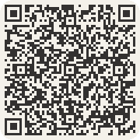
The Compost Intensive Course teaches you to make it.
No prerequisites. Start the Foundation Courses today and build with the cohort as early as January.

