Slide 1
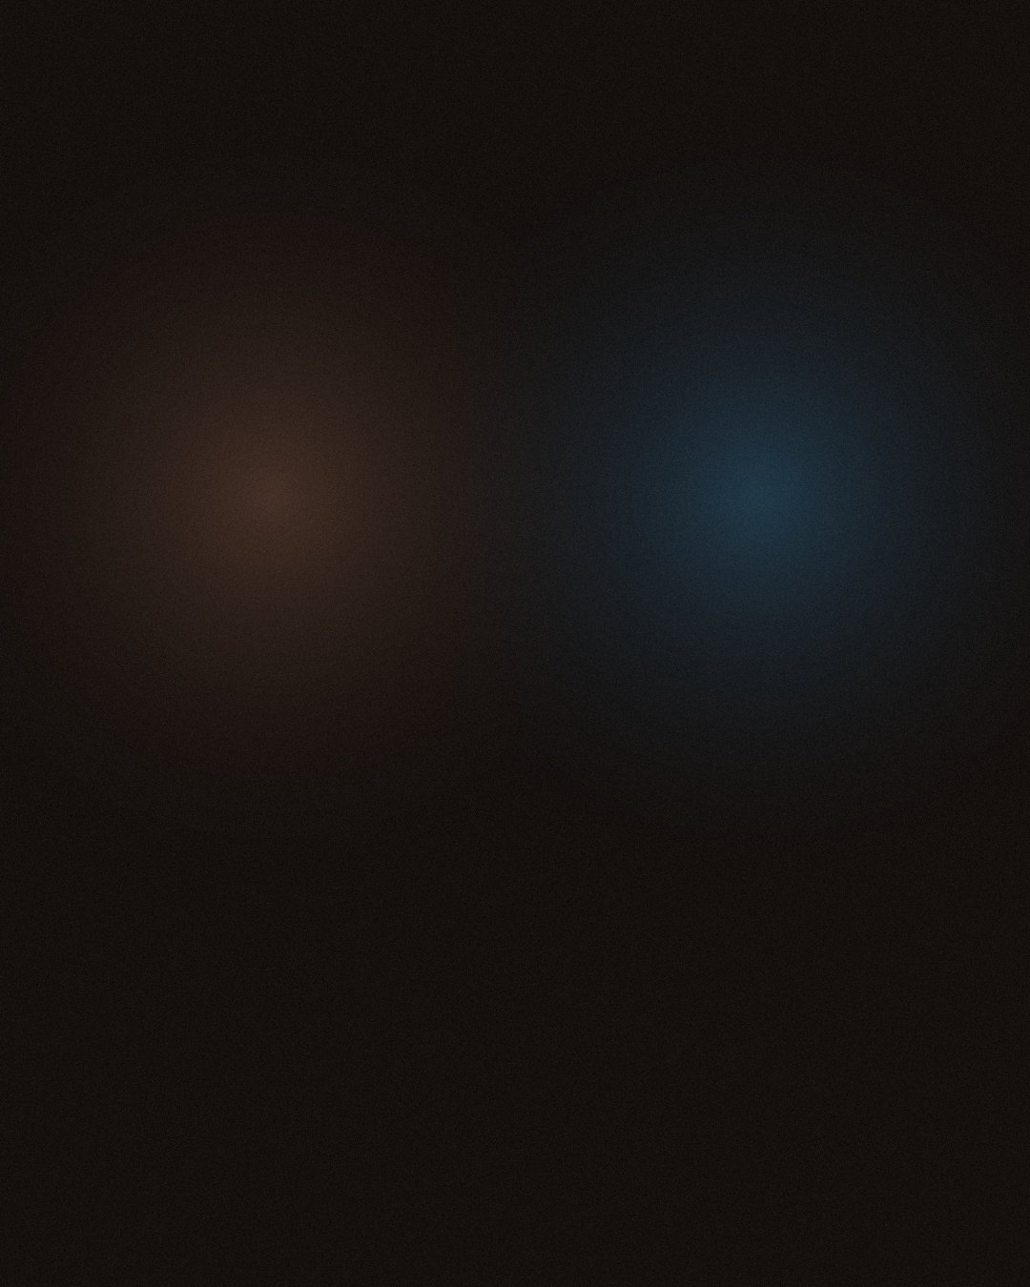



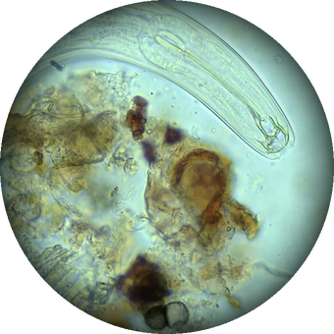





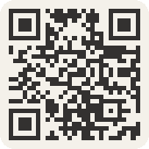

Judge it by hand.
Then see the life in it.
In the Compost Intensive
Microscopy, in the Foundation Courses
Photo: Keisha Wheeler
Look
Feel
Smell
Structure
Maturity
Until 2 December.
Link in bio.

