Slide 1


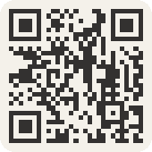

Start today.
Pick your season.
Start the Foundation Courses any day. One 2027 Compost Intensive cohort is included.
11 Jan
to 26 Mar
D
J
N
F
30 Aug
to 7 Nov
O
M
2027
S
A
A
M
J
J
10 May
to 25 Jul
One week left,
until 2 December.

