Slide 1

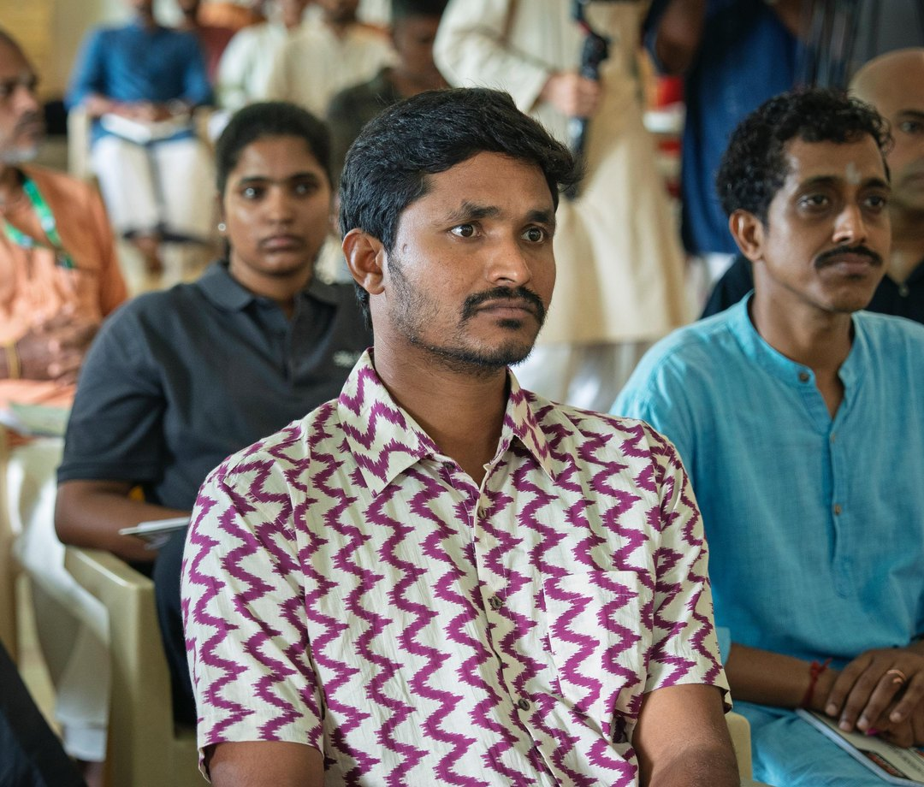

There is a farmer somewhere right now watching their soil fail

Slide 2

Not from drought or bad luck, but from a century of practices that stripped the living biology from the ground

Slide 3
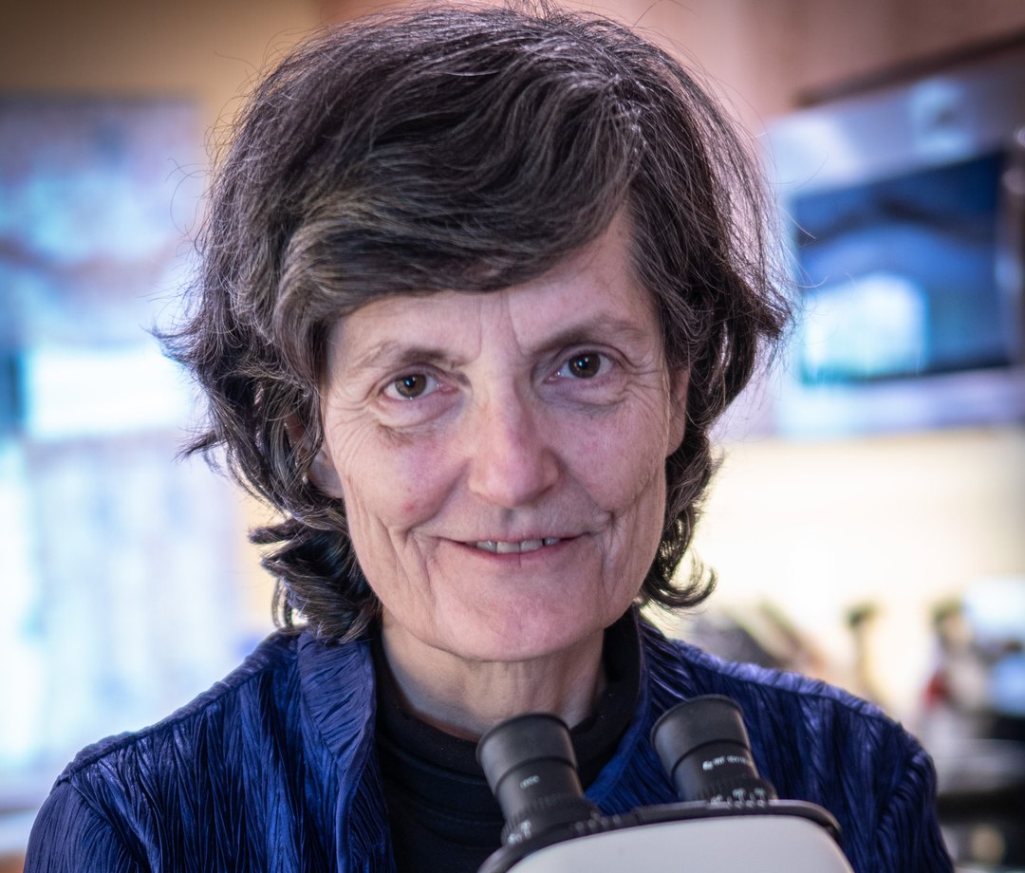
Dr. Elaine Ingham spent decades proving that soil is a living community

Slide 4
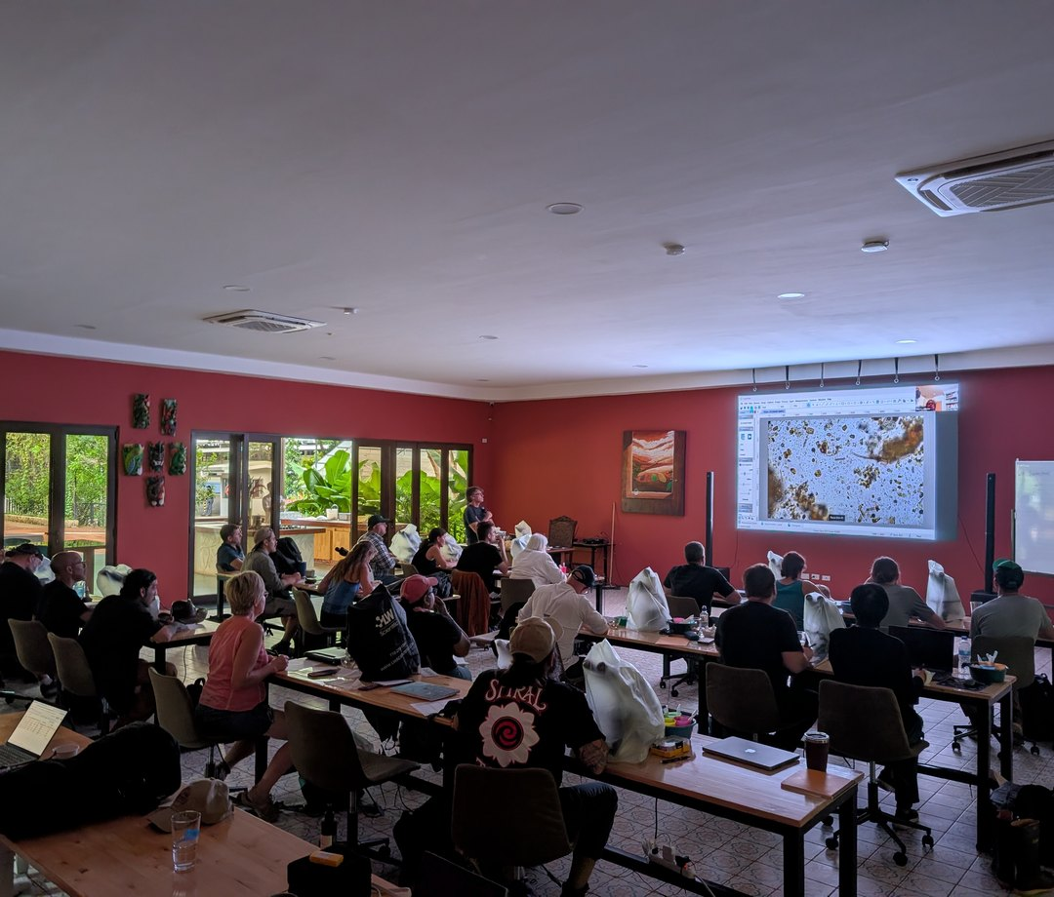
The science is sound. The methodology works. The problem is reach.

Slide 5
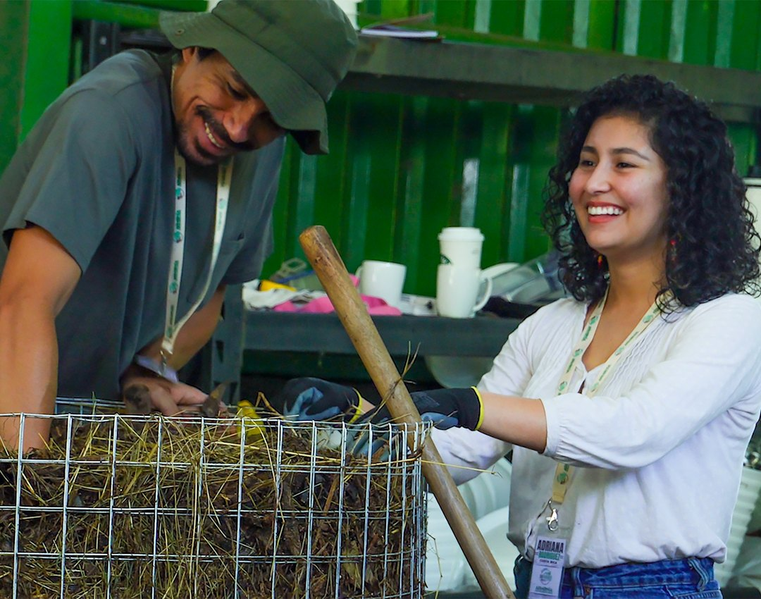
There are students who know this is their calling but cannot afford the next step

Slide 6
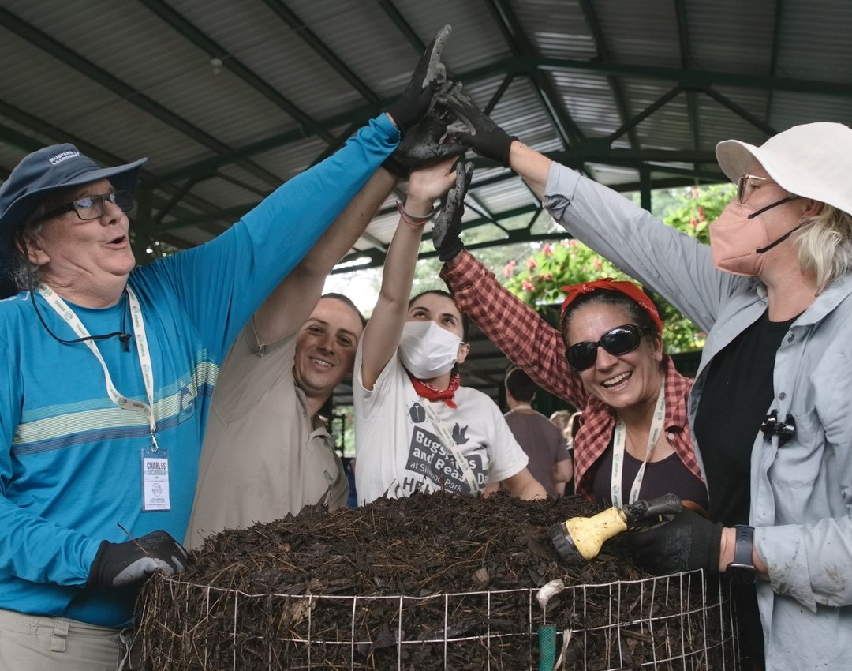
Every gift at any level funds scholarships, educational resources, and research

Slide 7


The soil can recover.
It wants to.
Donate · Link in bio

