Slide 1
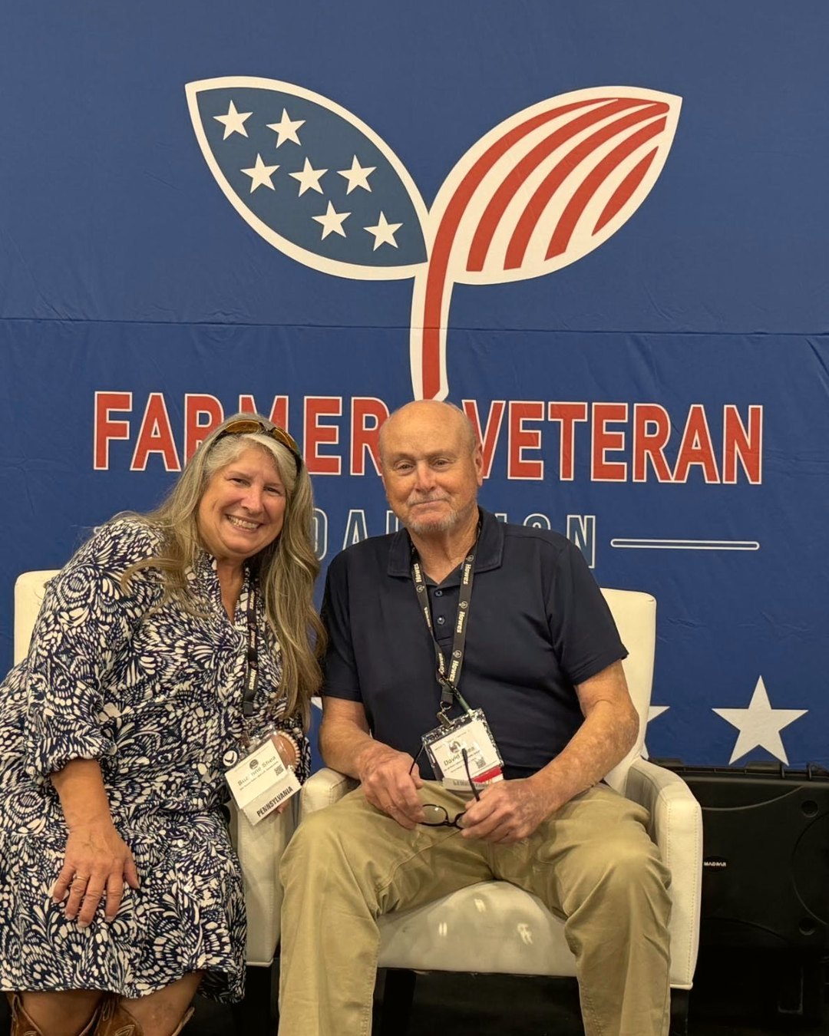


Veteran farmers
building living soil
Consultant Suzanne Shea presented at
the Farmer Veteran Coalition
Stakeholders Conference

Slide 2
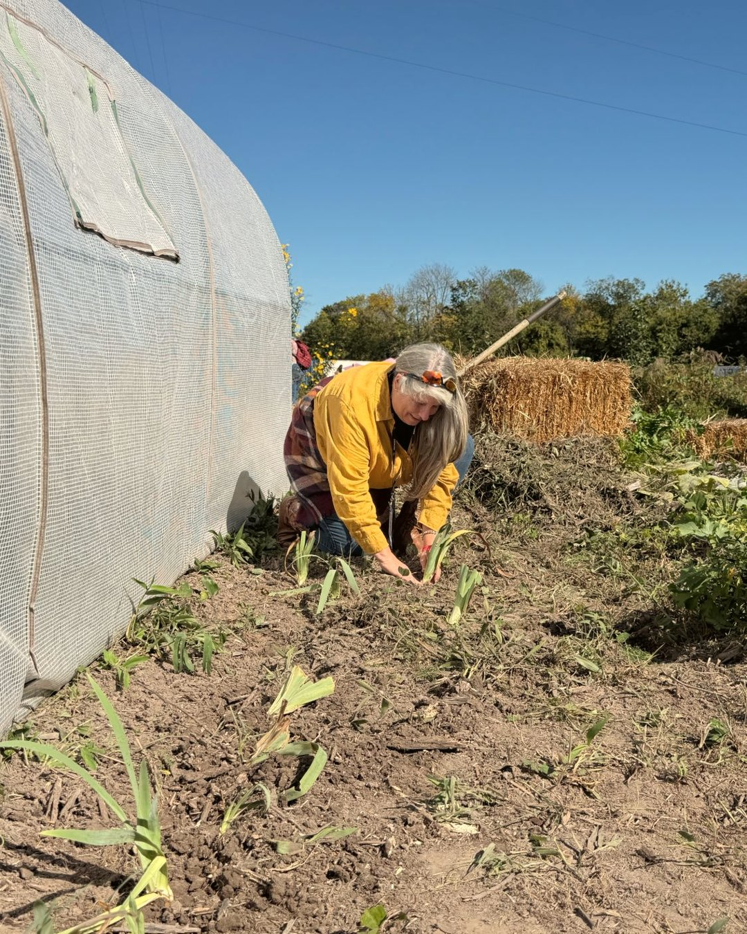

Her presentation taught veteran farmers about scalable sustainability through the Soil Food Web Approach.

Slide 3



