Slide 1


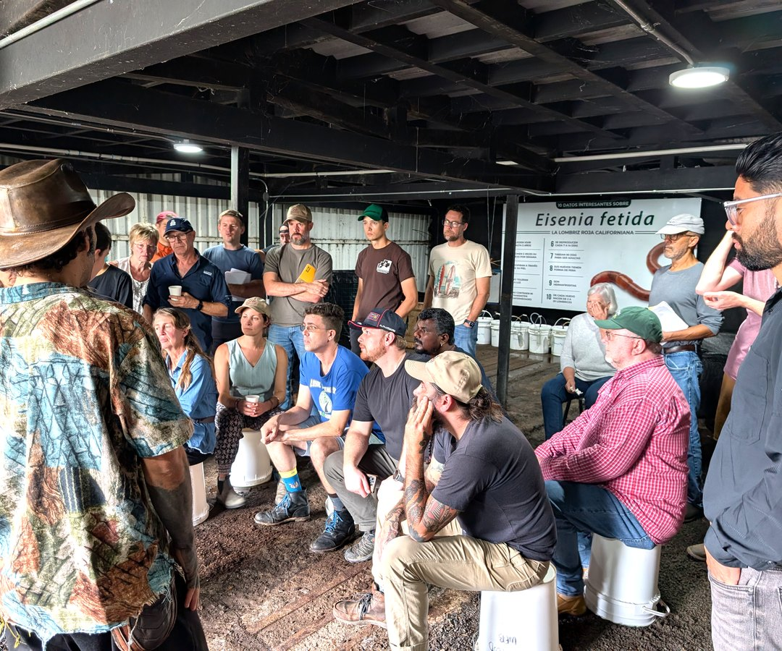

Costa Rica info session
Fri 6 Nov, 12pm Pacific, live on Zoom.
Free. Link in bio.

