Slide 1
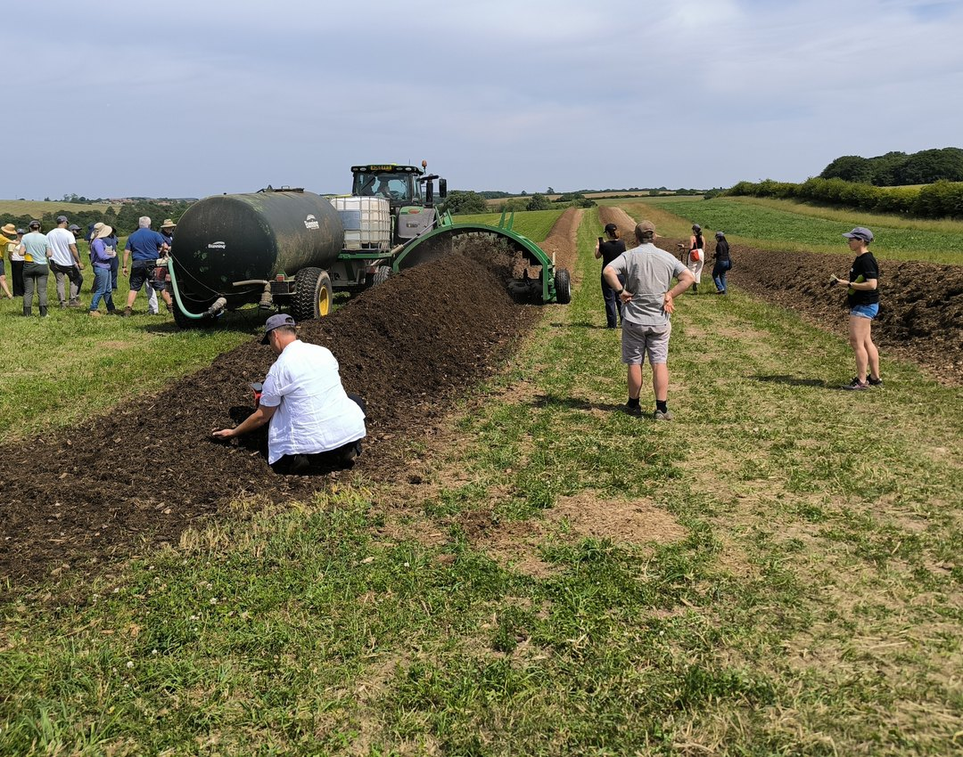



Happy Veterans Day
Thank you to every veteran who now farms.

