Slide 1


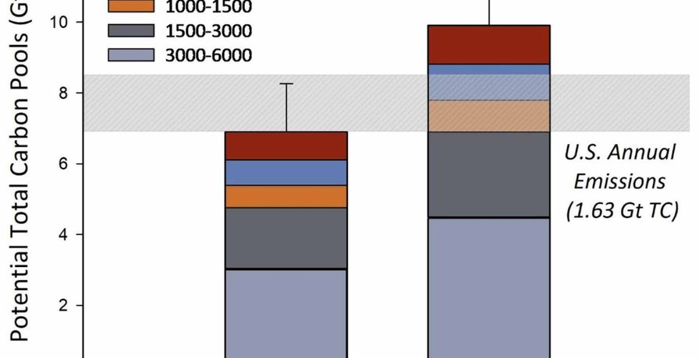

ENVIRONMENTAL RESEARCH: FOOD SYSTEMS
Figure 2, Lundgren et al. 2026, CC BY 4.0
Regenerative farms stored 39% more soil carbon
A new study of working farms. Link in bio.

Slide 2


The 1000 Farms Initiative measured working farms across North America.
From the most conventional to the most regenerative. Led by Ecdysis Foundation.

Slide 3


39% more total soil carbon
on the most regenerative farms.

Slide 4


+181% total fungi
in the most regenerative soils (figure 3 of the paper).

Slide 5


More life everywhere
Soil microbes, insects, plants and birds. The more biodiversity, the more carbon stored.

Slide 6

Yields matched national averages
and net profit per acre was similar.

Slide 7


One practice alone changed nothing
Farms using a single regenerative practice looked like conventional farms.

Slide 8

Read the paper
Lundgren et al., Environmental Research: Food Systems, 2026. Link in bio.

