Slide 1


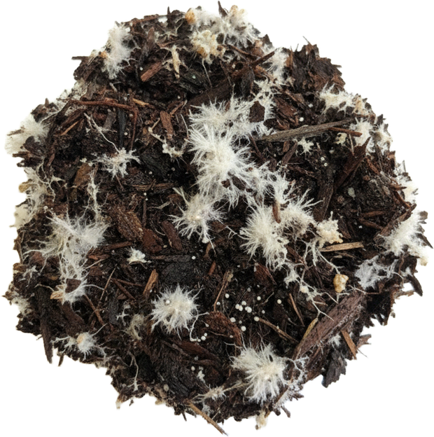
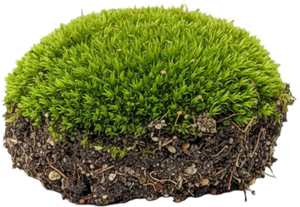


NEW STUDY
The most regenerative farms stored 39% more carbon in their soil.

Slide 2




THE 1000 FARMS INITIATIVE
Working farms across North America, from the most conventional to the most regenerative.
Led by Ecdysis Foundation.

Slide 3


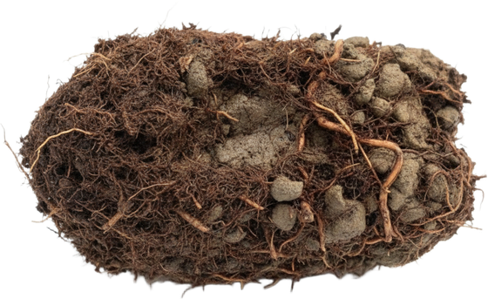
SOIL CARBON
39%
more total soil carbon on the most regenerative farms.

Slide 4


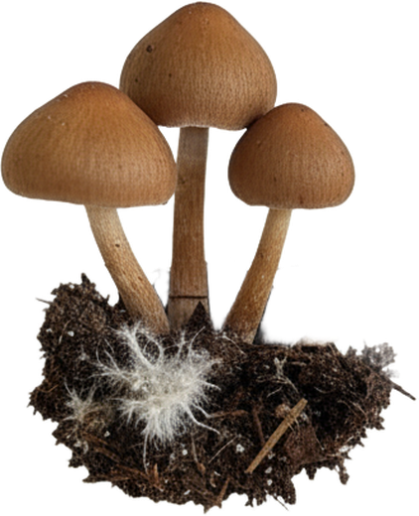
SOIL FUNGI
77%
more total fungi in regenerative soils.

Slide 5






MORE LIFE EVERYWHERE
Soil microbes, insects, plants and birds.
The more biodiversity, the more carbon stored.

Slide 6


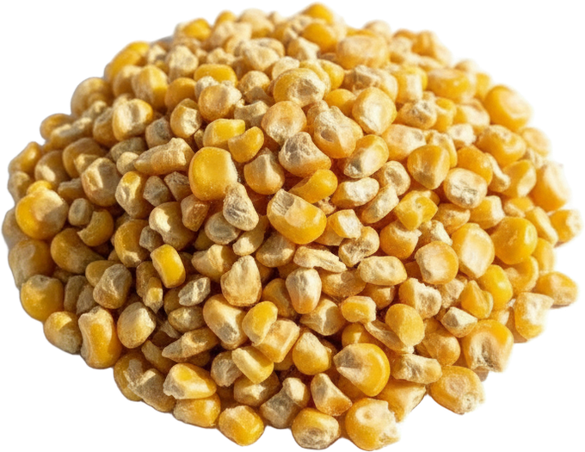
YIELD AND PROFIT
Regenerative yields matched national averages.
Net profit per acre was similar.

Slide 7


THE WHOLE SYSTEM MATTERS
One practice alone changed nothing.
Farms using a single regenerative practice looked like conventional farms.

Slide 8



READ THE PAPER
Lundgren et al., Environmental Research: Food Systems, 2026.
Link in bio.
doi.org/10.1088/2976-601X/ae8f4e

