Slide 1




Small Business Saturday
Meet Colleen
Dempster
Rewild Soils, Uxbridge, Ontario

Slide 2

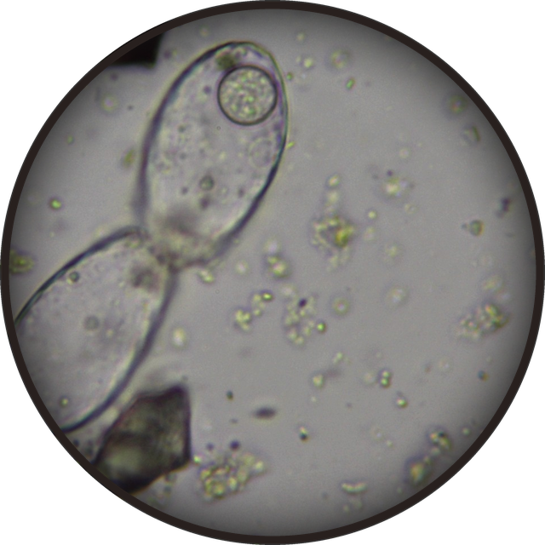
Testate amoeba, 40x. Robert Kenyon
A Soil Food Web certified lab since 2022
She has analysed more than 300 soil and compost samples under the microscope

Slide 3

“
Most people have never seen the microbes that make up the soil food web, so I show pictures and do live microscope demonstrations
Colleen Dempster

Slide 4


Colleen’s path
Started slowly
as a stay-at-home mom, alongside another part-time job
2022
became a Soil Food Web
certified lab
Now
finishing the last steps to become a Soil Food Web Consultant

Slide 5


“
Making compost and exploring samples under the microscope will always be something I enjoy
Colleen believes rewilding soils with microbes is about restoring systems and people’s connection with the Earth
Fungal hypha, 100x. Marco Trevisan

Slide 6



Our Foundation Courses teach you to work out what your soil needs
Learn to assess bacteria, fungi, protozoa, and nematodes
Link in bio
With thanks to Colleen Dempster

