Slide 1
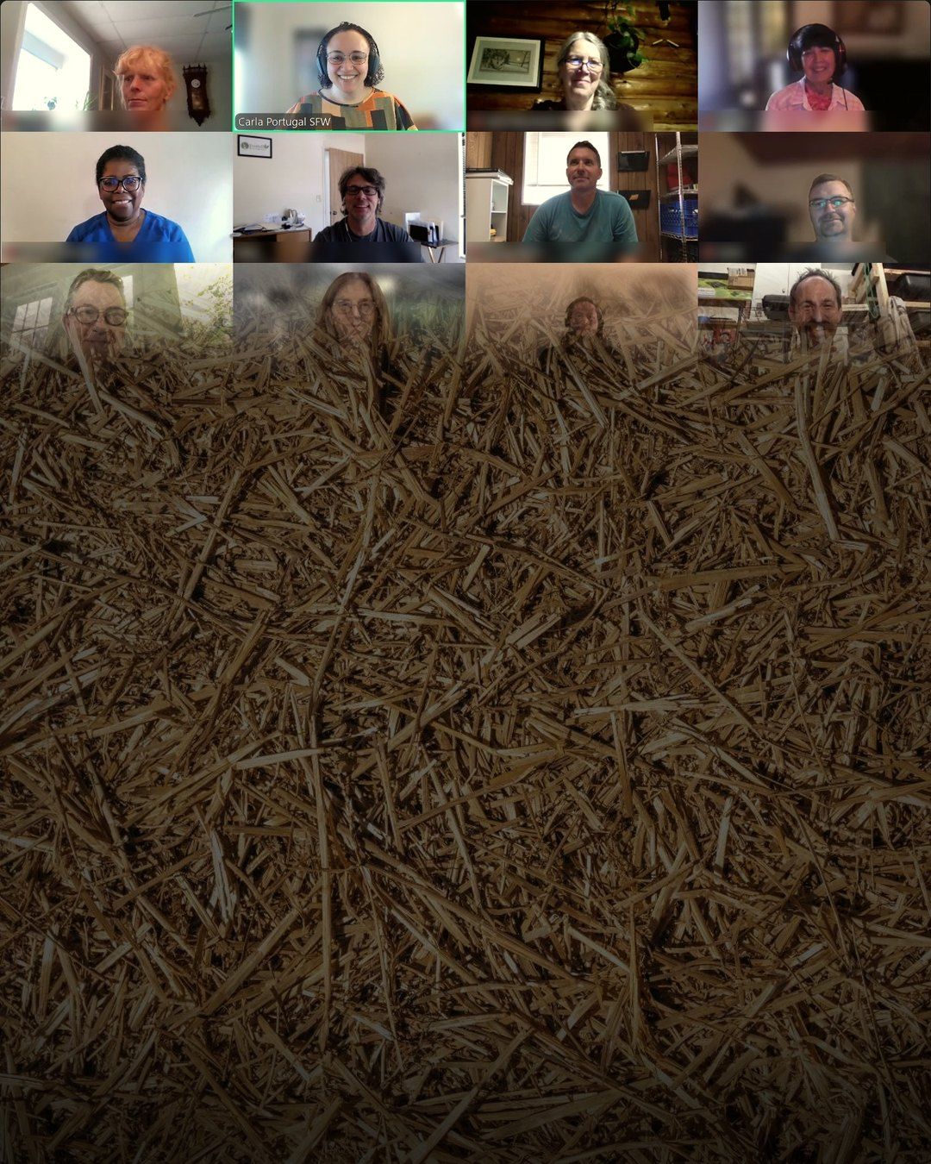
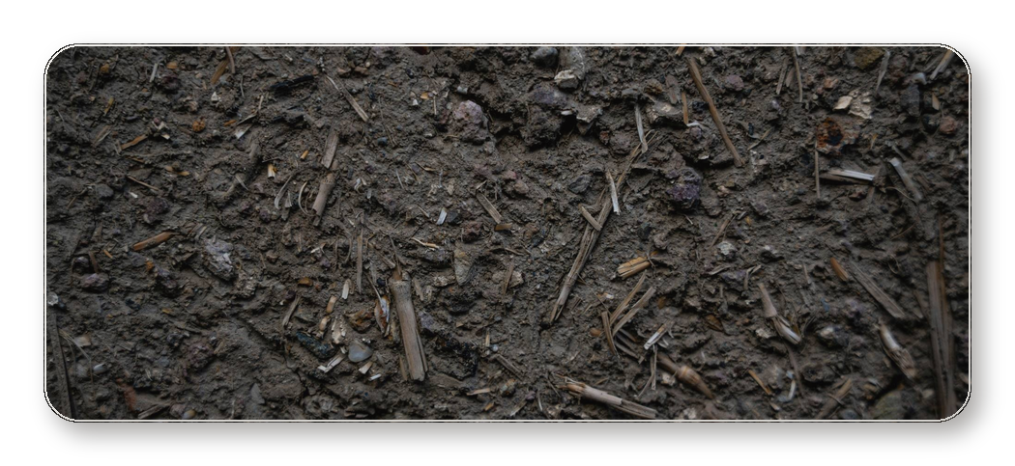

Will we see
you in the CIC
next year?

Slide 2
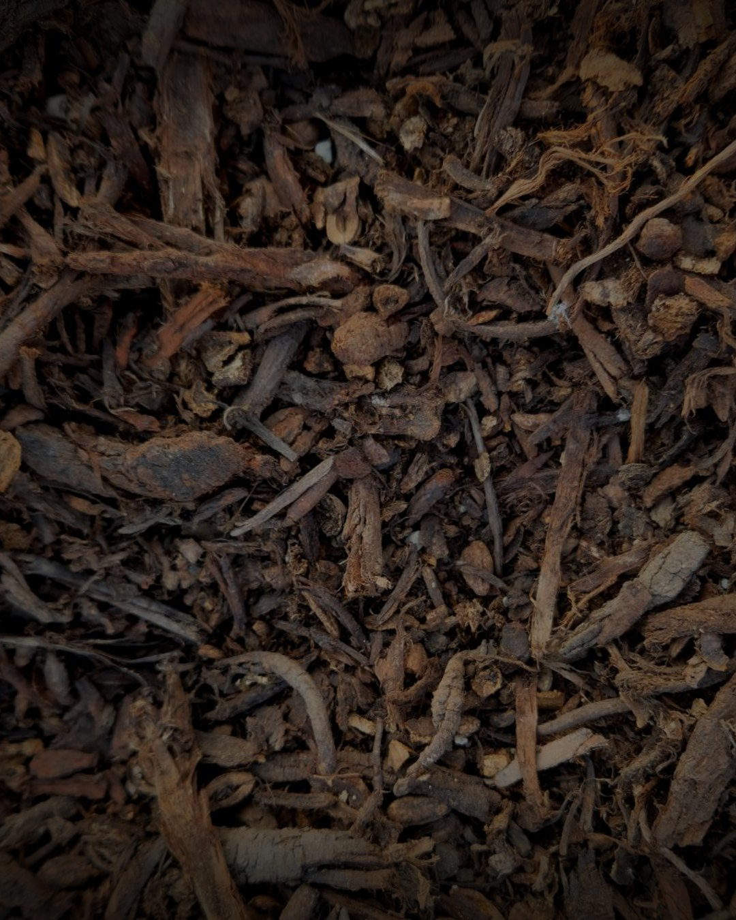

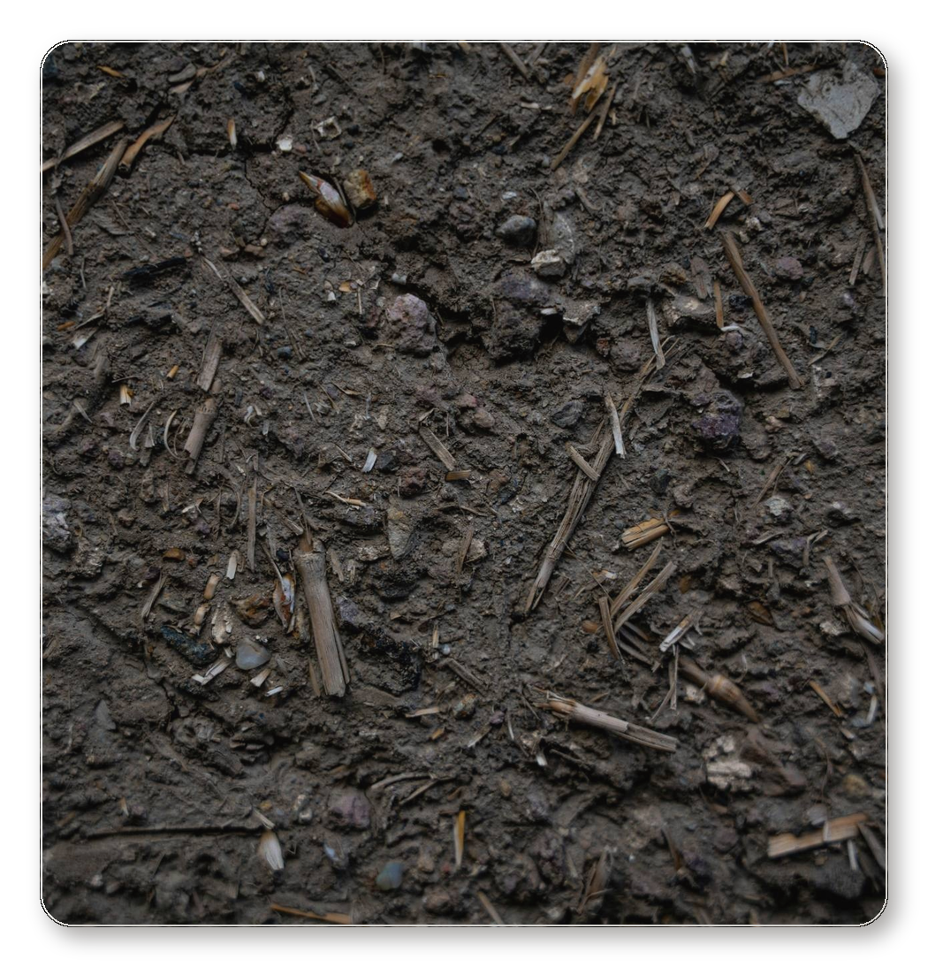
“What I really enjoyed about this course was the opportunity to engage with fellow participants from diverse countries during the live sessions. This exchange of experiences allowed us to gain valuable insights, especially when discussing region-specific challenges. Given that I live in a different climate, I found it particularly beneficial to learn how composting techniques can be adapted to various environments, enabling me to apply this knowledge effectively no matter where I am.”
–Kamai Fatma

Slide 3

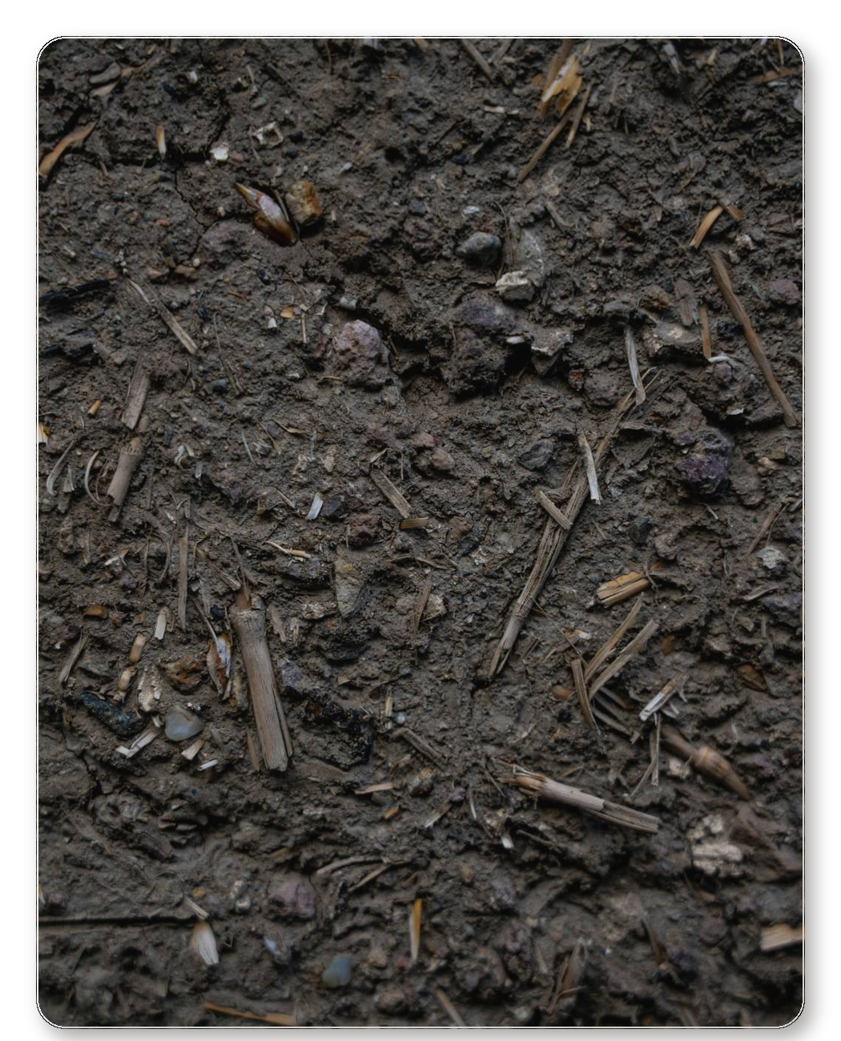
“The live sessions with fellow students and mentors have definitely been helpful for me personally. I prefer this format, especially when it goes beyond just theory-based content to include live teaching and discussions in our course. This approach allows me to grasp concepts more effectively and retain them better. Assignments have also been beneficial, as they help us incorporate theory into practice, providing valuable learning opportunities even when we make mistakes. The nuances are details of being able to plan and actually doing it is what actually strengthens my learning.”
–Pratik Thomas

