Slide 1

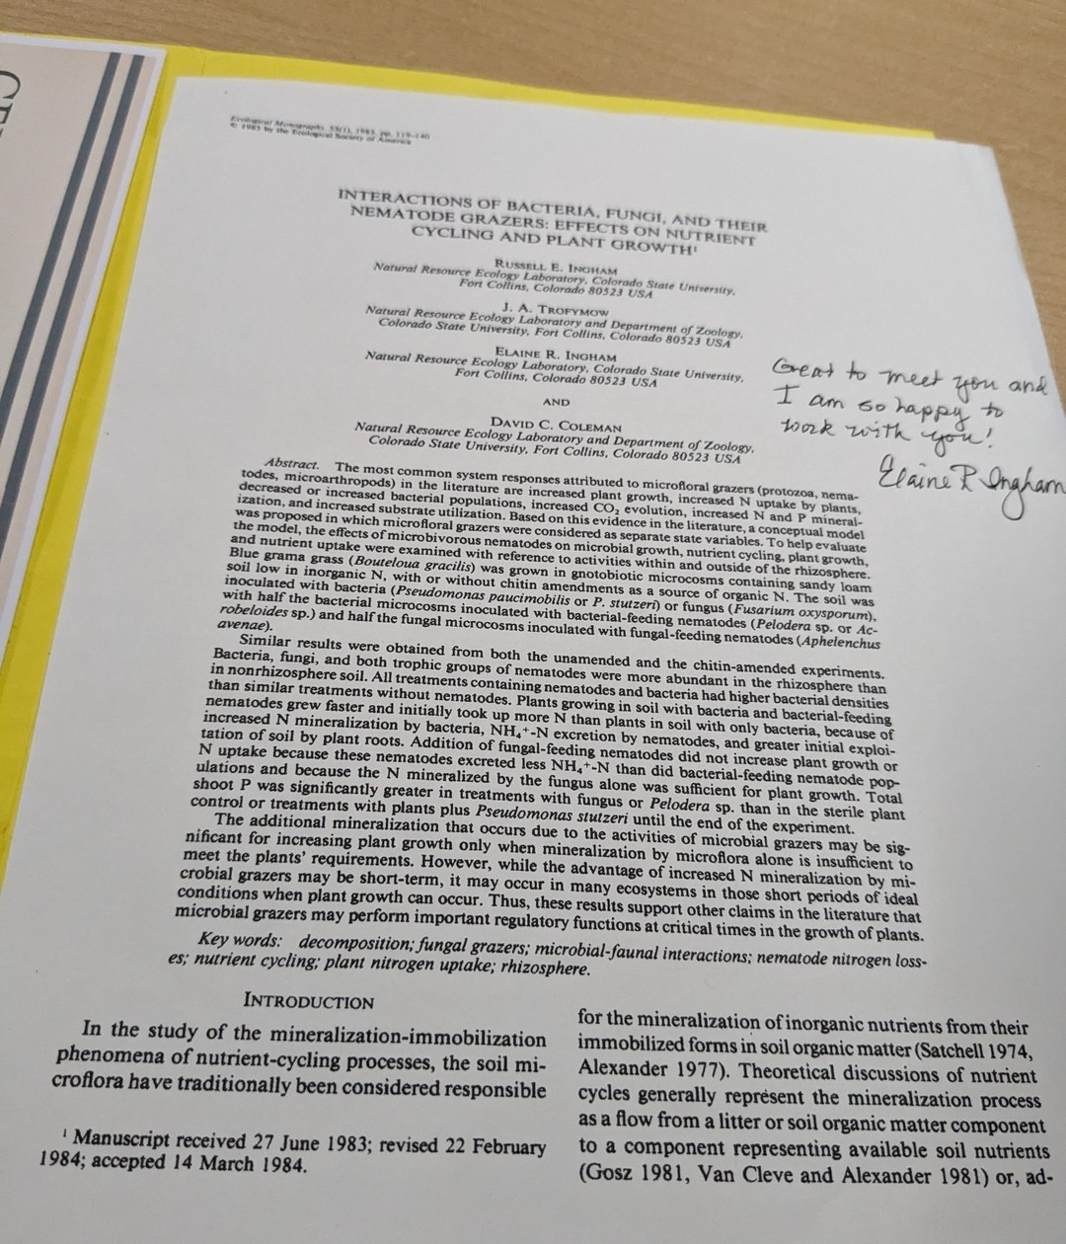
Four courses,
one bundle
Fall Enrollment Special until November 30. Link in bio.

Slide 2
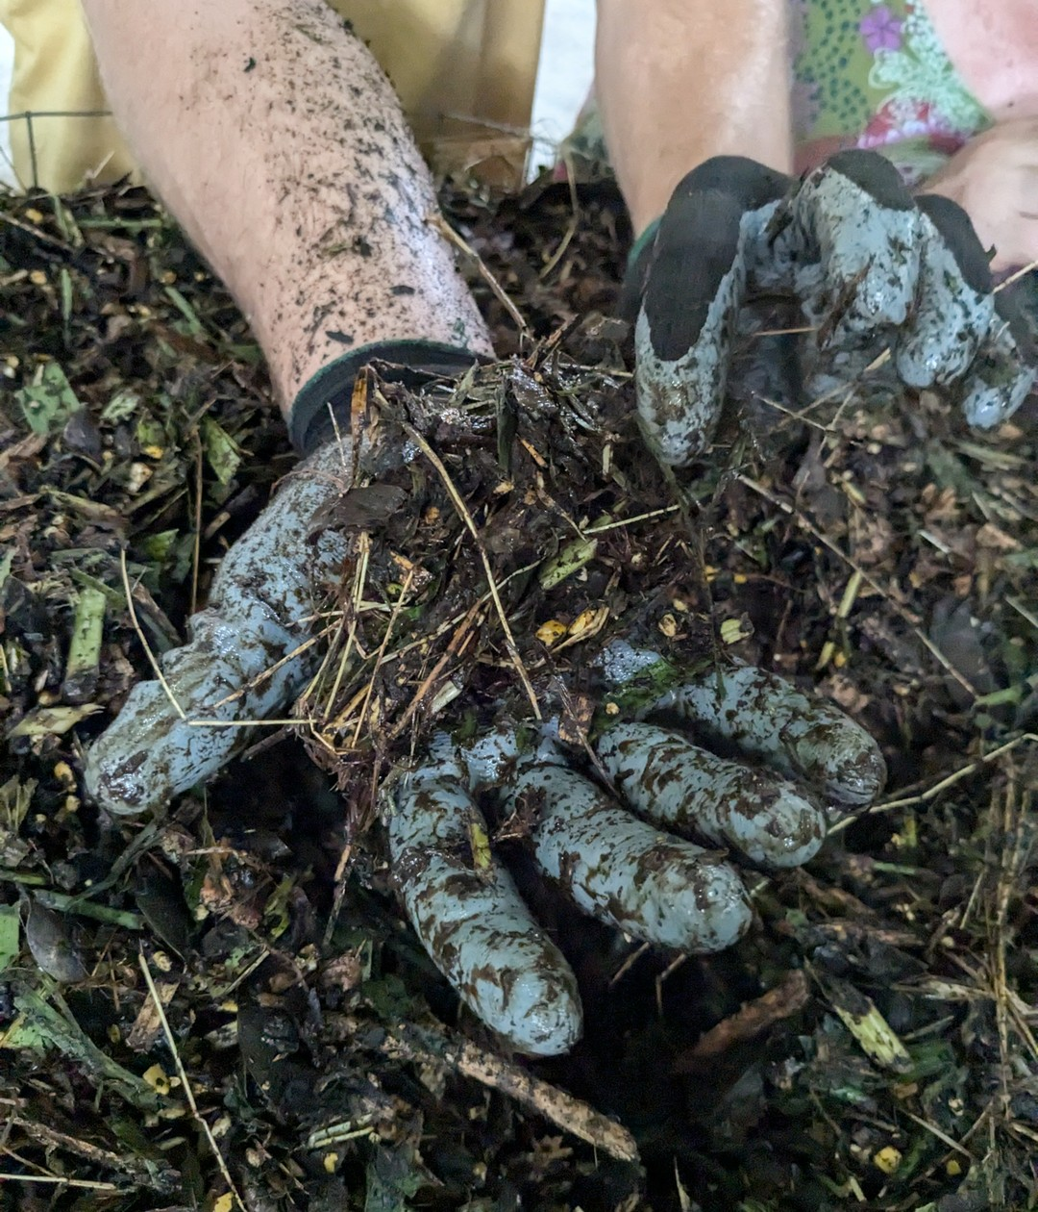
We are going
back to Armonía
Accelerator Workshop, Costa Rica, 18 to 29 January 2027. Link in bio.

Slide 3
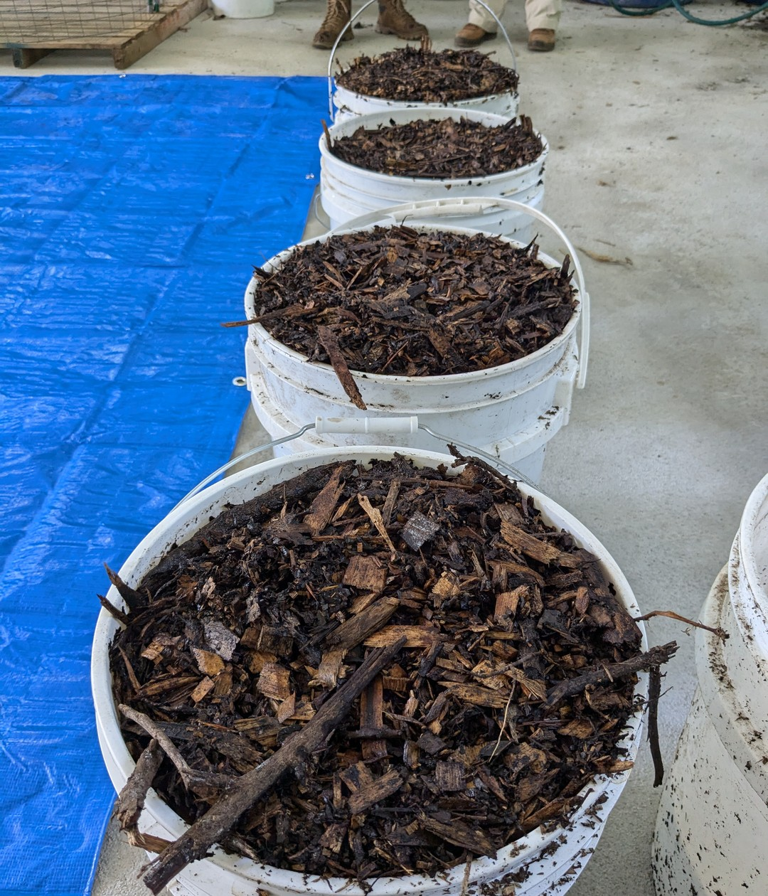
Last day of the
Fall Enrollment
Special
All four Foundation Courses in one bundle. Link in bio.

