Slide 1

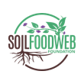
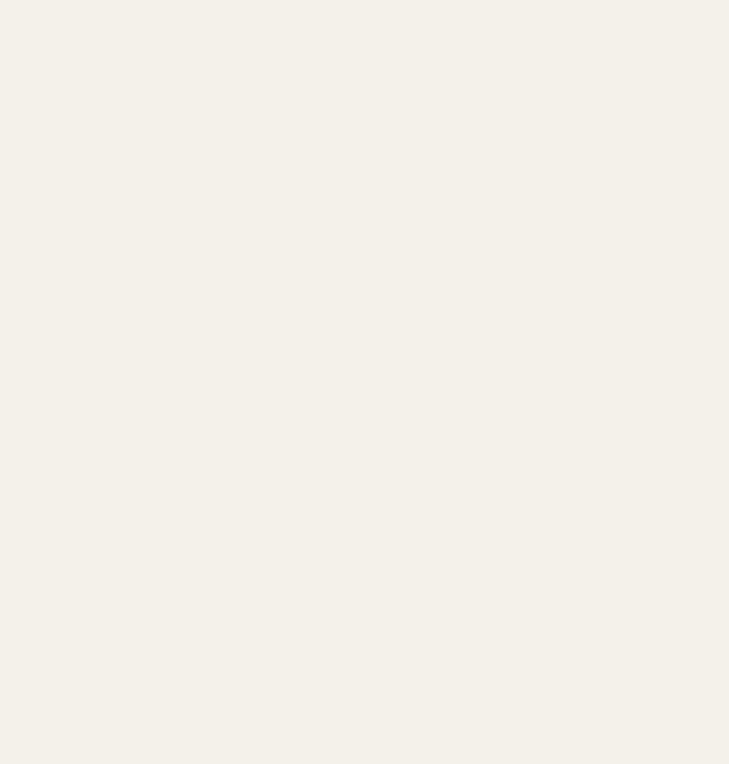
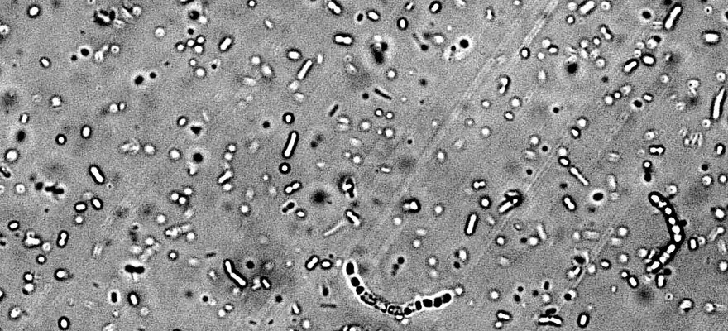


BeOpen
Soil bacteria. Photo: Gerri Gassert
An open atlas of soil life from 100,000 samples
By Biome Makers: soil life from over 90 countries.
Read More
Source:
beopen.earth/atlas

Slide 2

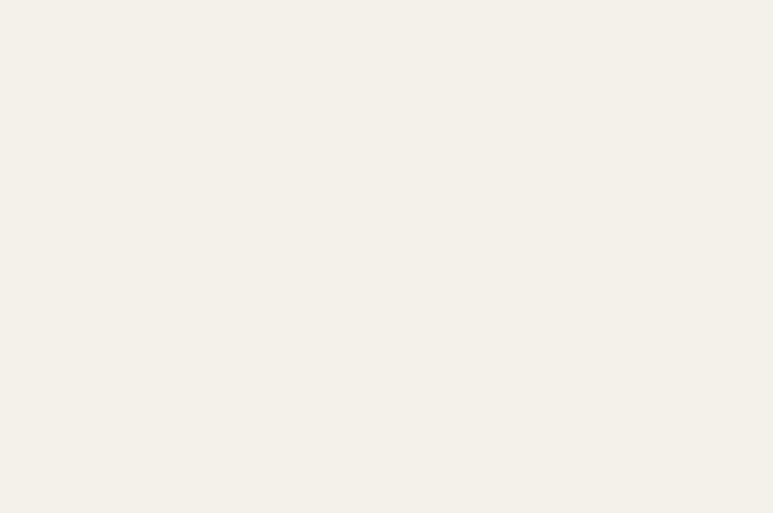
One protocol, 90+ countries
Every sample is collected, sequenced and analysed the same way, so continents can be compared.

Slide 3

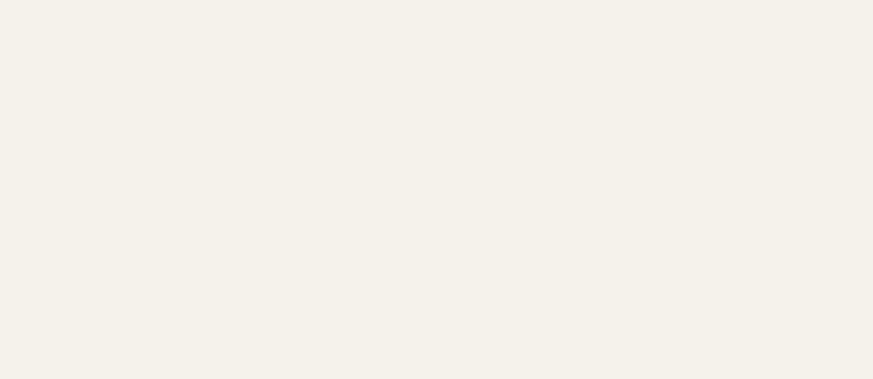
Open data
Researchers get raw reads and processed data for free.

Slide 4

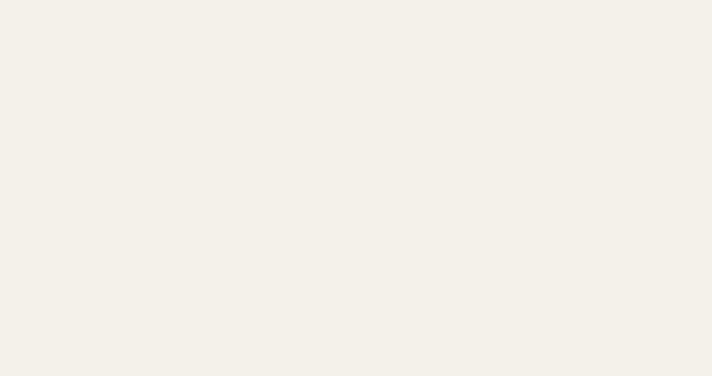
200+ research partners
And 3,000 datasets so far. Labs can join as contributors.

Slide 5

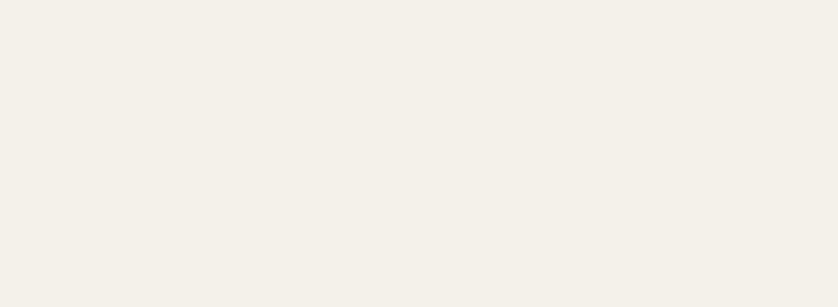
Explore the atlas
beopen.earth/atlas. Link in bio.

