Slide 1



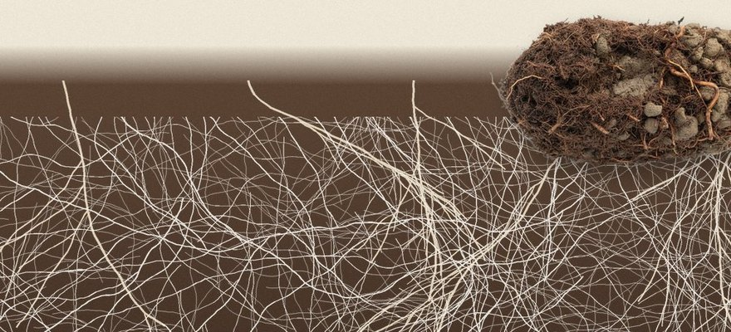


University of Sheffield
Illustration: Soil Food Web Foundation
A plant said to skip fungi traded food with one
University of Sheffield, Current Biology, 15 Oct 2026.
Read More
Source:
doi.org/10.1016/j.cub.2026.09.061

Slide 2


The plant: Arabidopsis
A small mustard plant. Its family lost the genes most plants use to welcome fungal partners.

Slide 3


The fungus
A Mucoromycotina fine root endophyte, from an ancient group of soil fungi.

Slide 4

Nitrogen and phosphorus in
The fungus carried both from the soil into the plant's shoots. The plant grew normally.

Slide 5

260% more carbon out
In return, the fungus received more than 260% more of the plant's carbon.

Slide 6


Next: cabbage and canola
Same plant family. The team wants to learn what this means for crops.

Slide 7

Read the study
University of Sheffield, led by Professor Katie Field. Current Biology, October 2026. Link in bio.

