Slide 1



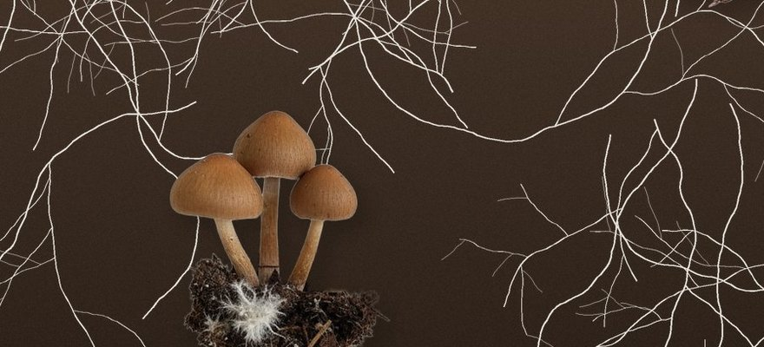


Flinders University
Illustration: Soil Food Web Foundation
Soil fungi lag behind replanted land
Flinders University, Molecular Ecology, October 2026.
Read More
Source:
doi.org/10.1111/mec.70552

Slide 2


Six years later
A team led by Professor Martin Breed sampled the soil fungi in replanted farmland again.

Slide 3


The work came back
What the fungi do in the soil, cycling nutrients and breaking down organic matter, kept recovering.

Slide 4


The community lagged
The mix of fungal species changed very little.

Slide 5


A likely brake
The farming history: soils still rich in leftover nutrients.

Slide 6

Measure below ground
Trees are the part of restoration we can see. The soil food web runs on its own timeline.

Slide 7

Read the study
Flinders University, Molecular Ecology, October 2026. Link in bio.

