Slide 1



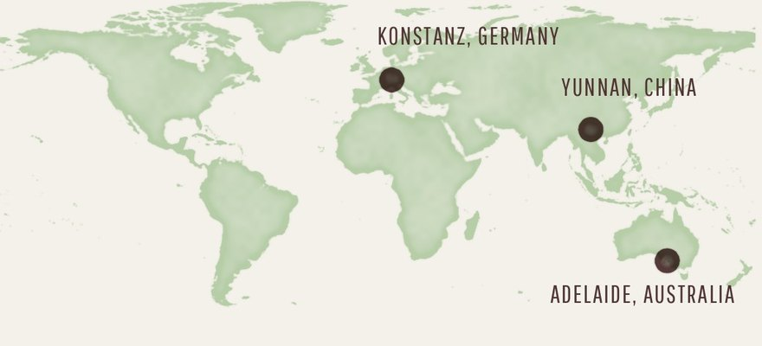


Fun Soil News
Maps: Natural Earth (public domain)
Three soil stories from October
A giant fungus, plastic-eating bacteria, returning fungi.
Read More
Source:
in the caption

Slide 2

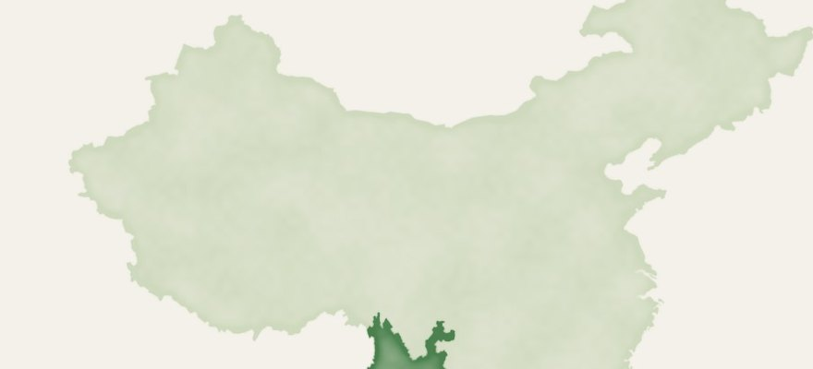

Frontiers in Fungal Biology
Map: Natural Earth (public domain)
A giant fungus grows up to 50 cm tall
Dianjunus rex, from oak roots in Yunnan, China.
Read More
Source:
doi.org/10.3389/ffunb.2026.1940464

Slide 3



The ISME Journal
Illustration: Soil Food Web Foundation
Forest soil bacteria ate bioplastic
Films gone in 250 to 330 days. Konstanz, Germany.
Read More
Source:
doi.org/10.1093/ismejo/wrag203

Slide 4

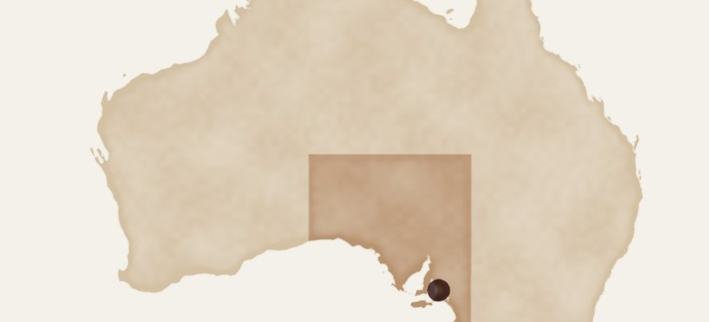

Molecular Ecology
Map: Natural Earth (public domain)
Soil fungi back at work after replanting
Six years of recovery in South Australia.
Read More
Source:
doi.org/10.1111/mec.70552

