Slide 1
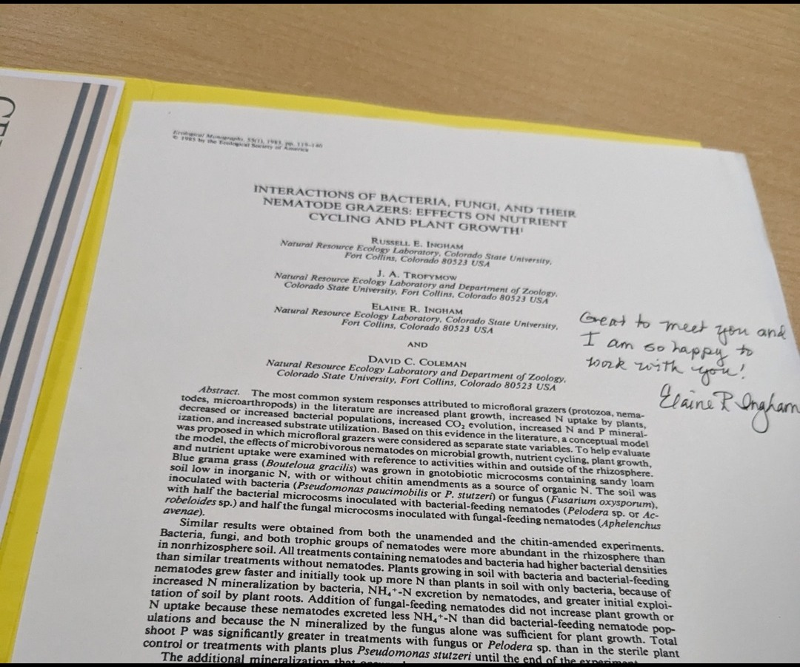

FALL ENROLLMENT SPECIAL
Four courses,
one bundle
Plus a Compost Intensive seat

Slide 2
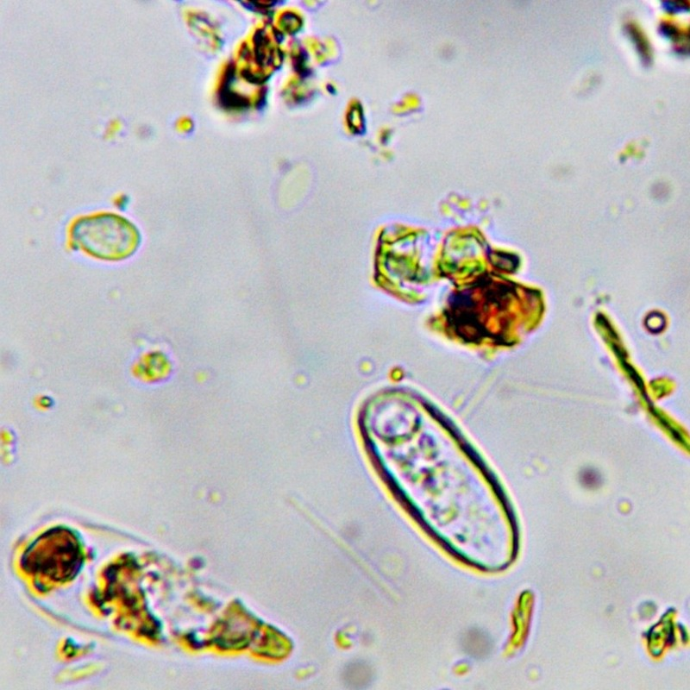
FOUR COURSES
AND A COMPOST
INTENSIVE SEAT
What's inside
Introduction to the Soil Food Web
BioComplete™ Compost
BioComplete™ Liquid Amendments
Microscopy
A 2027 Compost Intensive seat
Dr. Elaine's webinar archive
Until November 30. Link in bio.

