Slide 1
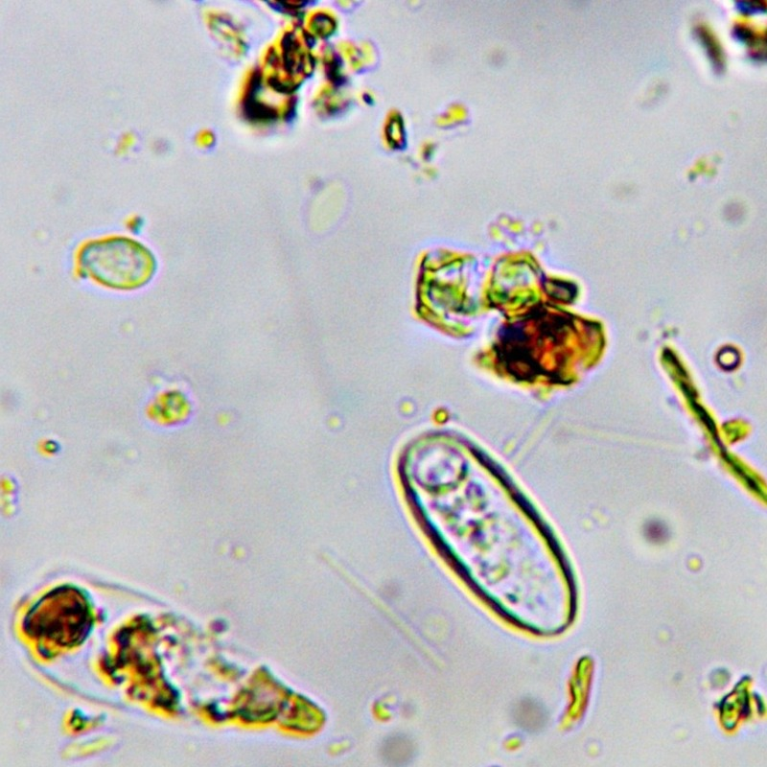

THE FOUNDATION COURSES
Start any time
1
2
Introduction to the Soil Food Web
BioComplete™ Compost
3
BioComplete™ Liquid Amendments
4 Microscopy
Until November 30. Link in bio.

