Slide 1



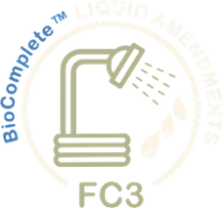



Foundation Courses + Compost Intensive
Fall Enrollment Special
Until 2 December.

Slide 2


Our 4 flagship Foundation Courses
Dr. Elaine Ingham's seminal lectures on the soil food web and how to restore it. 40+ years of her knowledge, easy to follow and self-paced.

Slide 3


The Compost Intensive Course
10 weeks live with Soil Food Web expert mentors who worked extensively alongside Dr. Elaine Ingham, and a global cohort of peers.

Slide 4


Join our student community
A community for Foundation Courses students, and your own Compost Intensive cohort.

Slide 5


Dr. Elaine's legacy webinar archive
Hundreds of hours recorded live with Dr. Elaine and others, going deeper into the Foundation Courses and beyond, to deepen your learning and put it into action.

Slide 6




FALL ENROLLMENT SPECIAL
OVER
50%
OFF
the Foundation Courses + Compost Intensive bundle
Until 2 December

Slide 7

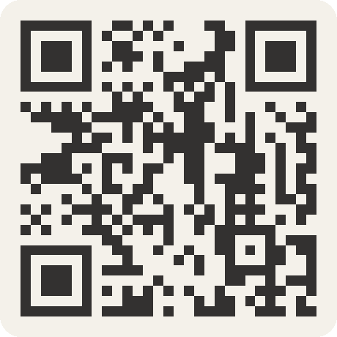
Foundation Courses + Compost Intensive
Fall Enrollment Special
Until 2 December.

