Slide 1


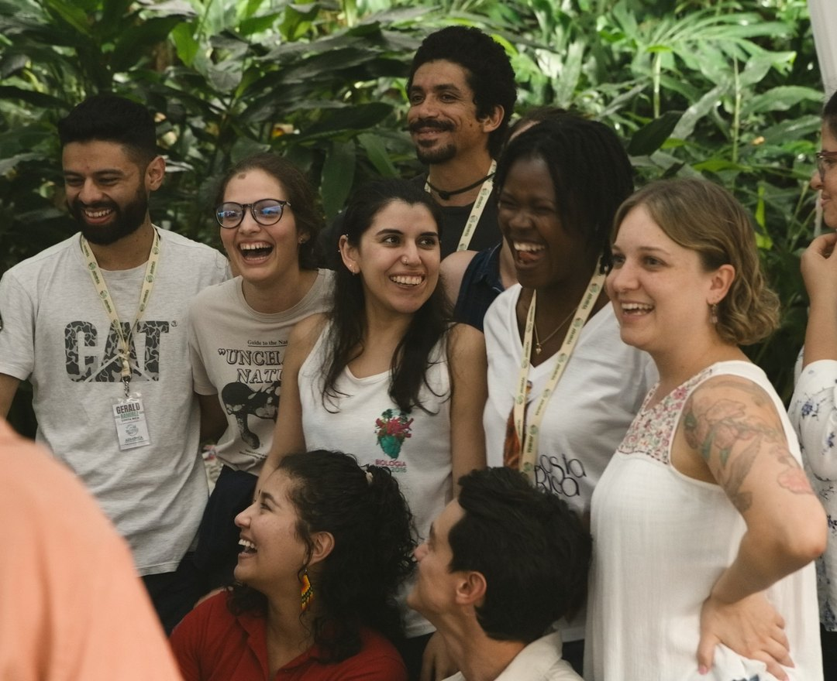

What we're thankful for
Our staff share what made an impact on them this year.

