Slide 1

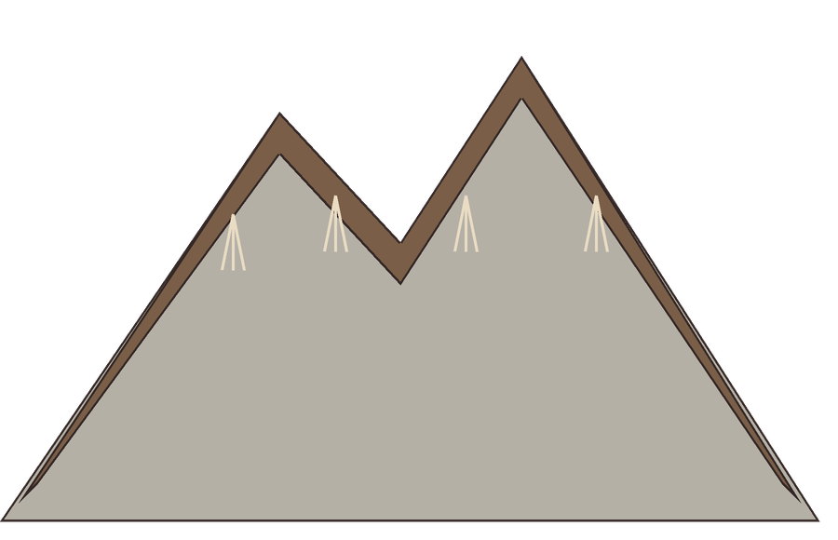


Mountain soils are thin, young and fragile.
a thin layer of soil over rock

Slide 2

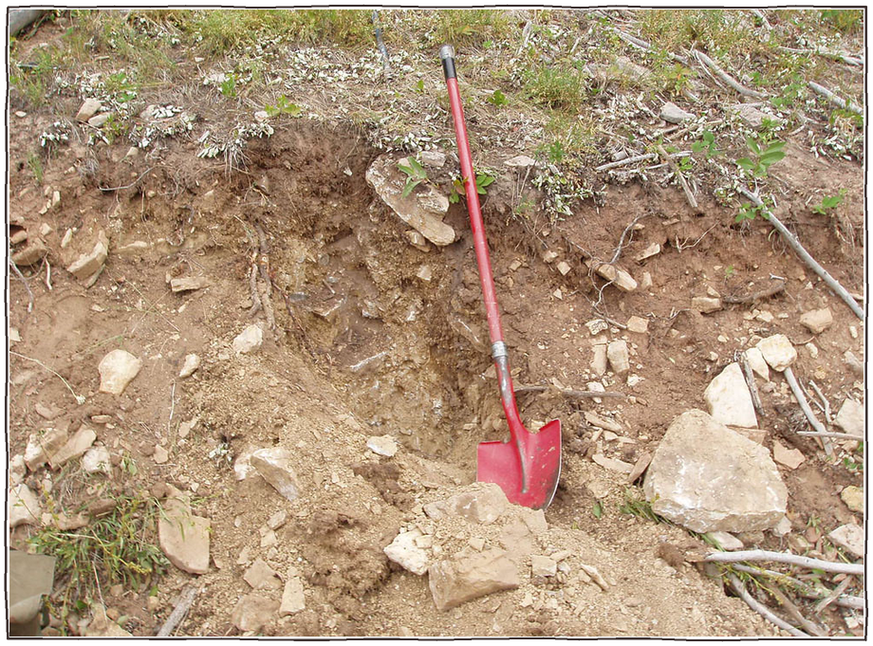
Cold and steep slopes slow soil formation.
thin, rocky mountain soil, Montana
Photo: USDA NRCS Montana, Public domain

Slide 3

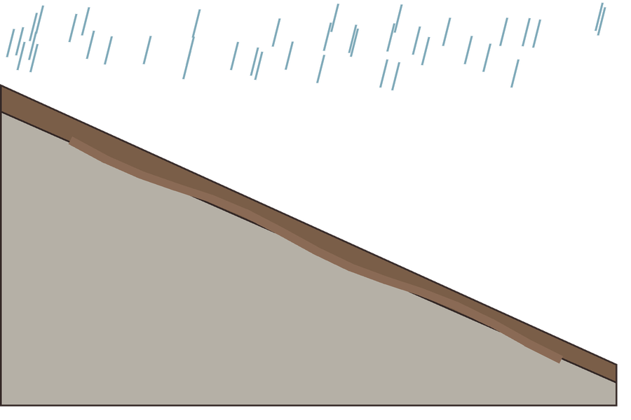

Without roots and cover, one heavy storm can wash away centuries of soil.
soil washing downhill

Slide 4

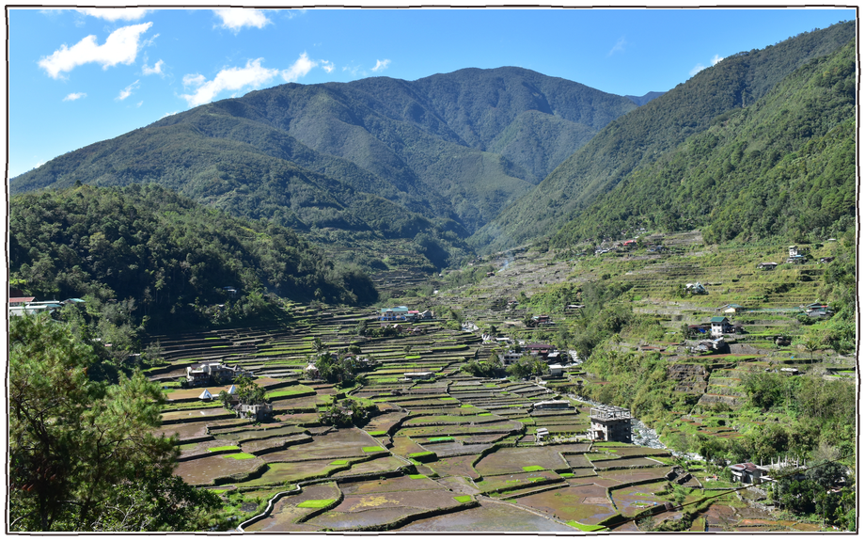
Terraces, cover and living roots hold mountain farms together.
Hapao rice terraces, Ifugao, Philippines
Photo: Arian Zwegers, CC BY 2.0

