Slide 1

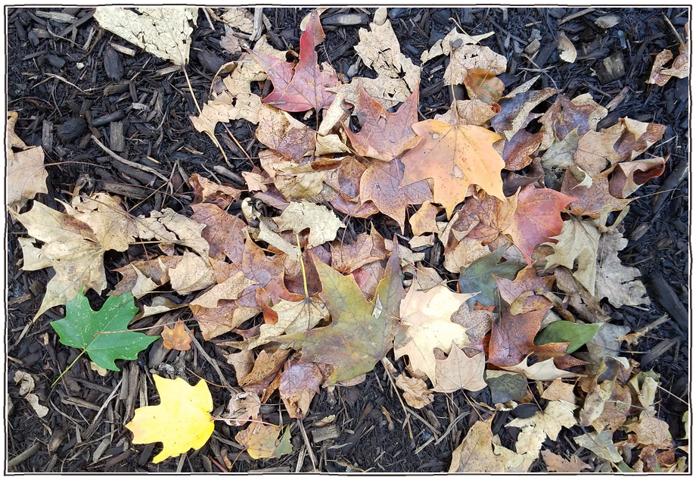

Your fallen leaves can become fungal compost.
Photo: Dan Keck, CC0 1.0

Slide 2

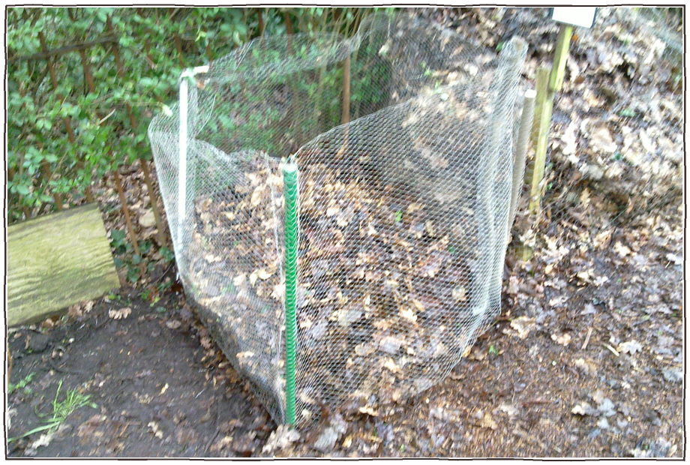
Pack wet leaves into a wire cage or a bag with holes.
a wire cage full of leaves
Photo: United Diversity, CC BY 2.0

Slide 3

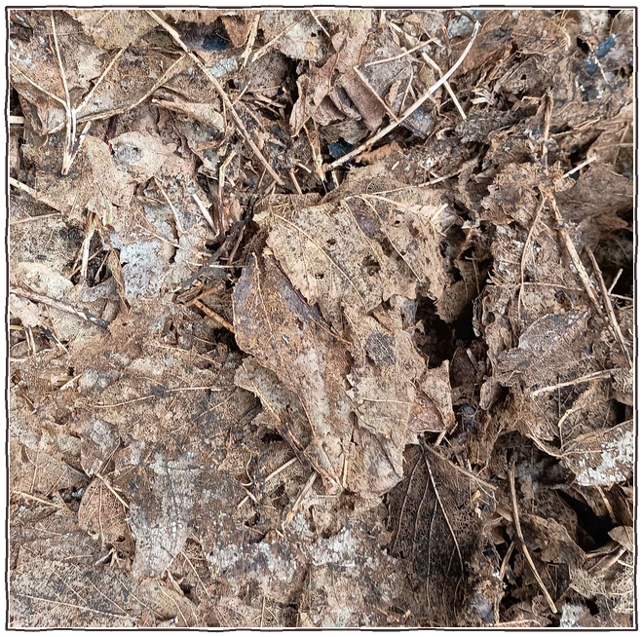

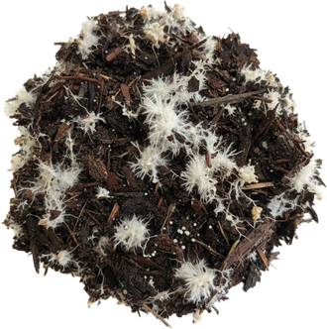
Keep them damp. Fungi do the work, slowly.
white fungal threads
Photo: Belbury, CC BY 4.0

Slide 4

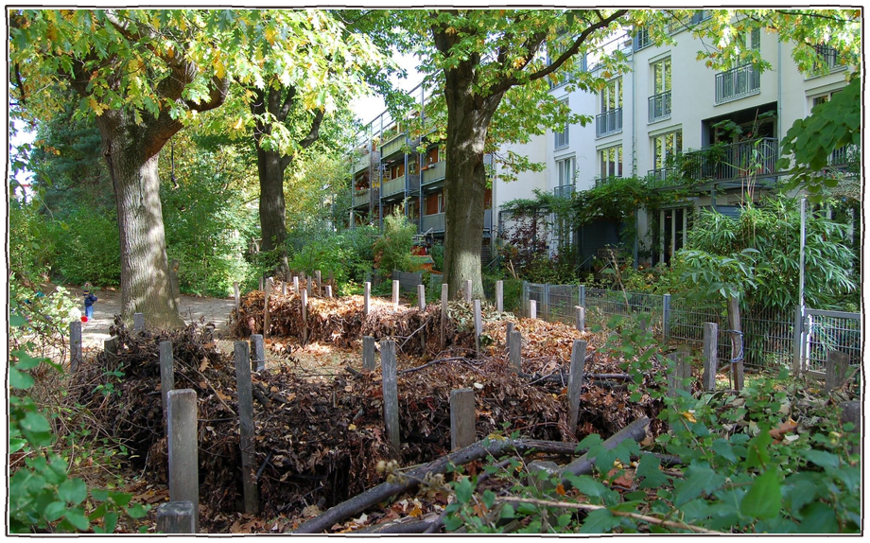
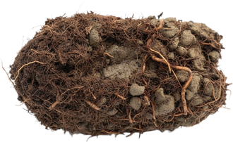

In 1 to 2 years you get dark, crumbly leaf mold.
dark and crumbly
Photo: Andy Wright, CC BY 2.0

Slide 5

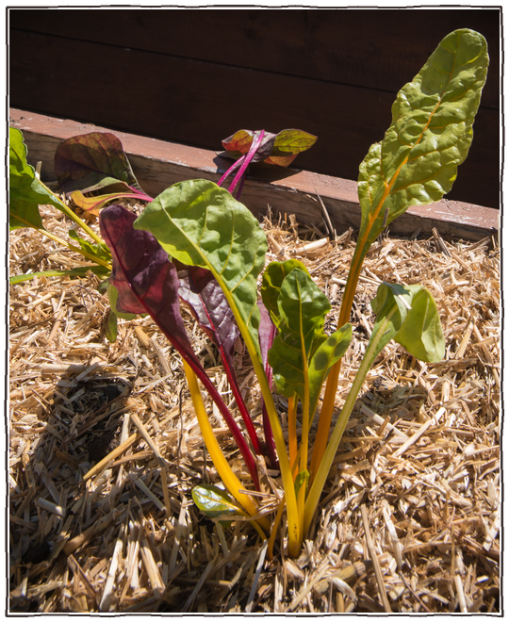
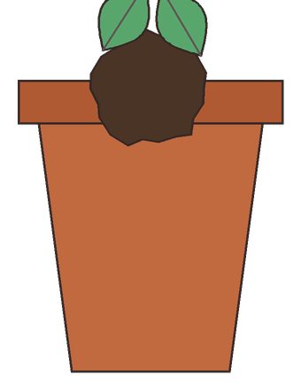
Use it as mulch or mix it into potting soil.
in potting soil
as mulch
Photo: Lance Cheung, USDA, Public domain

