Slide 1

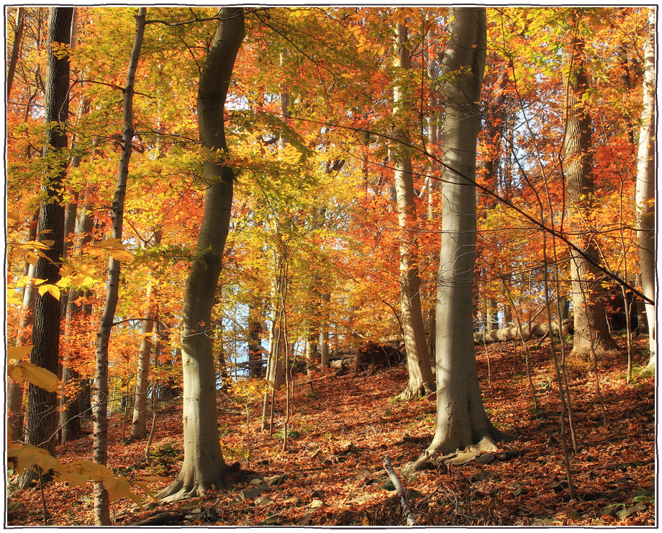

Imagine a world without earthworms.
Photo: Nicholas_T, CC BY 2.0

Slide 2

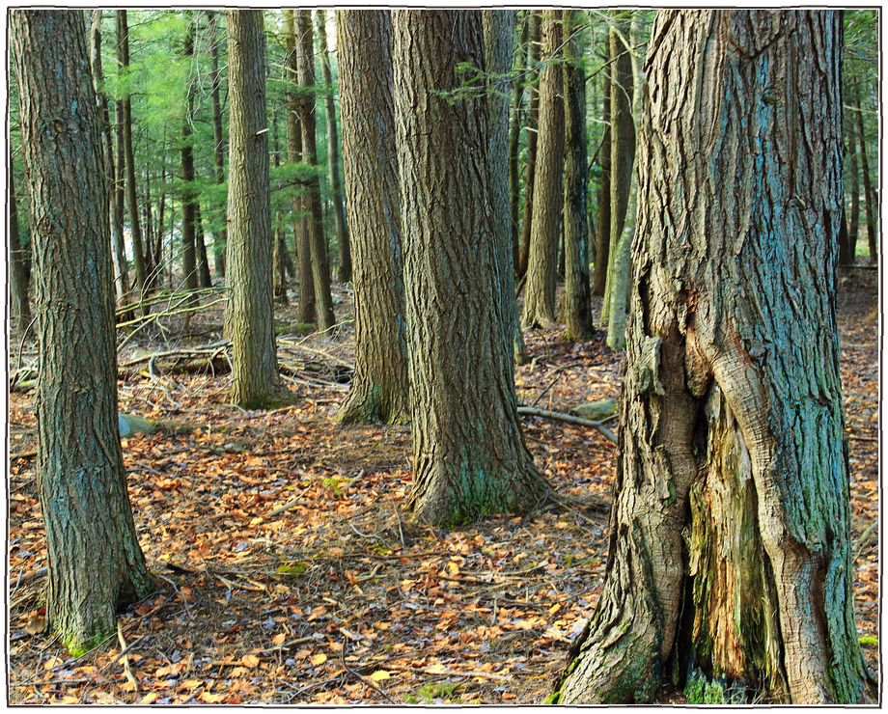
It already exists.
a thick layer of leaf litter
Photo: Nicholas_T, CC BY 2.0

Slide 3

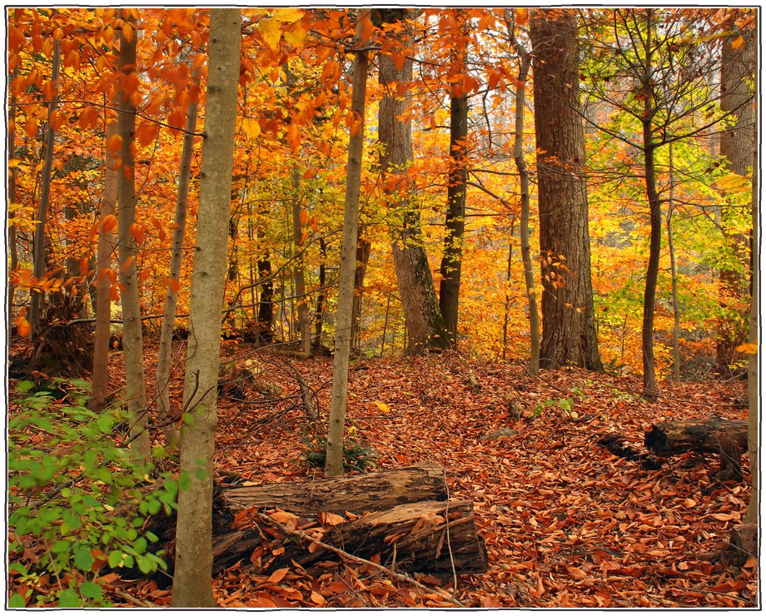
Many northern North American forests evolved without them after the last Ice Age.
Pennsylvania hardwood forest, autumn
Photo: Nicholas_T, CC BY 2.0

Slide 4

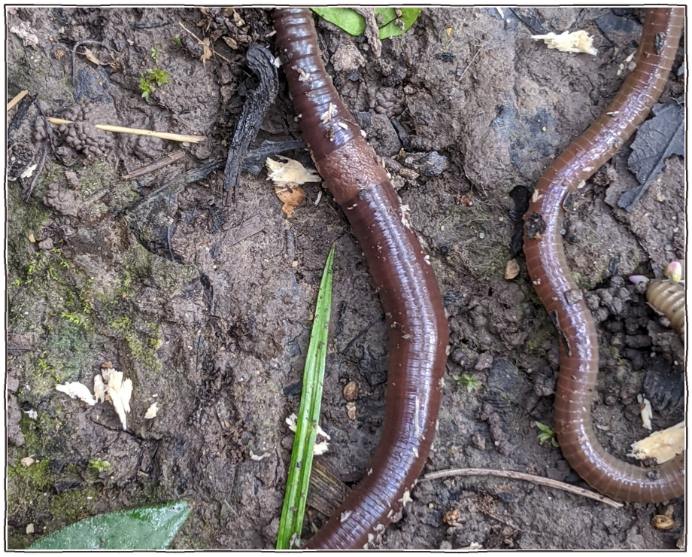
Introduced worms now eat through the leaf litter those forests depend on.
worms on bare, worm-worked soil
Photo: John Abrams, CC BY 4.0

Slide 5

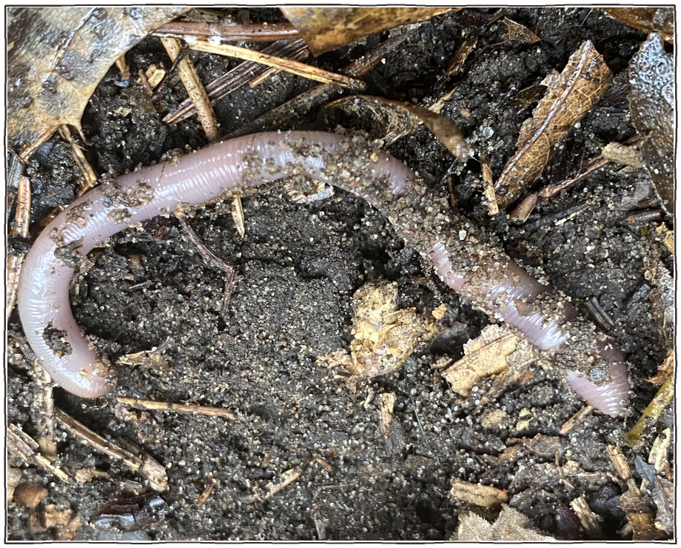
Even a good organism can be the wrong one in the wrong place.
an introduced earthworm, Minnesota
Photo: Brett Ortler, CC BY 2.0

