Slide 1



Why give on Giving Tuesday?

Slide 2

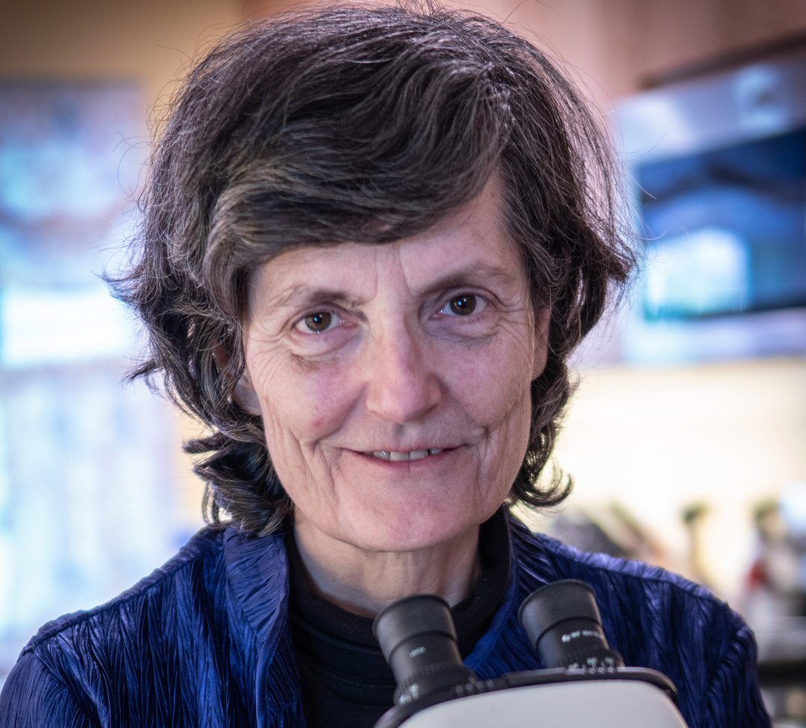
We carry Dr. Elaine Ingham’s science forward

Slide 3
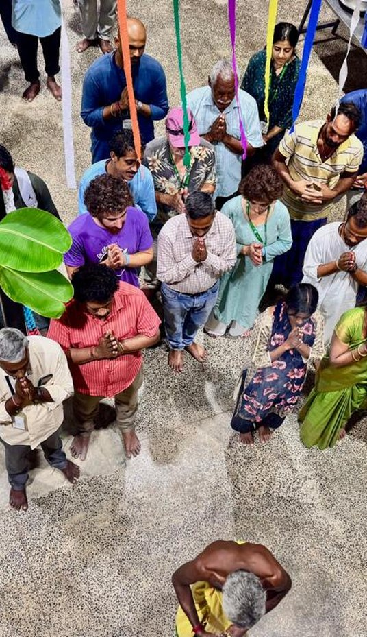
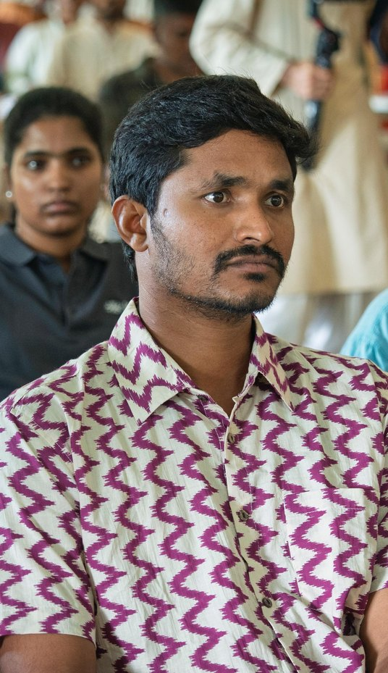
61 farmers in India this October. 46 students from 10 countries at our workshop.

Slide 4
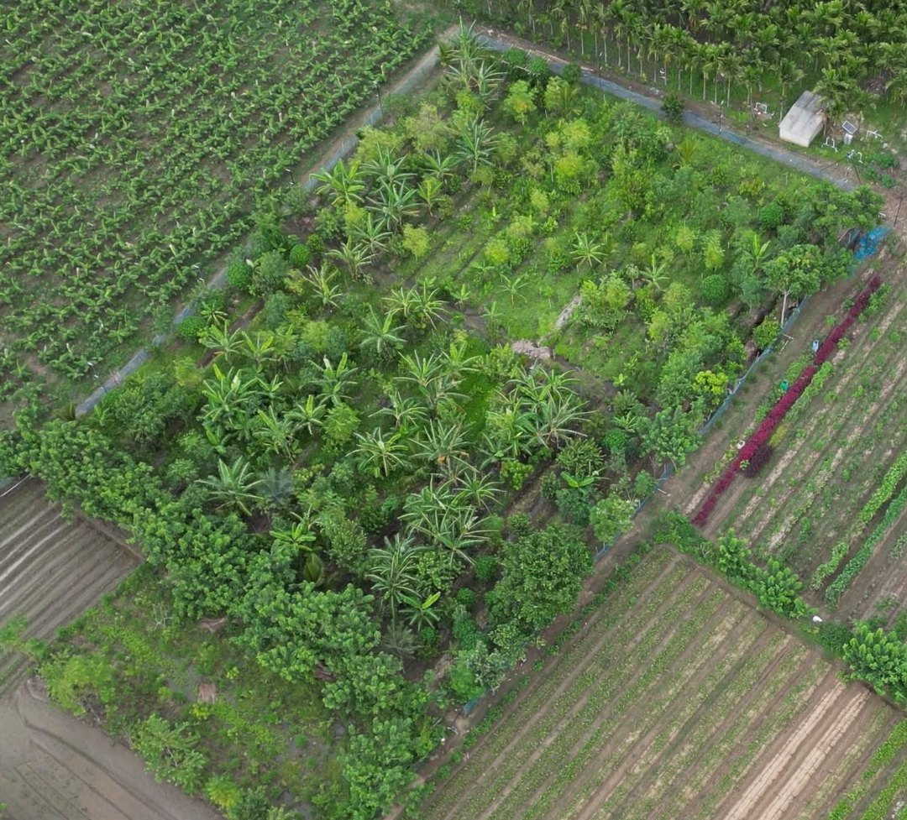
Our goal:
100,000 acres
regenerated in 2027

Slide 5
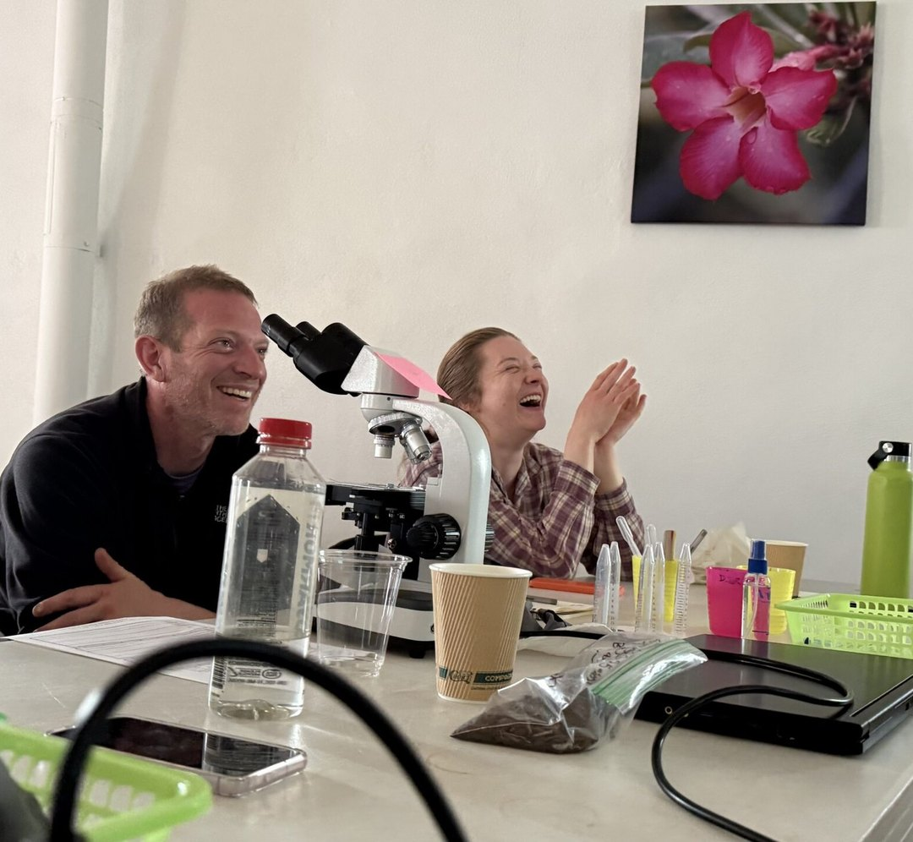
Your gift helps a student learn to restore soil. Link in bio

