Slide 1

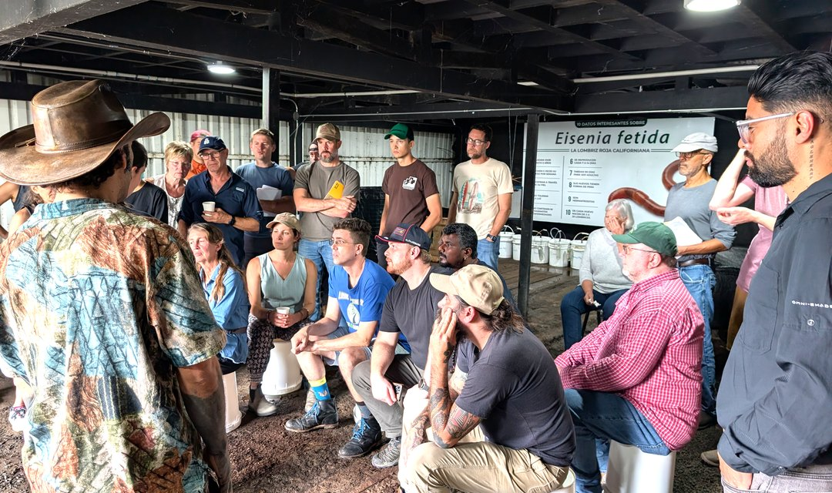



FREE LIVE INFO SESSION
Costa Rica Accelerator Workshop
FRI 6 NOV
Live on Zoom. Meet the team, ask your questions. Recorded for anyone who can't join live.
12pm Pacific
LINK IN BIO
Photo: Soil Food Web Foundation (Costa Rica, October 2025)

