Slide 1
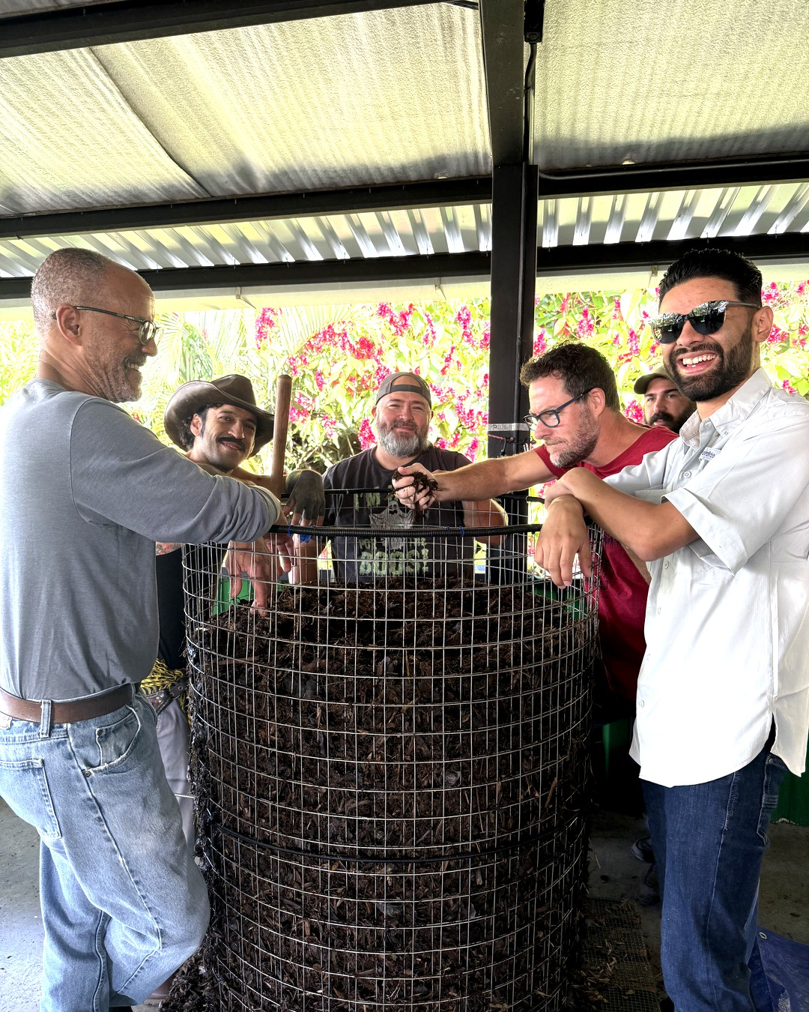
Early Nematode Discount ends tomorrow
Accelerator Workshop · Costa Rica
Notes:
Photo: IMG_4534.HEIC
Costa Rica Oct 2025, Armonía: laughing around the wire mesh bin with a thermometer

Slide 2
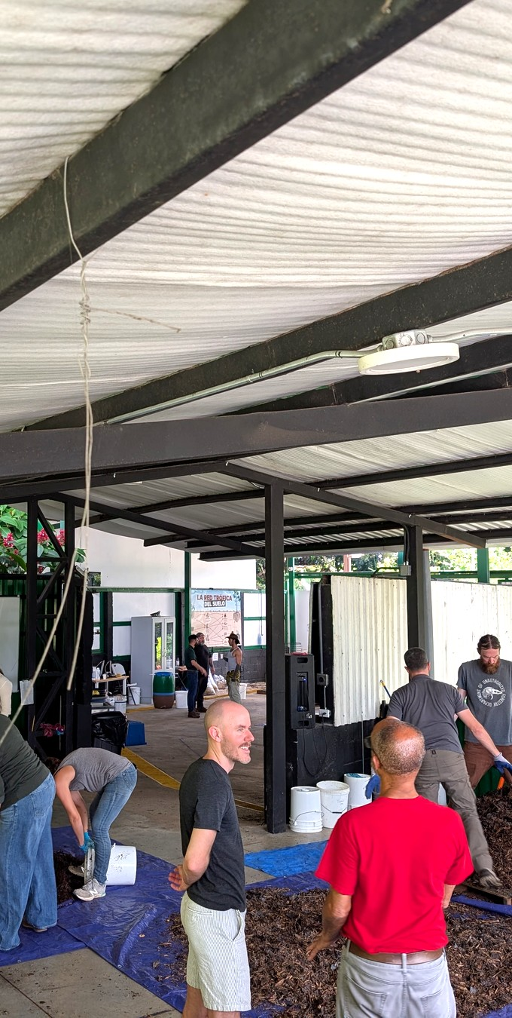
Ten days of hands‑on training
Notes:
Photo: PXL_20251022_151710920.MP.jpg
Costa Rica Oct 2025, Armonía: wide view of the shed, several teams building at once

Slide 3
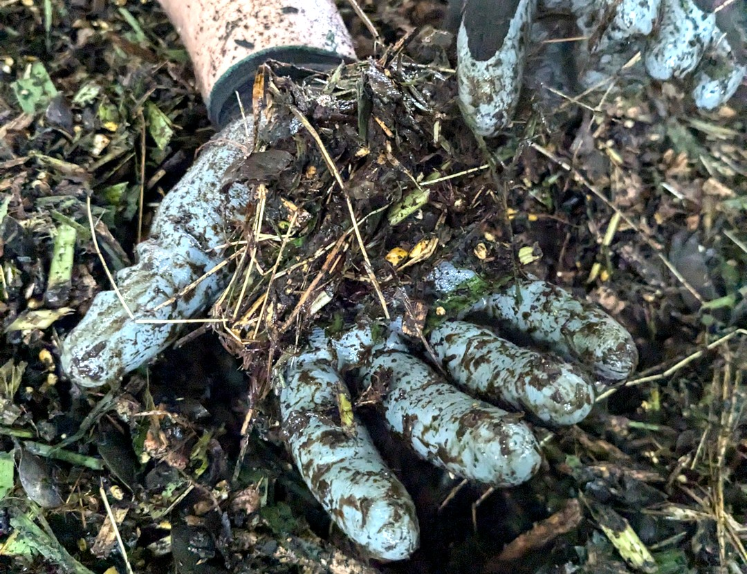
Build BioComplete™ compost with your team
Notes:
Photo: PXL_20240716_224324982_HandsInSoil.jpg
Costa Rica Jul 2024, Armonía: hands in woody compost (HandsInSoil)

Slide 4
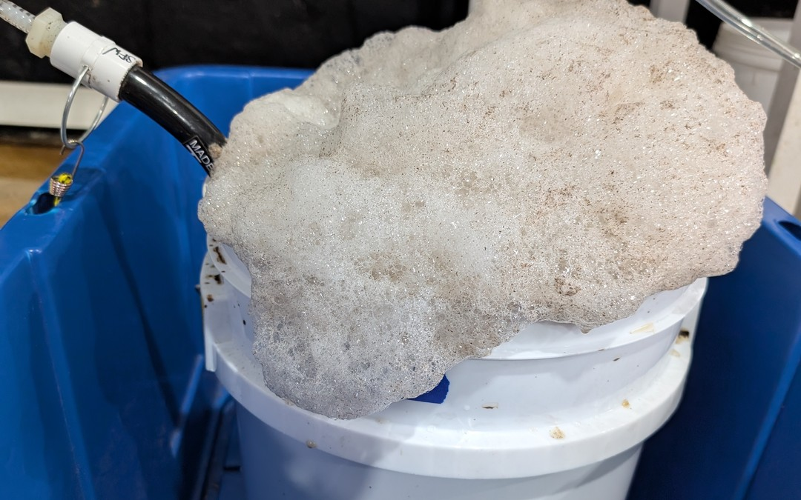
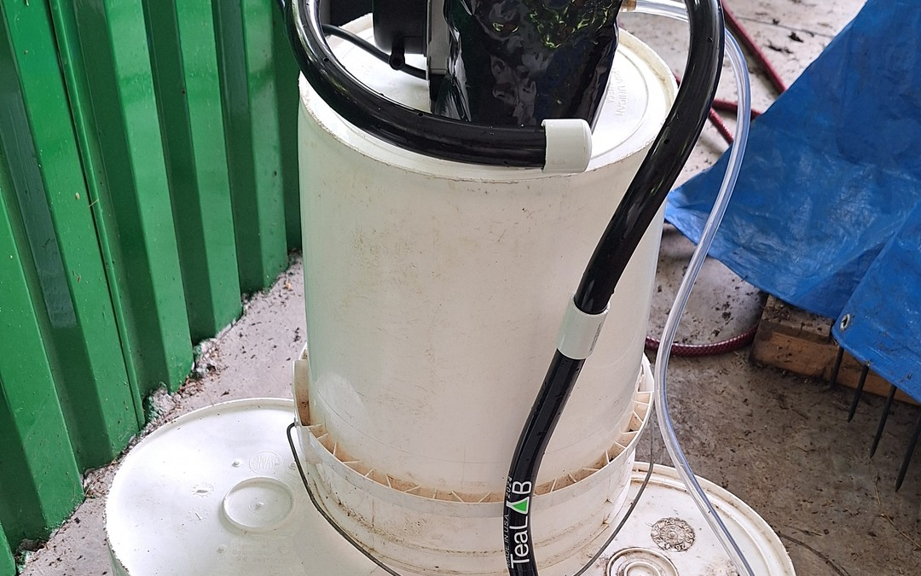
Brew extracts and teas
Notes:
Photo: PXL_20251020_222404850.jpg + Compost_Tea_Prep.jpg
Costa Rica Oct 2025: frothy brew in the blue tub (top); Costa Rica Jul 2024: Compost Tea Prep bucket brewer (bottom)

Slide 5
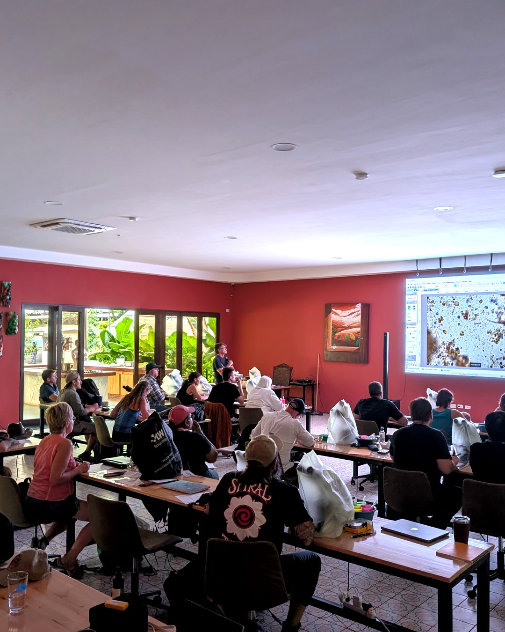
Read the biology, with a mentor beside you
Notes:
Photo: PXL_20251023_191907277.jpg
Costa Rica Oct 2025, Armonía: class watching live microscopy on screen (Drive ID 1YTuACdcqtVqv99HAArkRDlBUYdnCP8KZ), brightened

Slide 6
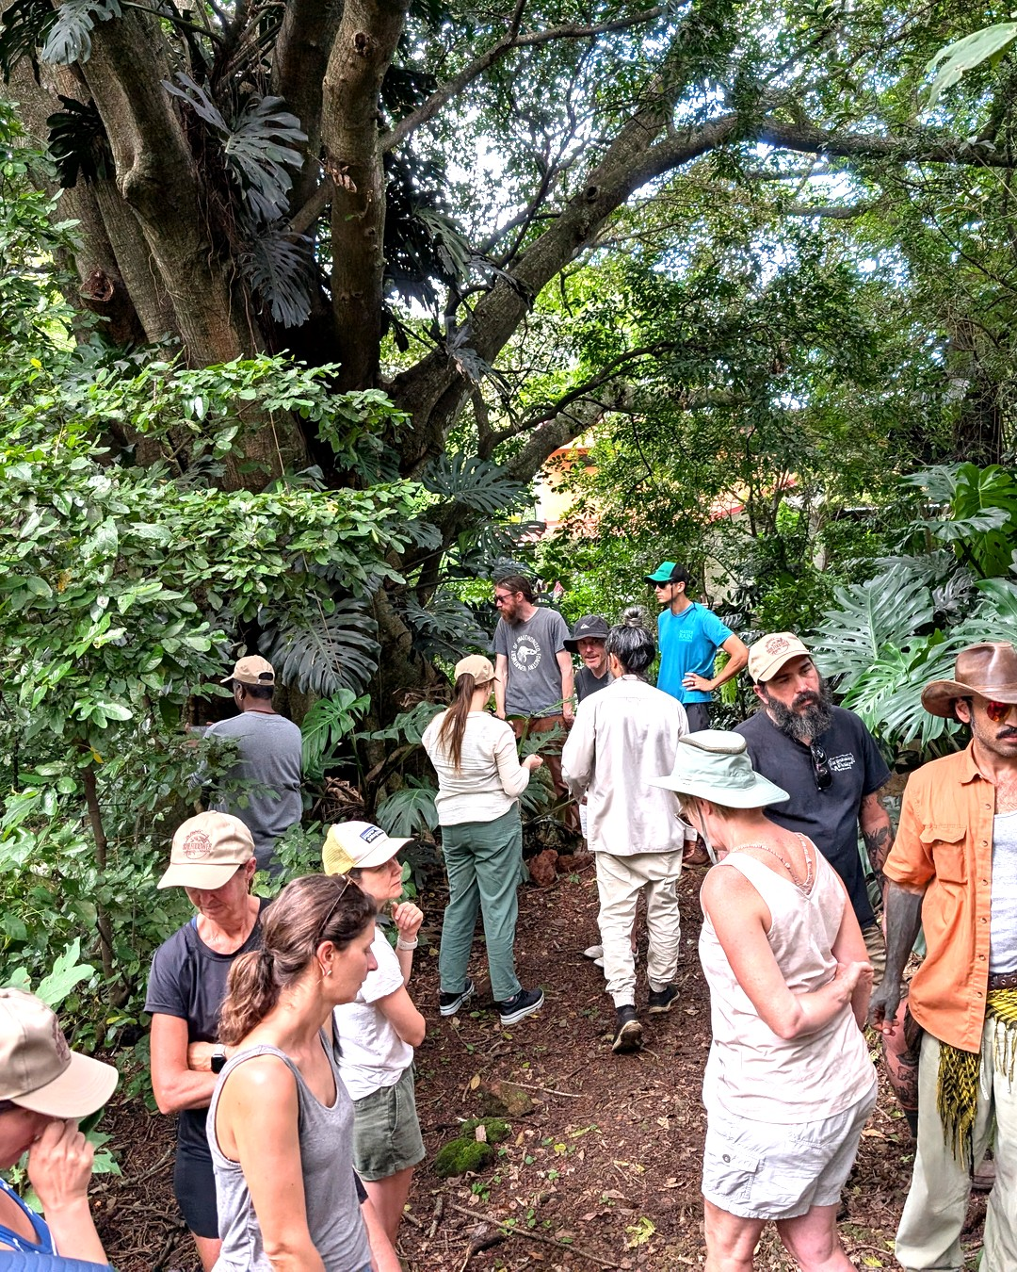

Accelerator Workshop
Heredia, Costa Rica
January 18–29, 2027
Register, link in bio
Notes:
Photo: PXL_20251022_172210012.jpg
Costa Rica Oct 2025, Armonía: the class under the big tree in the forest

