Slide 1




Fun Soil News
October 2026
Three good stories from the soil this month.

Slide 2
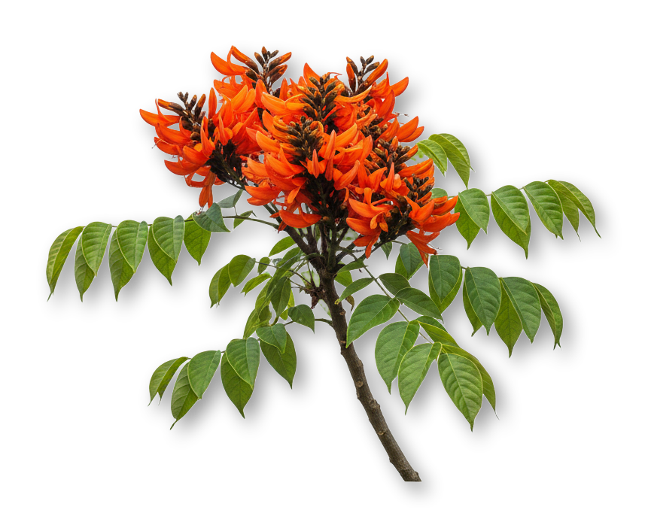
FUN SOIL NEWS · OCTOBER 2026
Australia
Six years after replanting, the fungi in restored farmland were still recovering what they do in the soil.
Flinders University News, 20 October 2026

Slide 3
FUN SOIL NEWS · OCTOBER 2026
Forests
Climate warming can slow how tree roots feed the microbes in the soil around them.
Phys.org, October 2026

Slide 4
FUN SOIL NEWS · OCTOBER 2026
Biochar
Researchers used "bomb carbon" in wood shavings to measure how long biochar stays in soil.
Phys.org, October 2026

