Slide 1

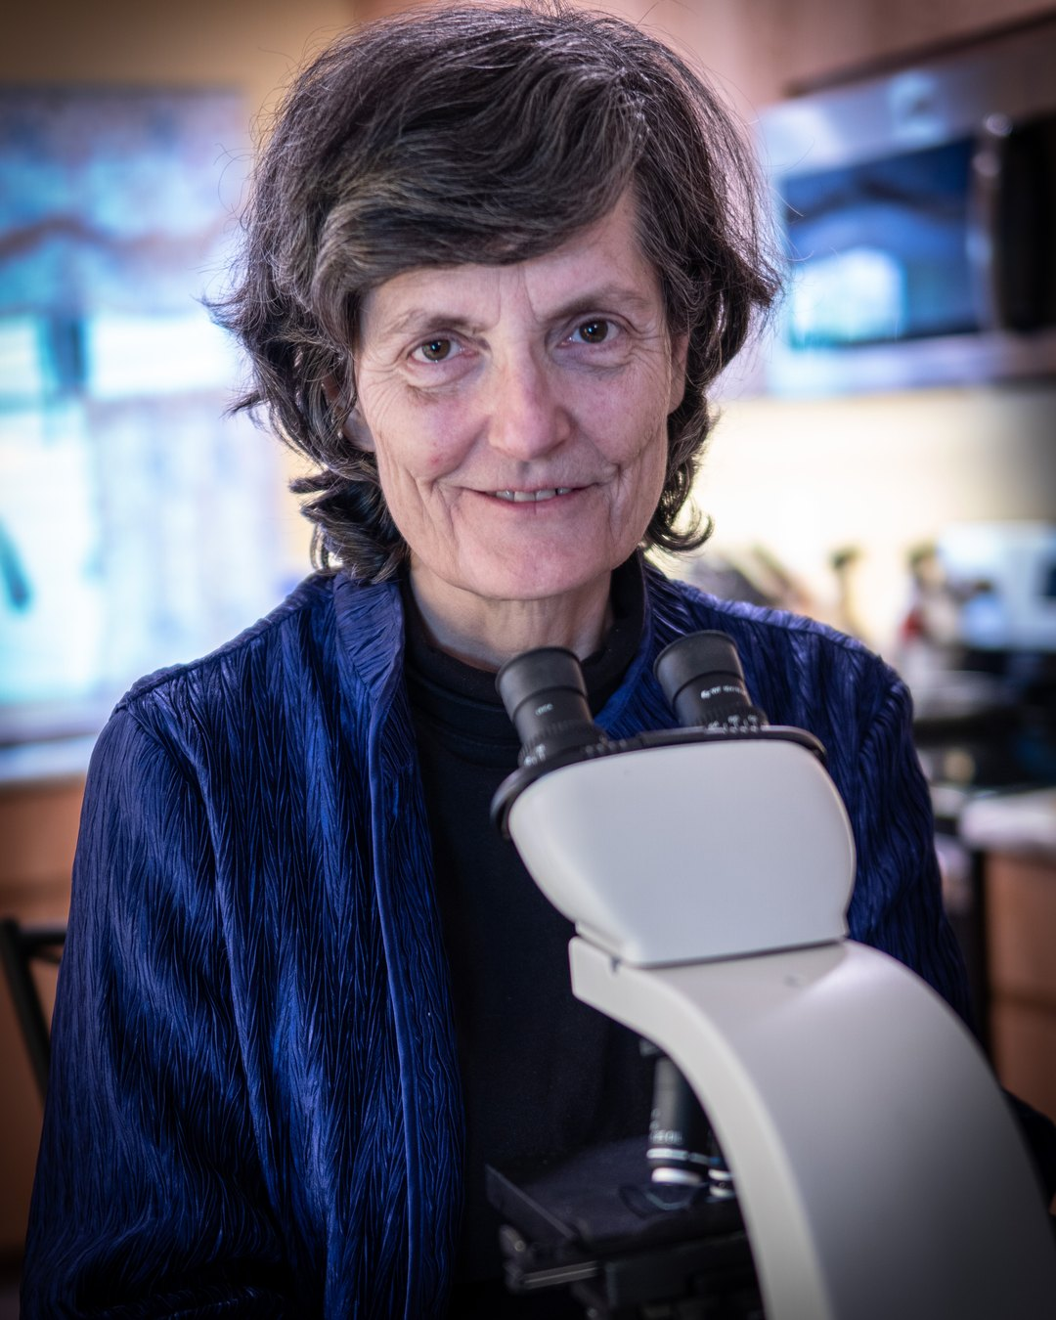

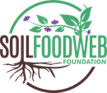
INTERNATIONAL WOMEN'S DAY
Dr. Elaine Ingham developed the concept of the soil food web.

Slide 2

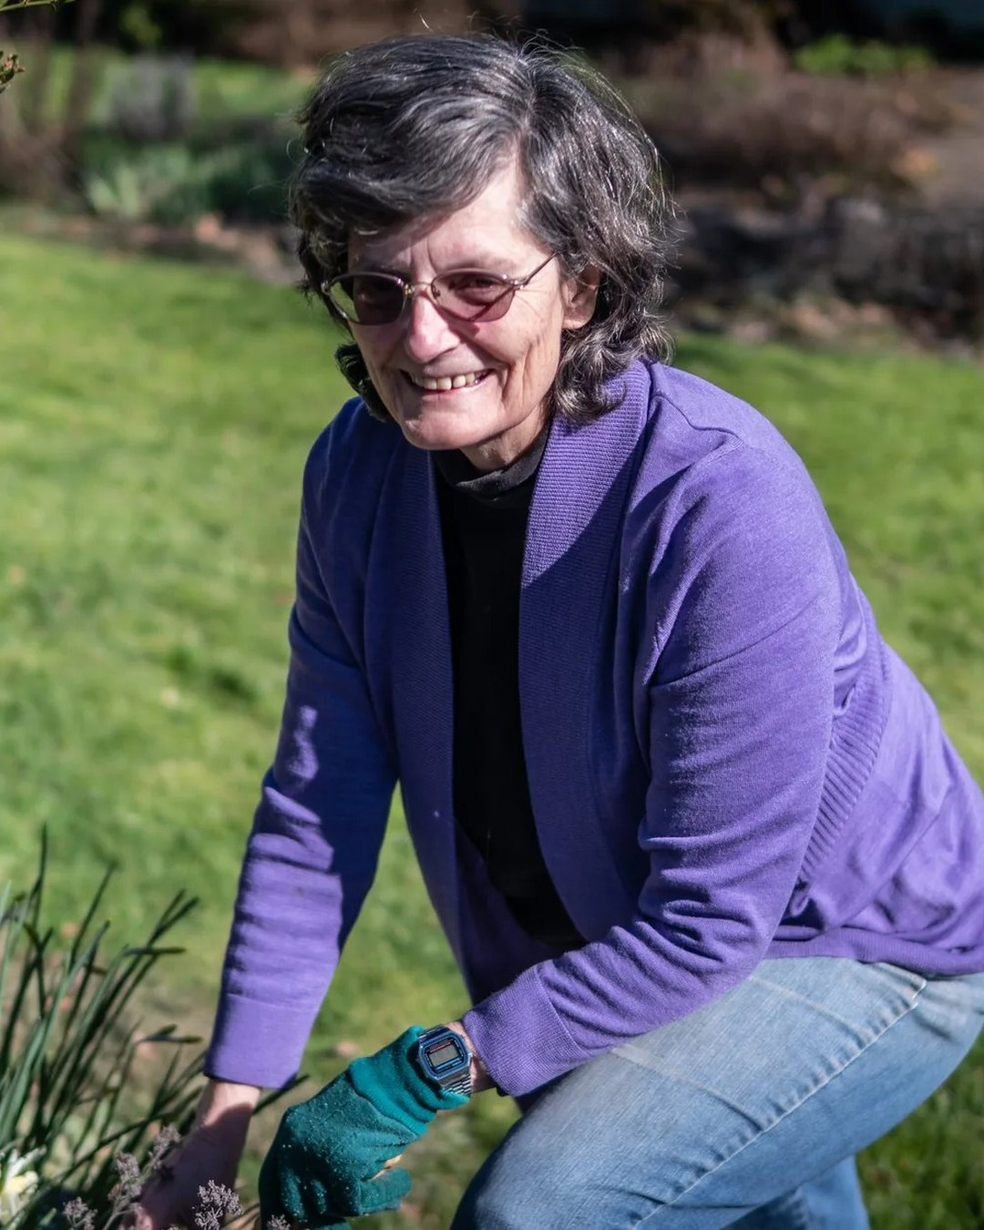

A SCIENTIST FIRST
Microbiology, then decades of research.
St. Olaf College, 1974. A master's in microbiology at Texas A&M, a doctorate at Colorado State, and Oregon State University faculty from 1986.

Slide 3

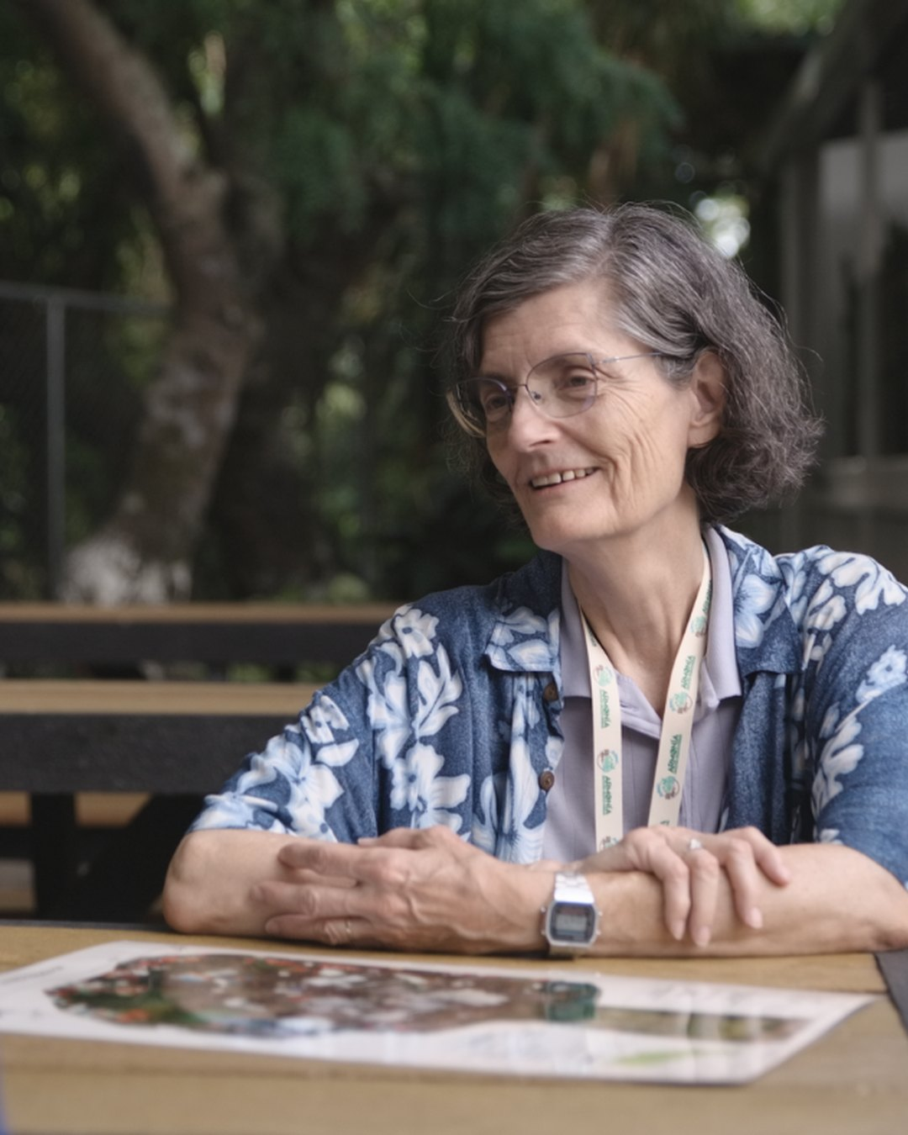
THEN SHE TAUGHT IT
Dozens of papers, then a school.
She wrote the Soil Biology Primer for the USDA Natural Resources Conservation Service and taught microscopy, compost and compost tea to growers around the world.

Slide 4

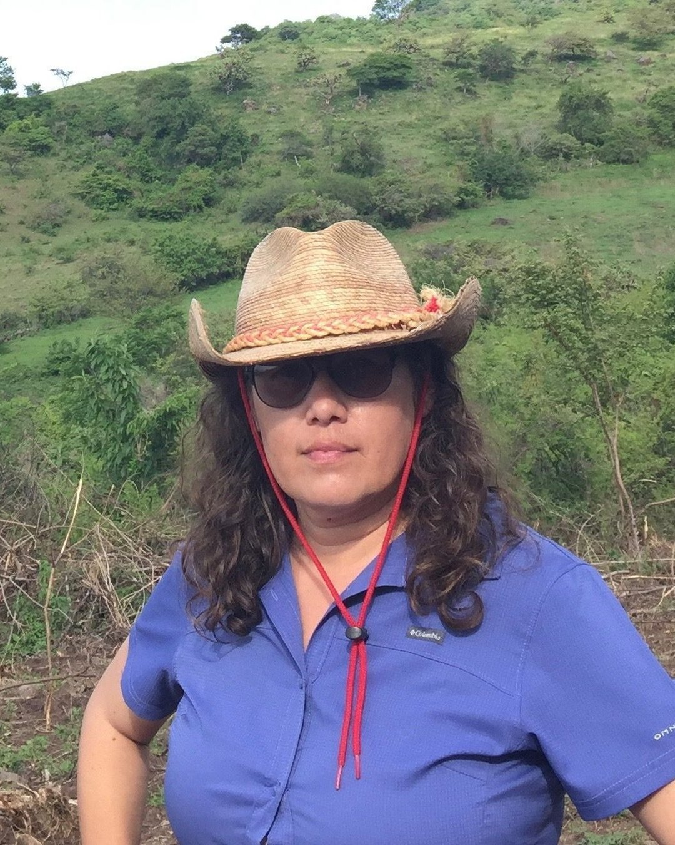
THE WOMEN TEACHING IT NOW
Loida Vasquez, Director of Advanced Education
“The most is learned from failed piles.”

Slide 5

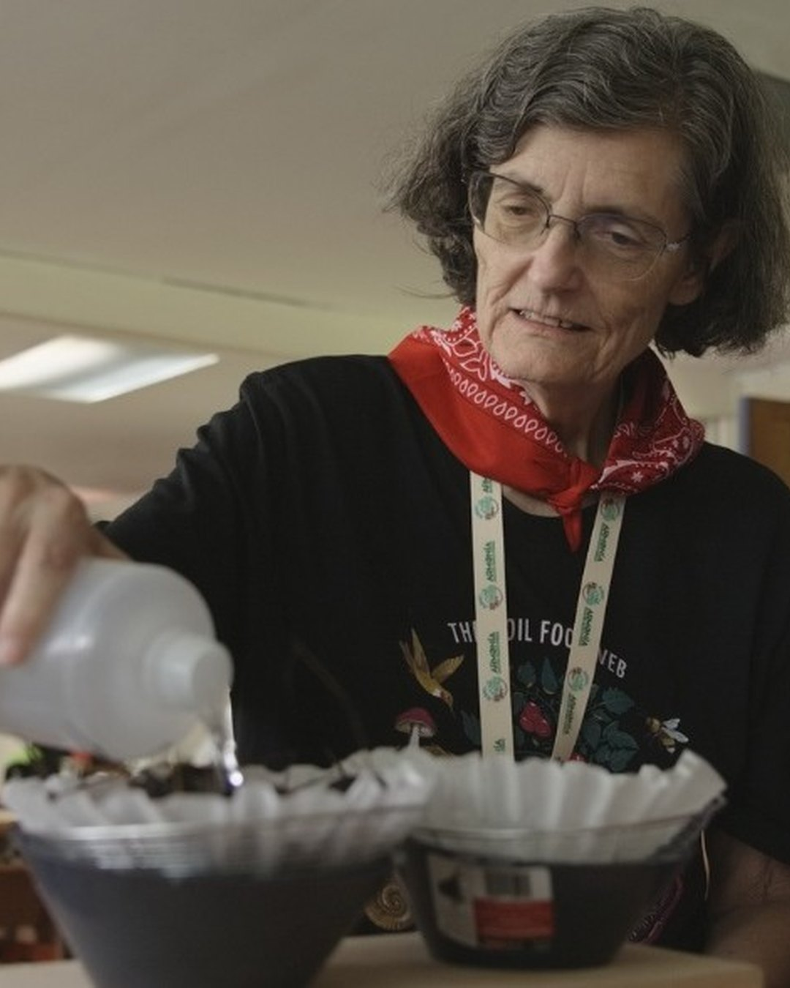
CARRY IT ON
Start learning the soil food web. Link in bio.

