Slide 1

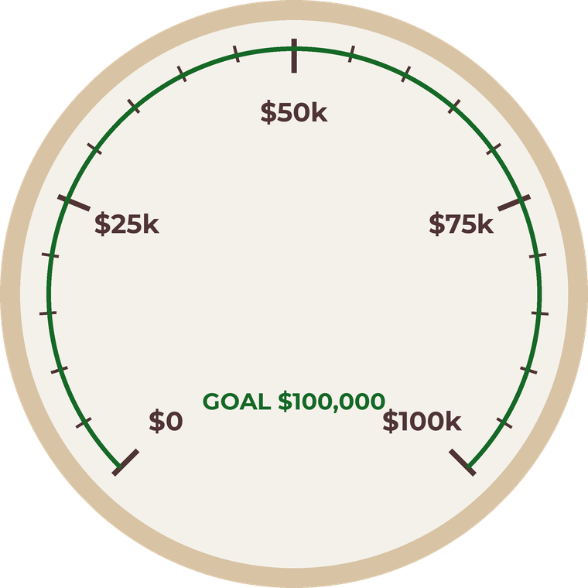



GivingTuesday · December 1
Help us reach
our goal
Give · Link in bio

