Slide 1
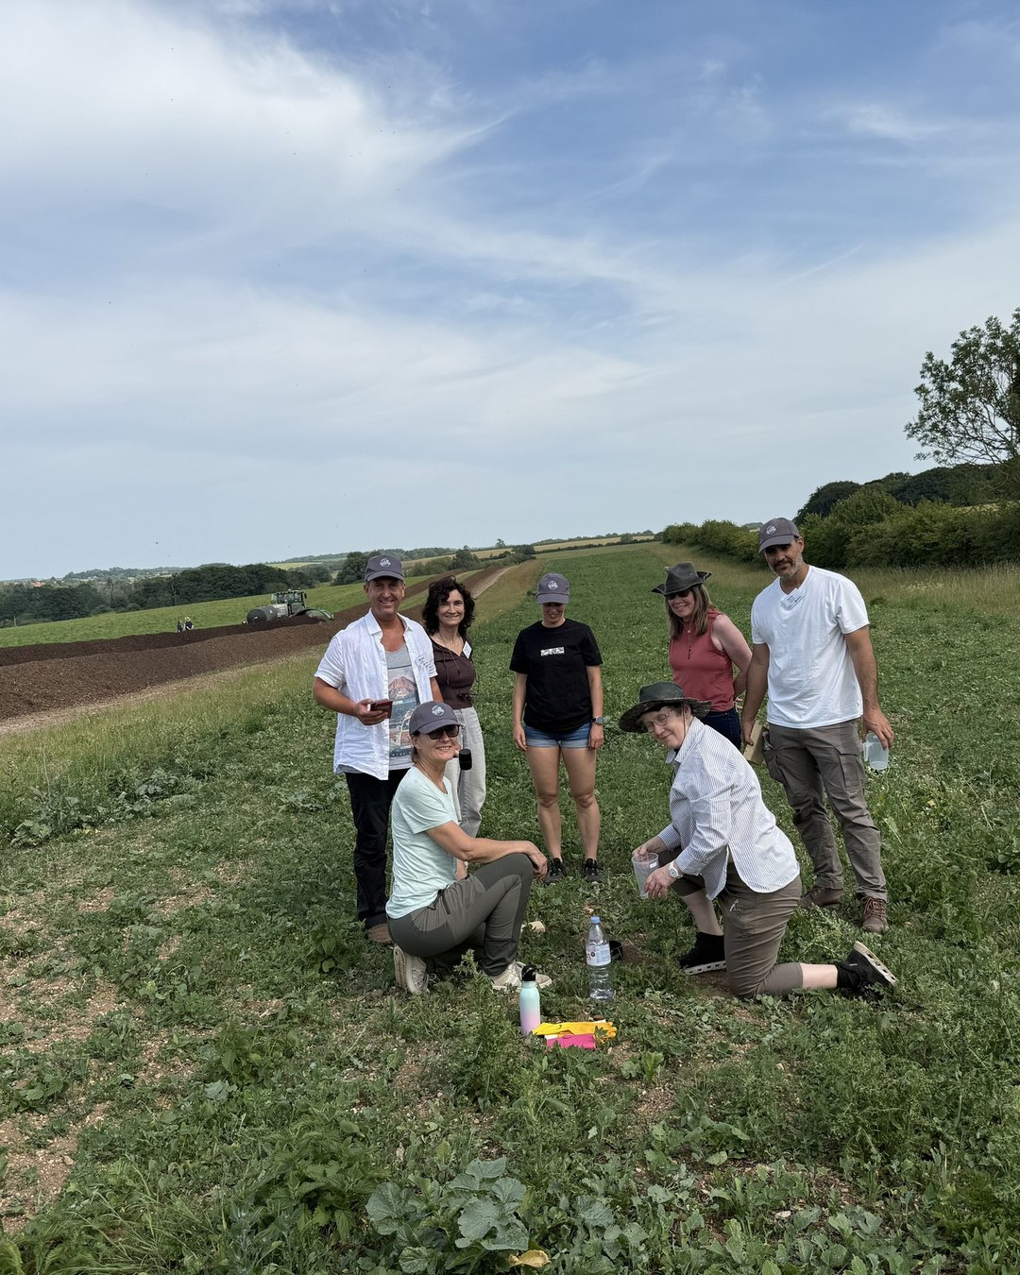





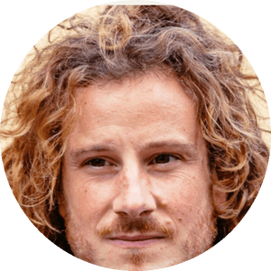
JOIN US TOMORROW
Johnson-Su compost on real farms
Juan de la Serna
Resoilutions
Thu 12 Nov
9am Pacific, free
Field walk, Norfolk, June 2025

