Slide 1
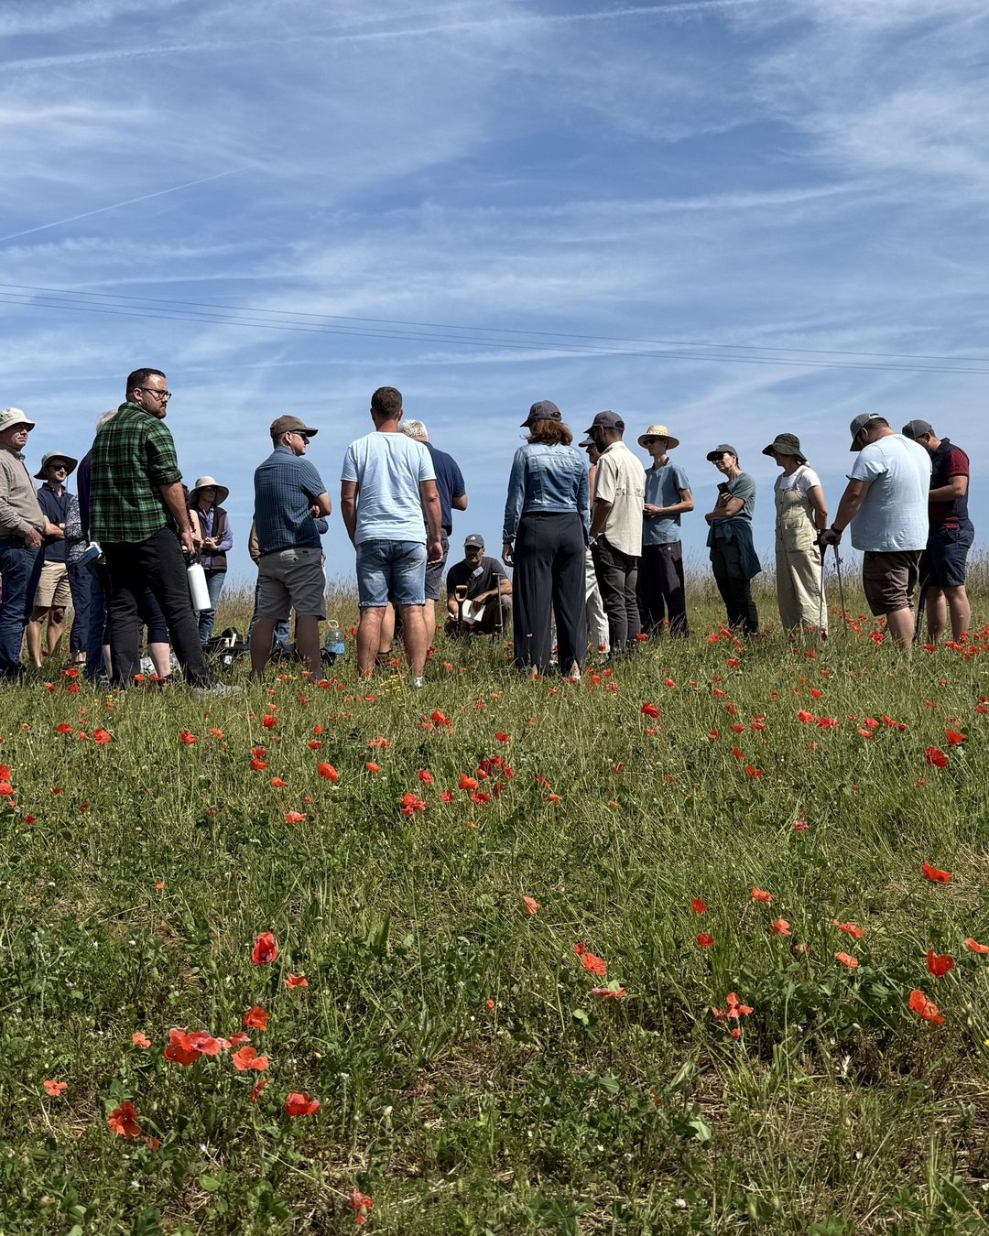





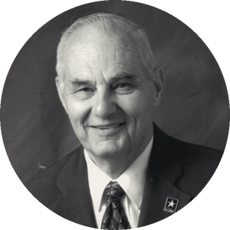
JOIN US TOMORROW
Agriculture beyond glyphosate
Dr. Don M. Huber
Emeritus Professor of Plant Pathology, Purdue University
Wed 18 Nov
9am Pacific, free
Wild Ken Hill, Norfolk

