Slide 1

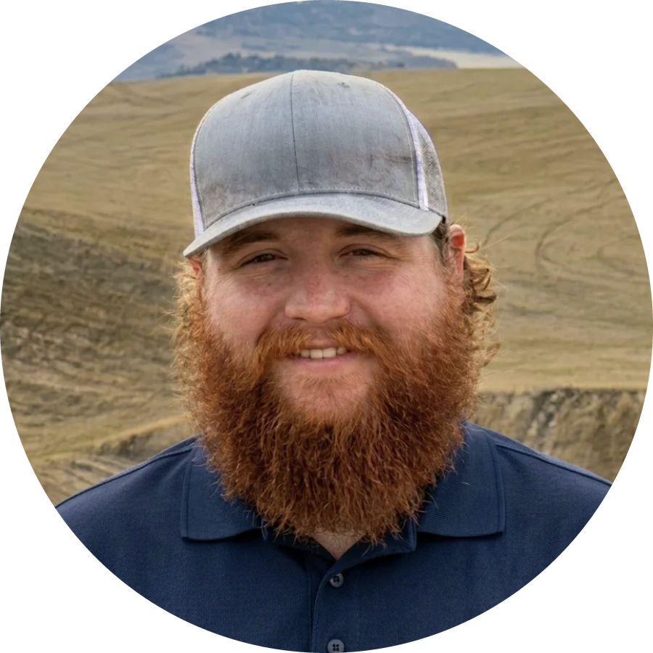


FREE WEBINAR · FALL 2026 SERIES
15 years of regenerative transformation in broad-acre corn and soy
with Matt Drane, AgriBio Systems
Wednesday, November 4
9am Pacific · 11am Central · Noon Eastern
Register free, link in bio

Slide 2
FREE WEBINAR
FALL 2026 SERIES
15 years of regenerative transformation in broad-acre corn and soy farming
with Matt Drane, AgriBio Systems
Wednesday, November 4
9am Pacific · 11am Central · Noon Eastern
Register free
link in bio

Slide 3


FREE WEBINAR
Fall 2026 series
15 years of regenerative transformation in broad-acre corn and soy
with Matt Drane, AgriBio Systems
Wednesday, November 4
9am Pacific · 11am Central · Noon Eastern
Register free, link in bio

