Slide 1



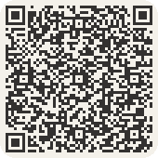

Pick your season
Start the Foundation Courses this winter. Then build with a ten-week 2027 cohort, with a live mentor every week.
J
F
M
A
M
J
J
A
S
O
N
D
11 Jan
to 26 Mar
10 May
to 25 Jul
30 Aug
to 7 Nov
One week left,
until 2 December.

