Slide 1







Foundation Courses + Compost Intensive
Fall Enrollment Special
Until 2 December.

Slide 2


The Foundation Courses teach you to work out what your soil needs.
Four courses, 63 lectures and about 150 hours of study, with 40+ years of Dr. Elaine's knowledge. Self-paced, start the day you enroll.

Slide 3

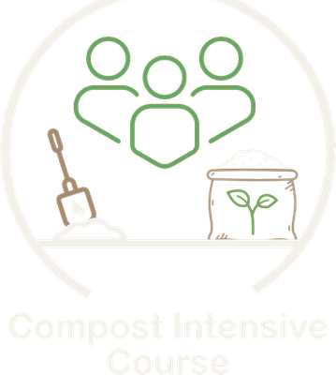
The Compost Intensive Course teaches you to make it.
Ten weeks online, with a 90-minute live session with a mentor every week. You build 2 compost piles right where you live.

Slide 4


Plus hundreds of hours with Dr. Elaine
Instant access to our legacy webinar archive, recorded live with Dr. Elaine Ingham.

Slide 5


Start today.
Pick your season.
01
Start today
4 courses, self-paced
02
Pick your cohort
January, May or August 2027
03
Build 2 compost piles
Right where you live
Fall Enrollment Special
Until 2 December.

