Slide 1


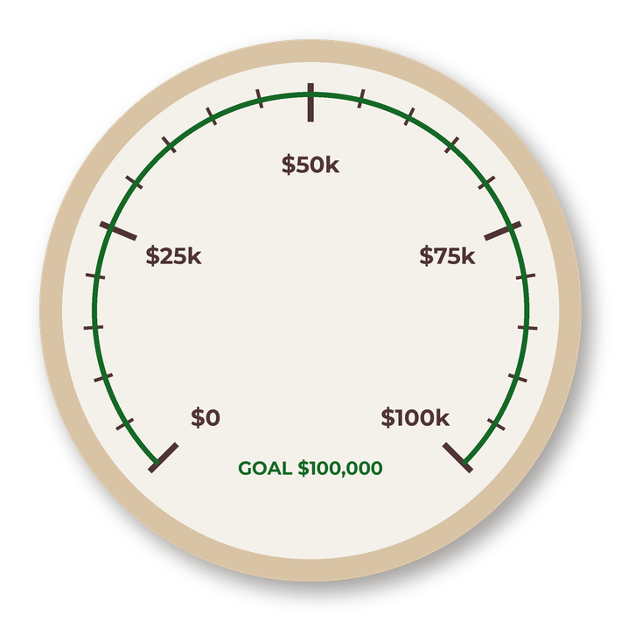

SOIL FOOD WEB FOUNDATION
GIVING TUESDAY
What we grew together in our first year

Slide 2

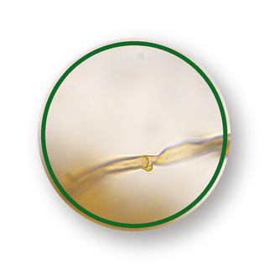
AT A GLANCE
OUR FIRST YEAR
IN NUMBERS
$300,000+
IN SCHOLARSHIPS AWARDED
35+
4
FREE LIVE EVENTS
WORKSHOPS
23
46
NUMBER OF COUNTRIES
REPRESENTED IN OUR PDC
INDIA WORKSHOP
PARTICIPANTS

Slide 3
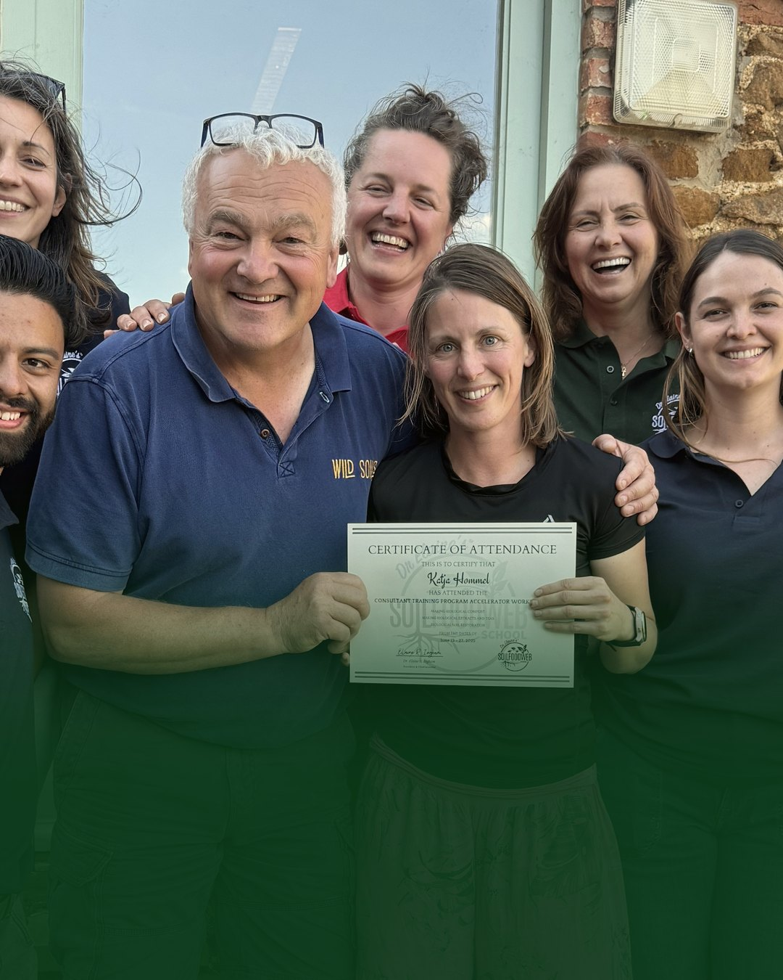
OPENING THE DOOR
$300,000+
in scholarships awarded for our various courses and workshops

Slide 4

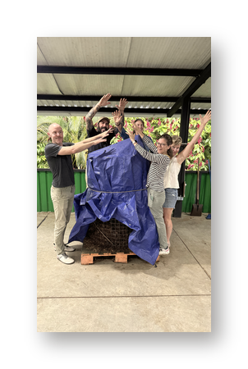
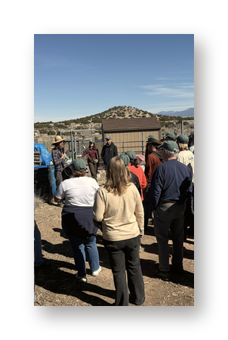
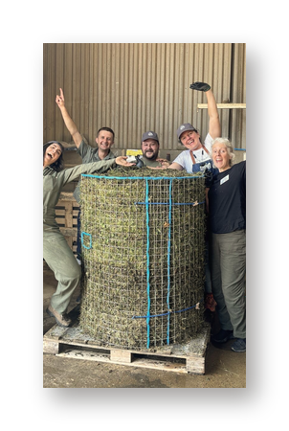
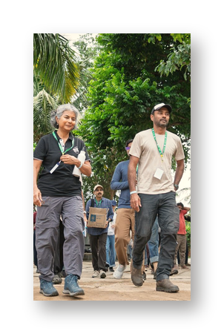
4
IN PERSON
WORKSHOPS
ON 4
CONTINENTS
COSTA RICA
UNITED
STATES
ENGLAND
INDIA
Oct 2025
Feb 2026
Jun 2026
Oct 2026
Hands-on training with our mentors, on four farms

Slide 5
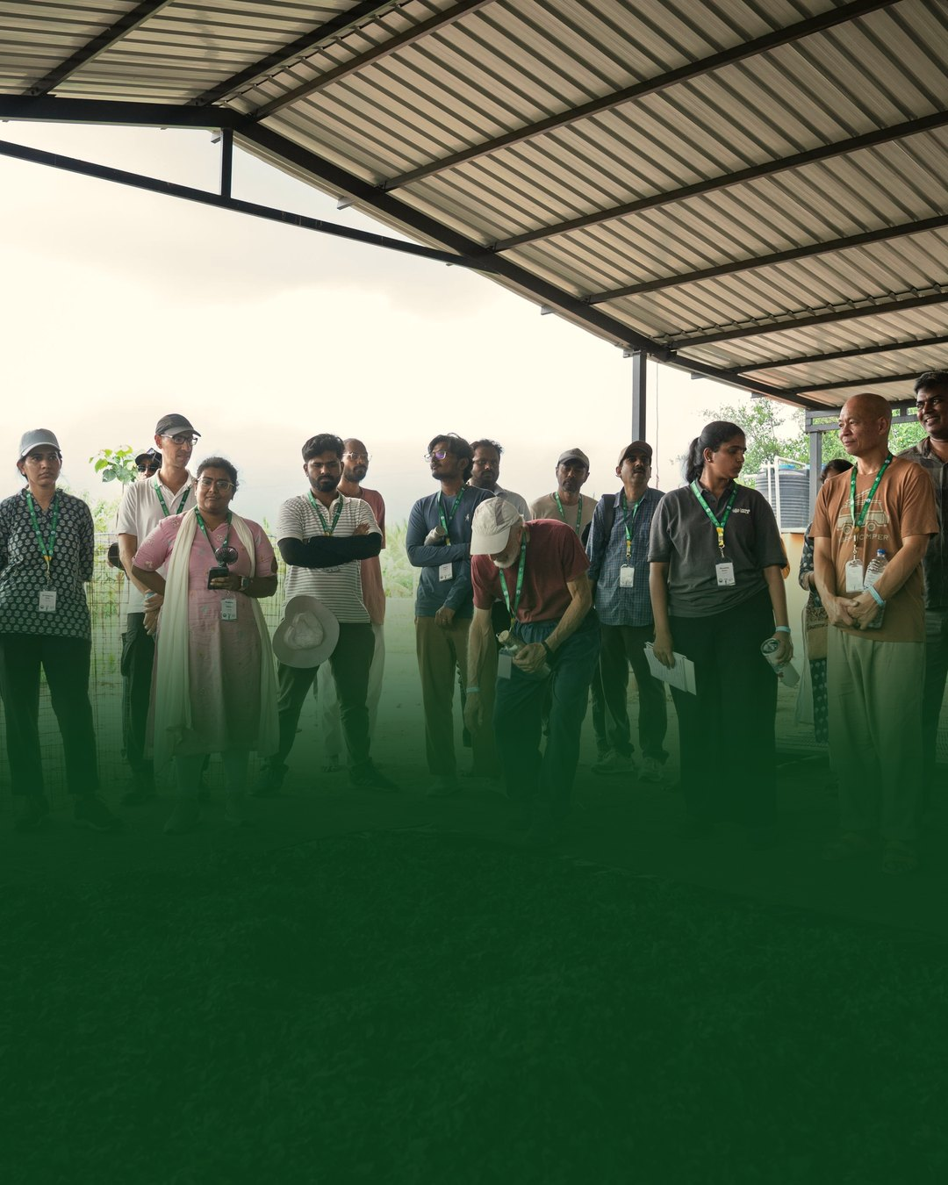
FIRST WORKSHOP IN INDIA
46
61
participants from 10 countries
at the Life in the Soils seminar
We partnered with Isha Foundation and Save Soil

Slide 6


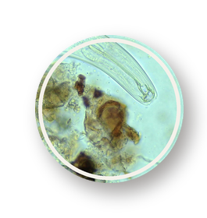
35+
FREE
LIVE
EVENTS
SOME OF OUR WEBINAR GUESTS:
Vandana Shiva
Geoff Lawton
Nicole Masters
Mary Reynolds
David Holmgren
Dr. Mary Cole

Slide 7


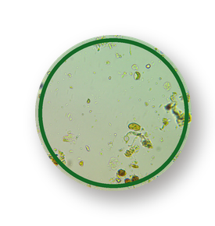

NEW PROGRAMS
TWO NEW WAYS TO LEARN
100
10
students from 23 countries
weeks, live online
COMPOST
INTENSIVE COURSE
PERMACULTURE
DESIGN
CERTIFICATE
No prerequisites, with Spanish transcriptions
With the Permaculture Association (UK)

Slide 8

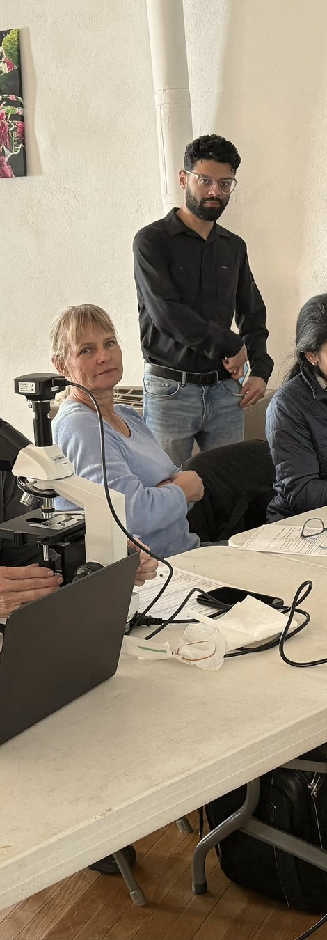




FOR OUR STUDENTS
A BETTER
PLACE TO
LEARN
Student mobile app
Updated Microbe Library
New learning platform
Free public community

Slide 9


OUR GOAL FOR 2027
100,000
ACRES REGENERATED
by our community of students and graduates

Slide 10
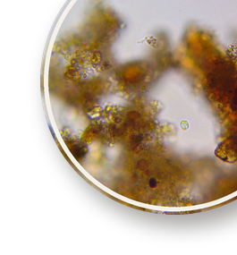


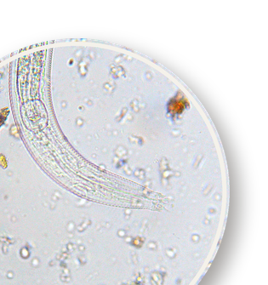
GIVING TUESDAY
$100,000
MATCH
Every gift is doubled.
Donate today

