Slide 1



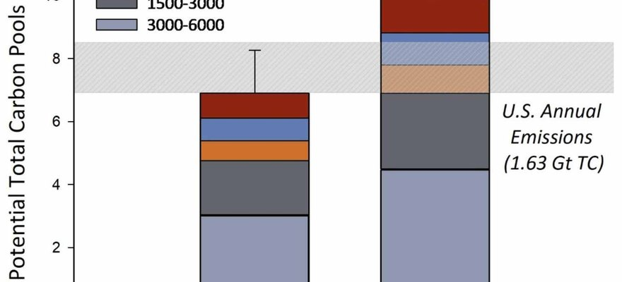

Environmental Research: Food Systems
Figure 2, Lundgren et al. 2026, CC BY 4.0
Regenerative farms stored 39% more soil carbon
A study of working farms across North America.
Read More
Source:
doi.org/10.1088/2976-601X/ae8f4e

Slide 2


1,000 Farms
The 1000 Farms Initiative measured working farms across North America, from the most conventional to the most regenerative. Led by Ecdysis Foundation.

Slide 3


39% more soil carbon
on the most regenerative farms.

Slide 4


+181% total fungi
in the most regenerative soils (figure 3 of the paper).

Slide 5


More life everywhere
Soil microbes, insects, plants and birds. The more biodiversity, the more carbon stored.

Slide 6

Same yields
Yields matched national averages, and net profit per acre was similar.

Slide 7

The whole system counts
Farms using one regenerative practice alone looked like conventional farms.

Slide 8


Read the paper
Lundgren et al., Environmental Research: Food Systems, 2026. Link in bio.

