Slide 1



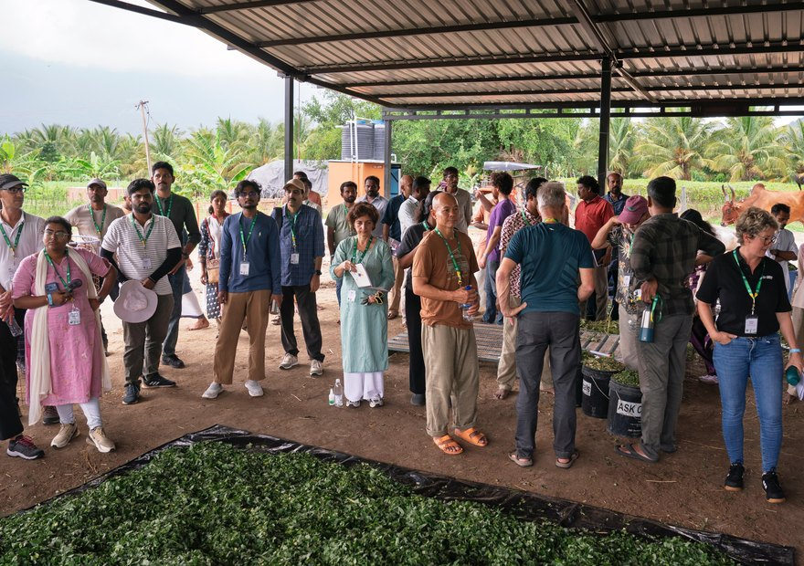


News9 Live
Photo: Soil Food Web Foundation, Coimbatore
“A meaningful step”
Evan Buckman on bringing our Accelerator Workshop to India for the first time.
Read the article

