Slide 1



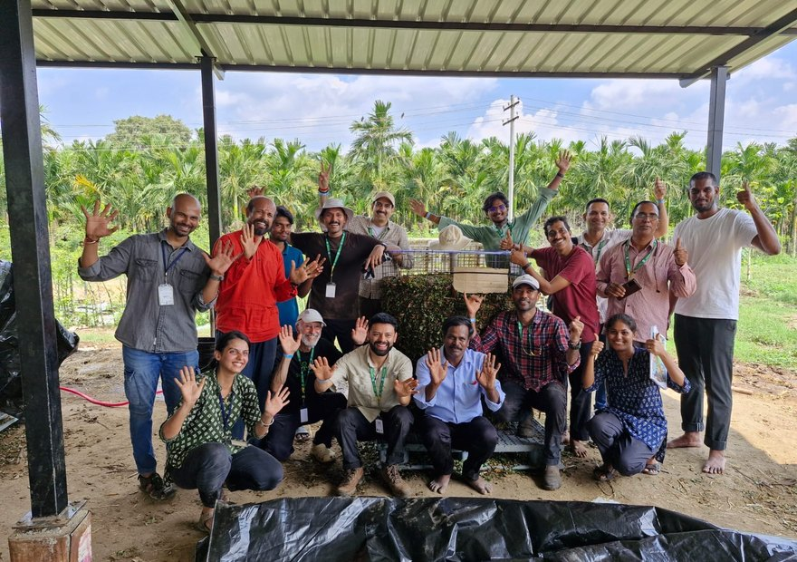


TV9 Gujarati
Photo: Soil Food Web Foundation, Coimbatore
On TV9 Gujarati too!
Two programmes in Coimbatore: the Life in the Soil Seminar and the Accelerator Workshop.
See the post

