Slide 1
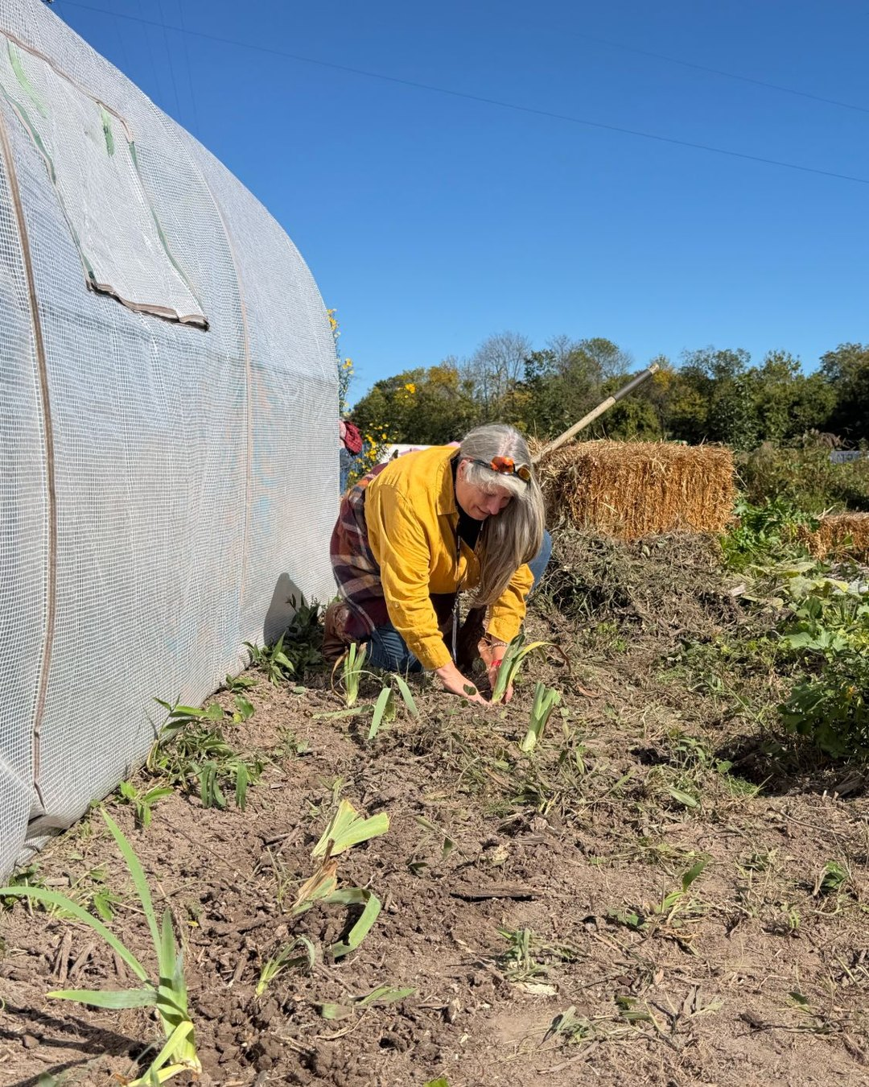

Scaling
Sustainably
A talk by
Suzanne Shea

Slide 2

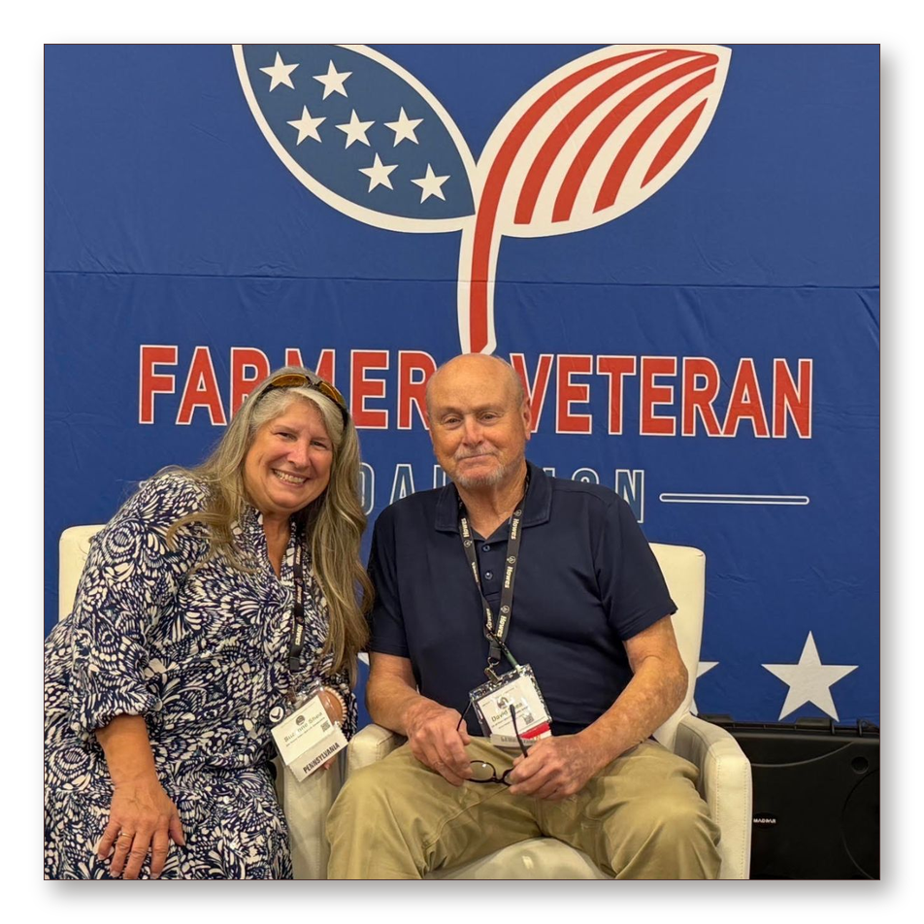

Suzanne Shea
Farmer Veteran Coalition
Stakeholders Conference

Slide 3


