Slide 1
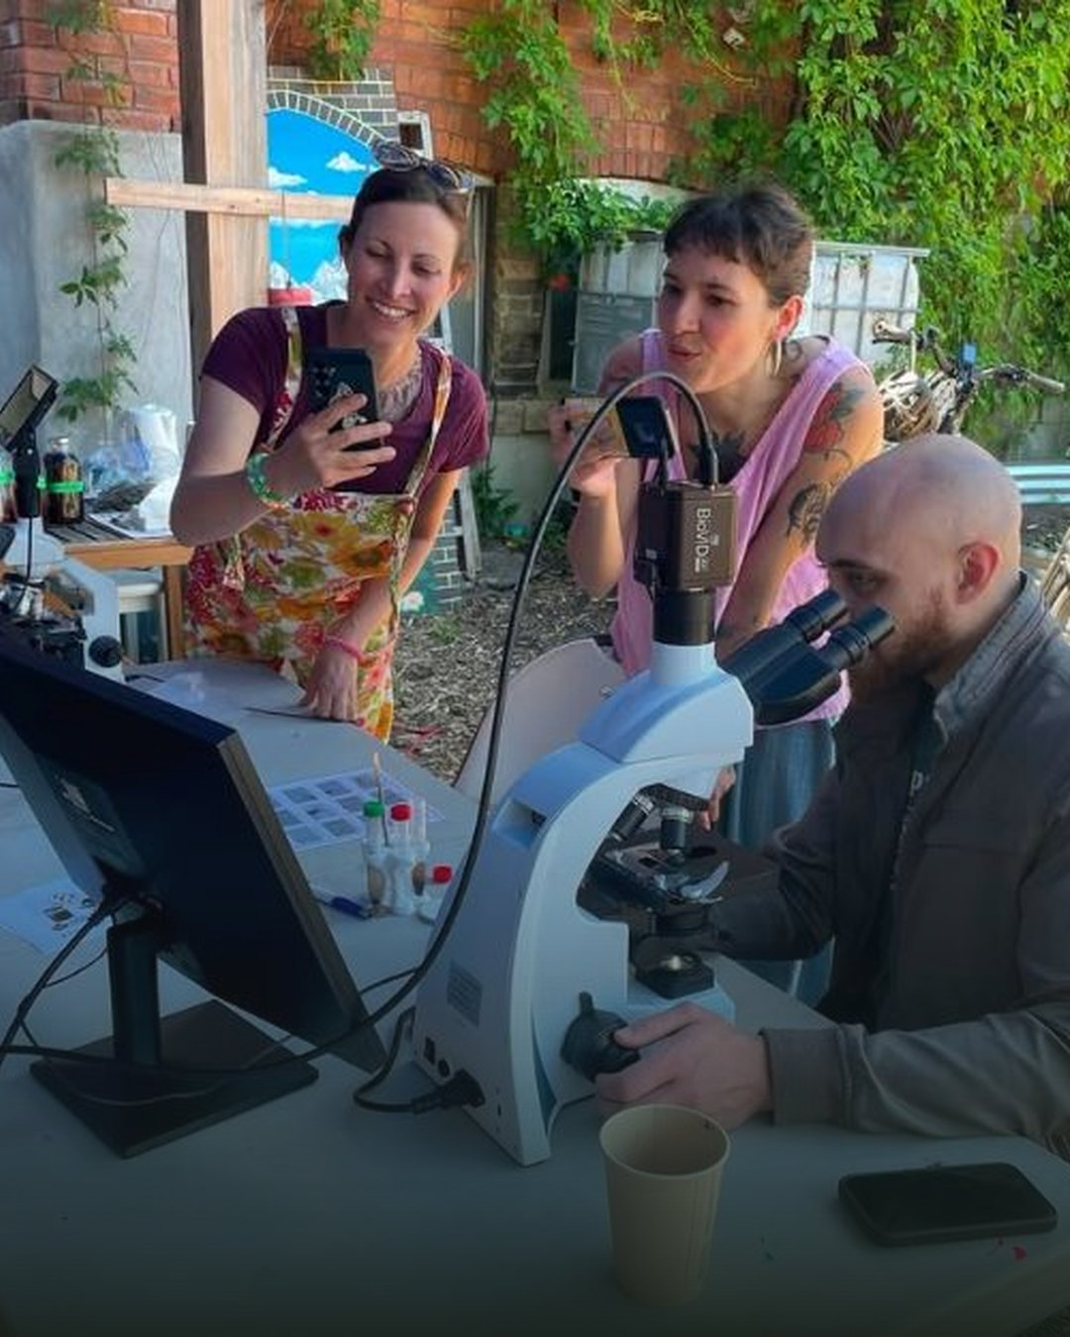

Happy Small
Business Saturday
Meet Colleen Dempster
of Rewild Soils

Slide 2

A Soil Food Web certified
microscopy lab since
2022
Colleen has looked at hundreds
of soil, compost and compost
tea samples

Slide 3

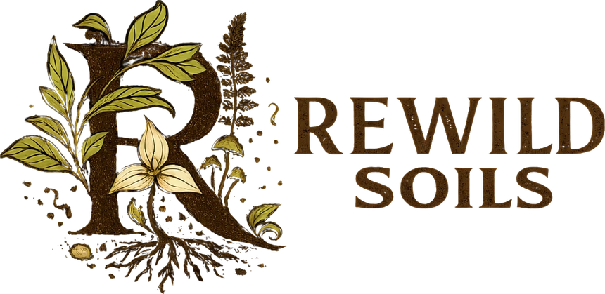


Meet Rewild Soils
Soil microscopy, consulting, workshops
and Biologically Complete compost,
from Uxbridge, Ontario
rewildsoils.com

