Slide 1



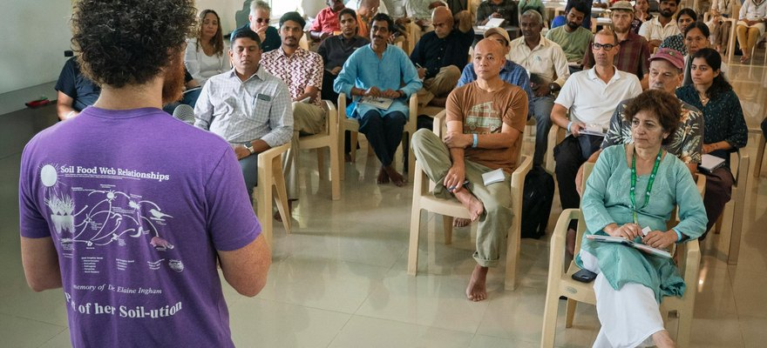


The Times of India
Evan Buckman teaching in Coimbatore
We made the Times of India
Our India Accelerator Workshop, Coimbatore, Tamil Nadu.
Read More
Source:
timesofindia.indiatimes.com/
articleshow/135370094.cms

Slide 2


46 participants from 10 countries
Farmers, soil scientists, microbiologists and consultants, from seven Indian states and abroad.

Slide 3


At the Save Soil model farm
Ten days at Sadhguru's Save Soil Regenerative Revolution farm, in collaboration with Isha Outreach.

Slide 4

Compost to microscope
BioComplete™ compost, compost extracts and teas, soil sampling and microscopy sessions.

Slide 5


61 at the seminar first
The two-day Life in the Soil Seminar ran on 16 and 17 October.

Slide 6


Read the article
The Times of India, 30 October 2026. Link in bio.

