Slide 1



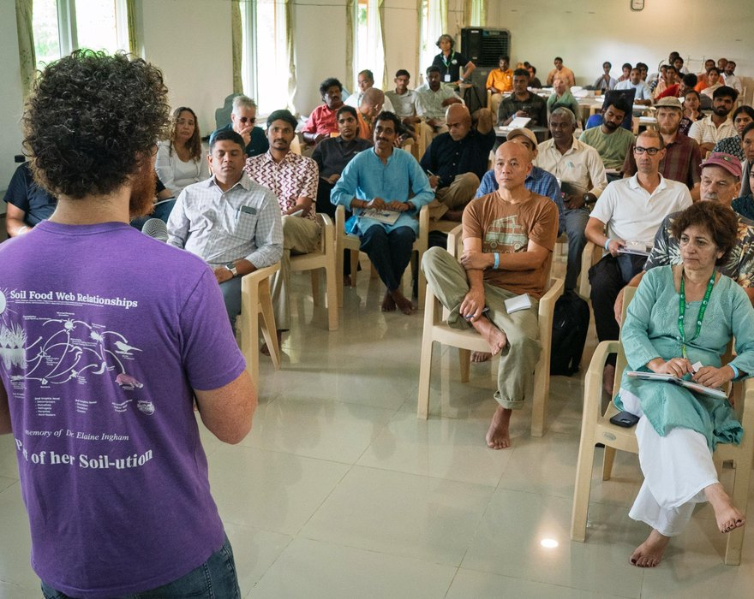


The Times of India
Evan Buckman teaching in Coimbatore
We made the Times of India!
46 people from 10 countries learned with us in Coimbatore.
Read the article

