Slide 1
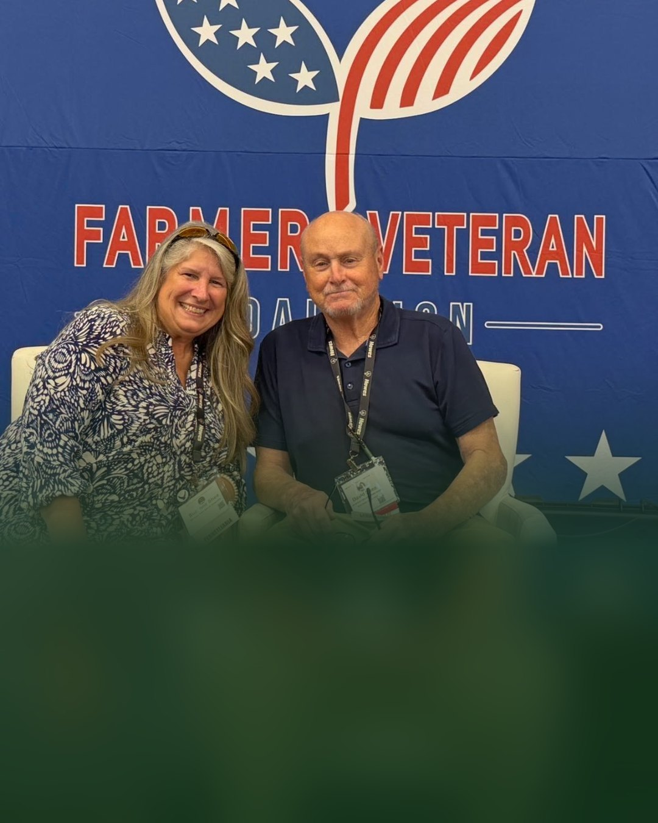

Farmer Veteran Coalition
Veteran farmers
building living soil
Consultant Suzanne Shea presented
at the Stakeholders Conference

