Slide 1


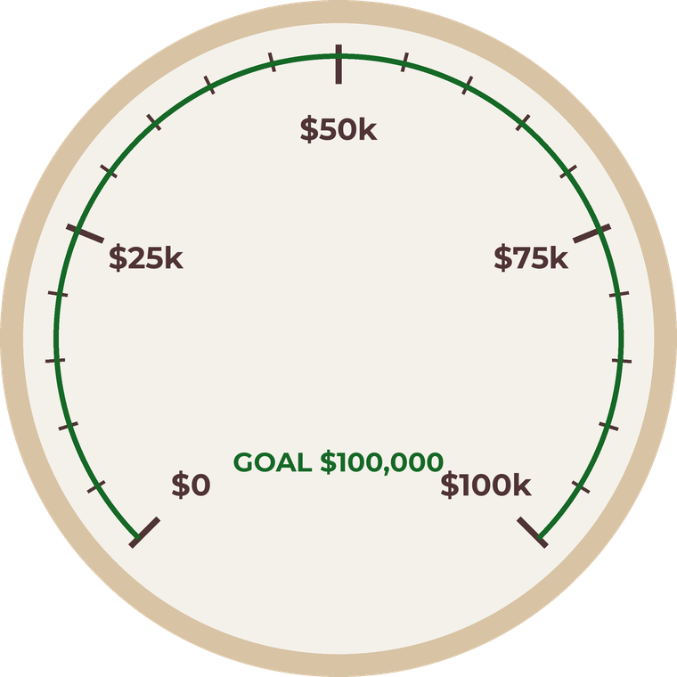



GivingTuesday · December 1
Help us reach
our goal
Give today

Slide 2

GivingTuesday · December 1
Help us reach
our goal
Give today

Slide 3

GivingTuesday · December 1
Help us reach
our goal
Give today

Slide 4

GivingTuesday · December 1
Help us reach
our goal
Give today

Slide 5

GivingTuesday · December 1
We did it.
Thank you!
Give today

