Slide 1



GivingTuesday · December 1
Healing soil.
Feeding humanity.
Restoring the
living world.
Help us raise $100,000
Give today

Slide 2
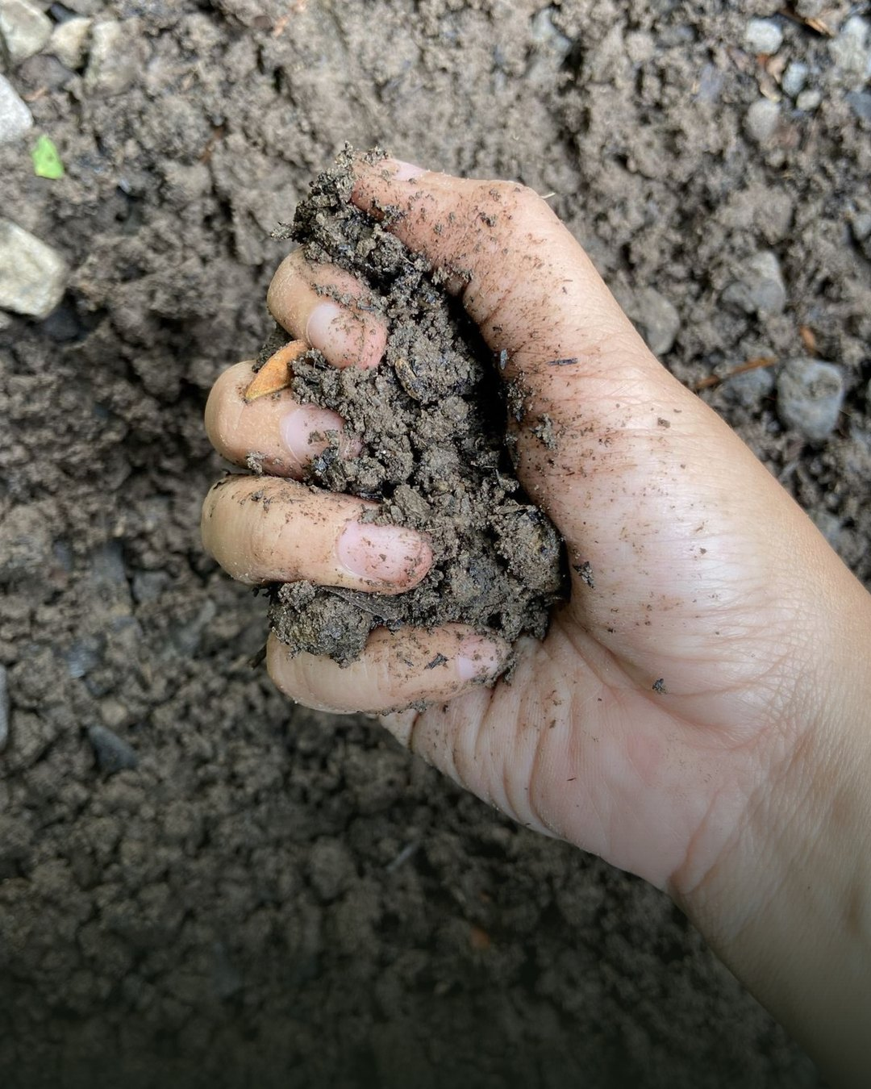
The soil under our feet is alive. For decades we’ve farmed it like it was dead.

Slide 3
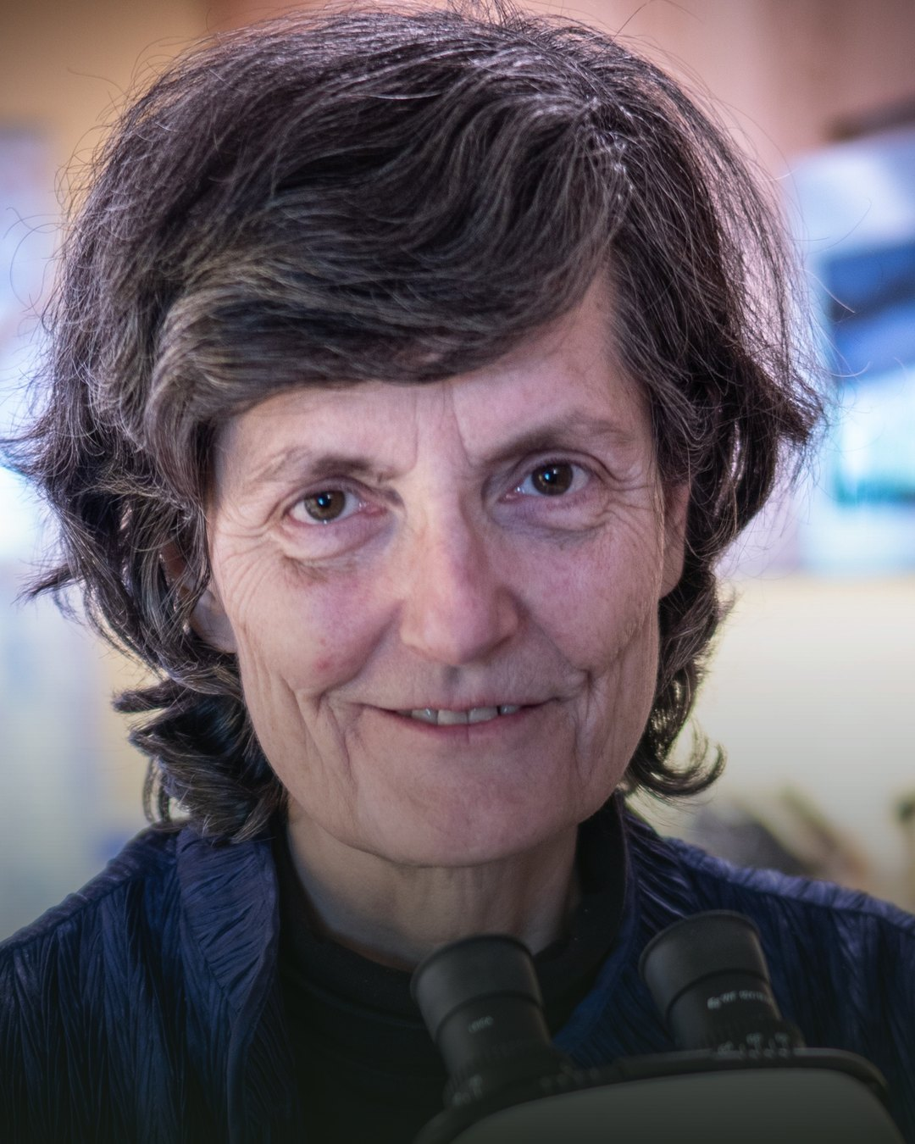
Healthy food comes from healthy soil

Slide 4
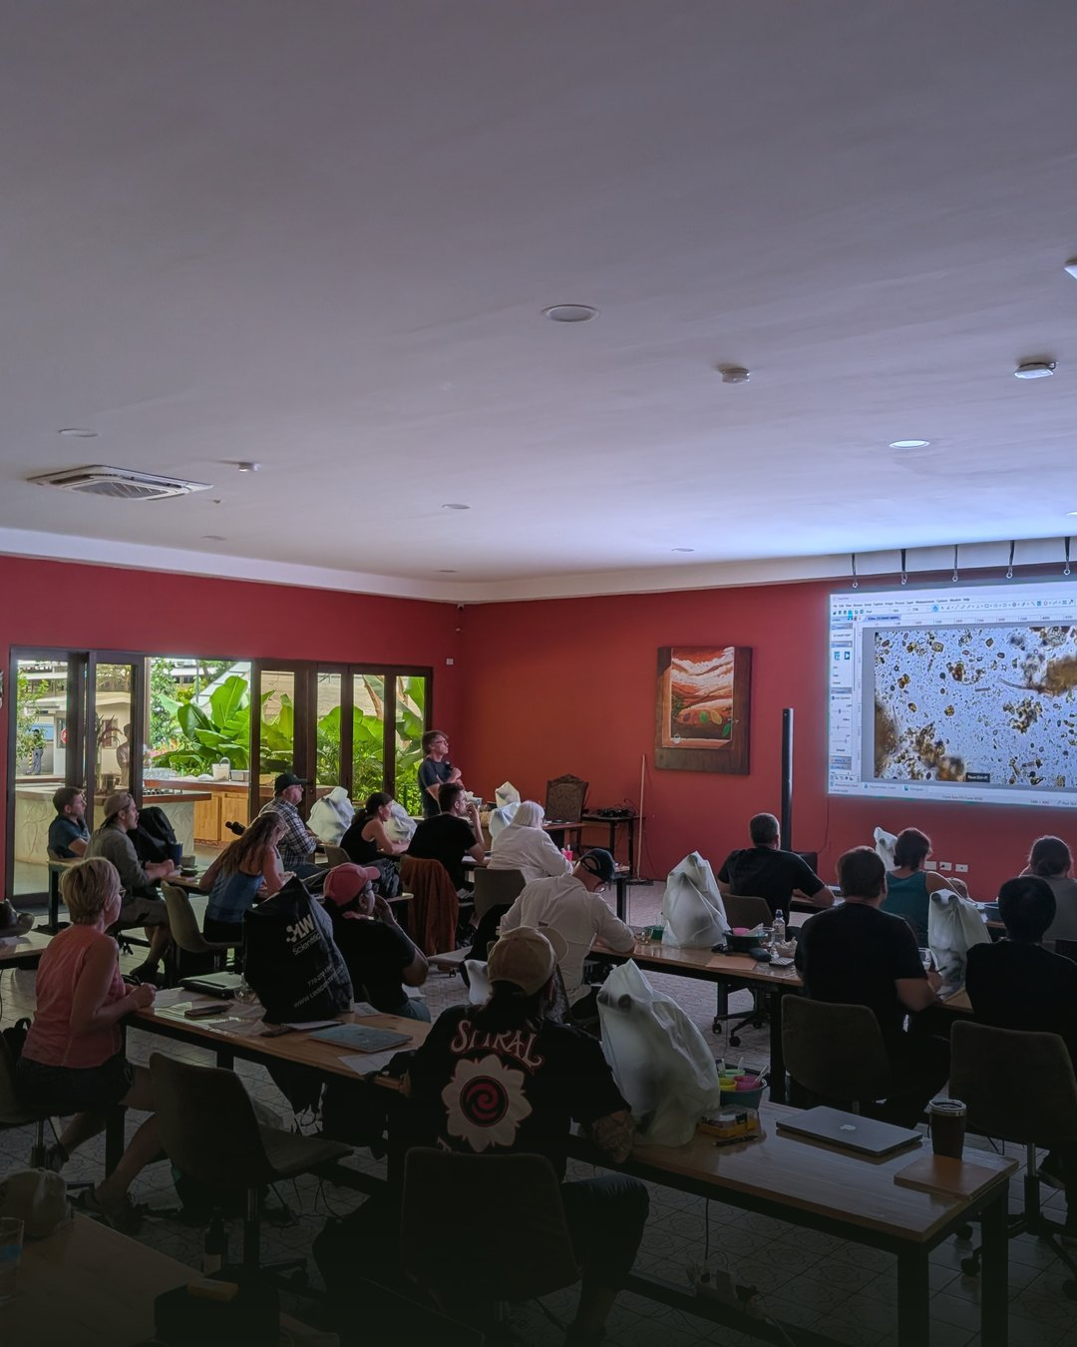
We teach farmers, agronomists and consultants to restore the living web in their soil

Slide 5
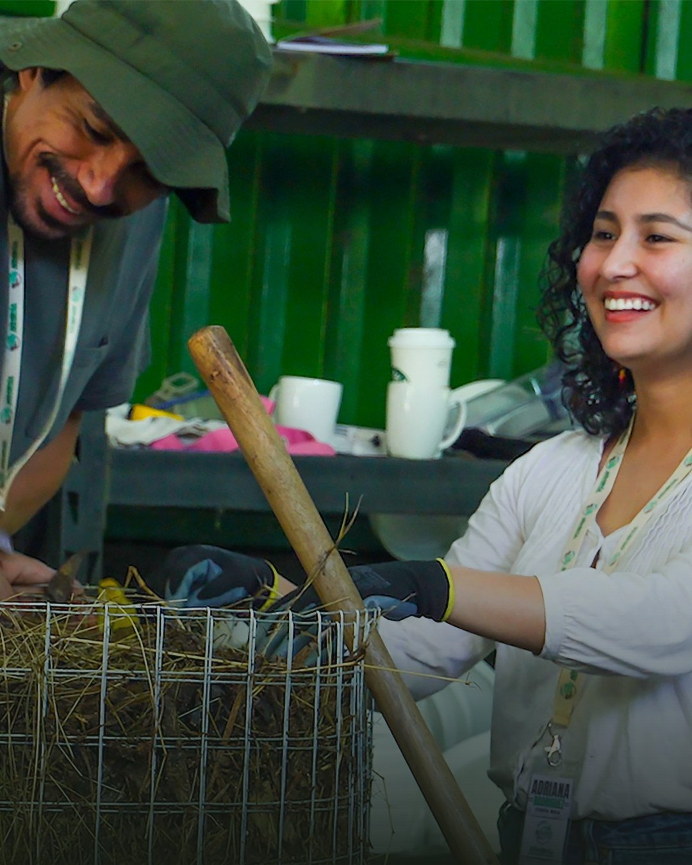
One trained farmer changes a whole farm. Then the neighbours ask how.

Slide 6
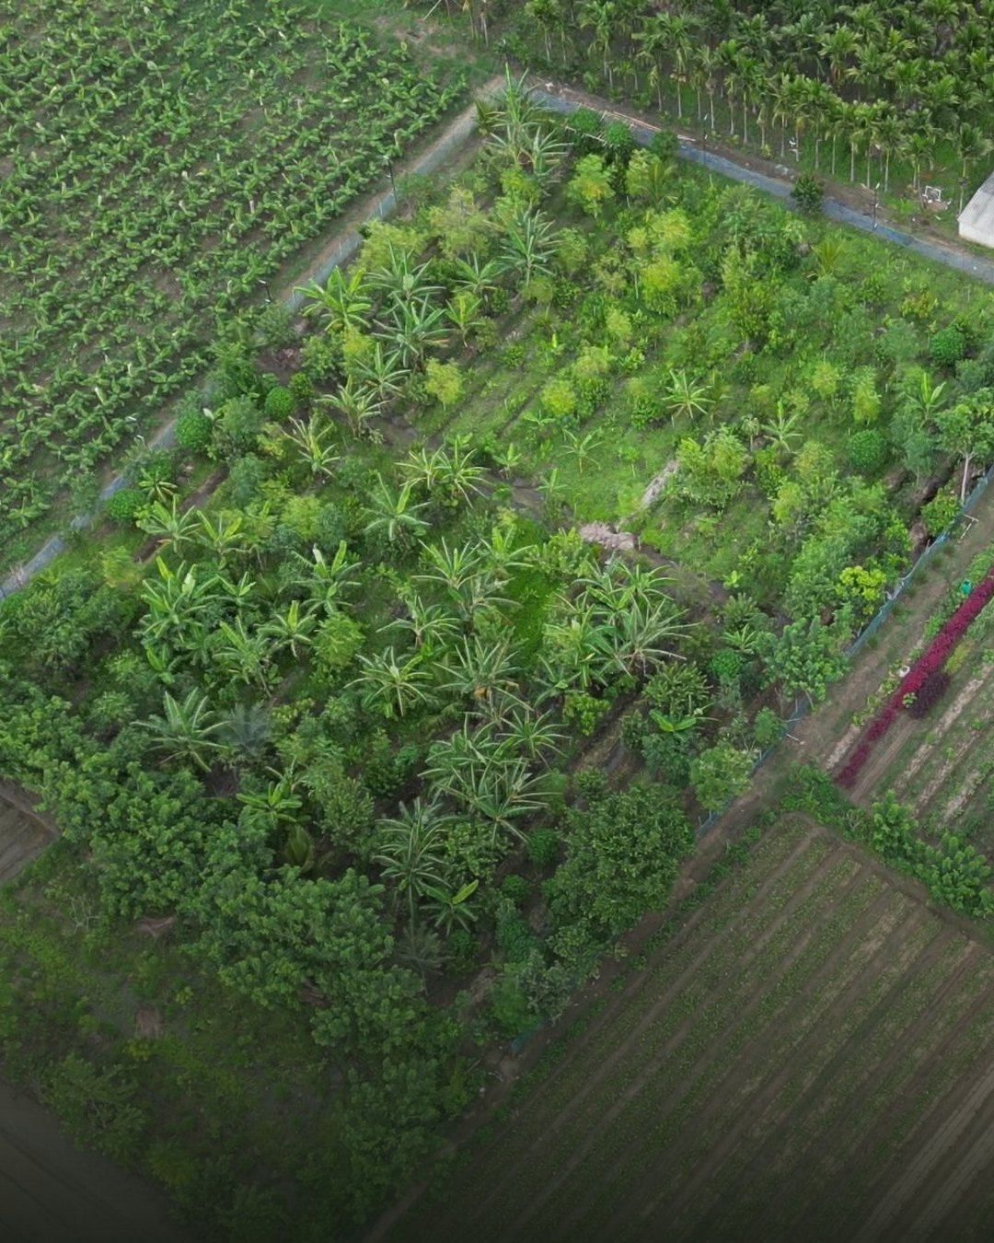
Farm by farm, in Costa Rica, New Mexico, England, Cyprus and India

Slide 7
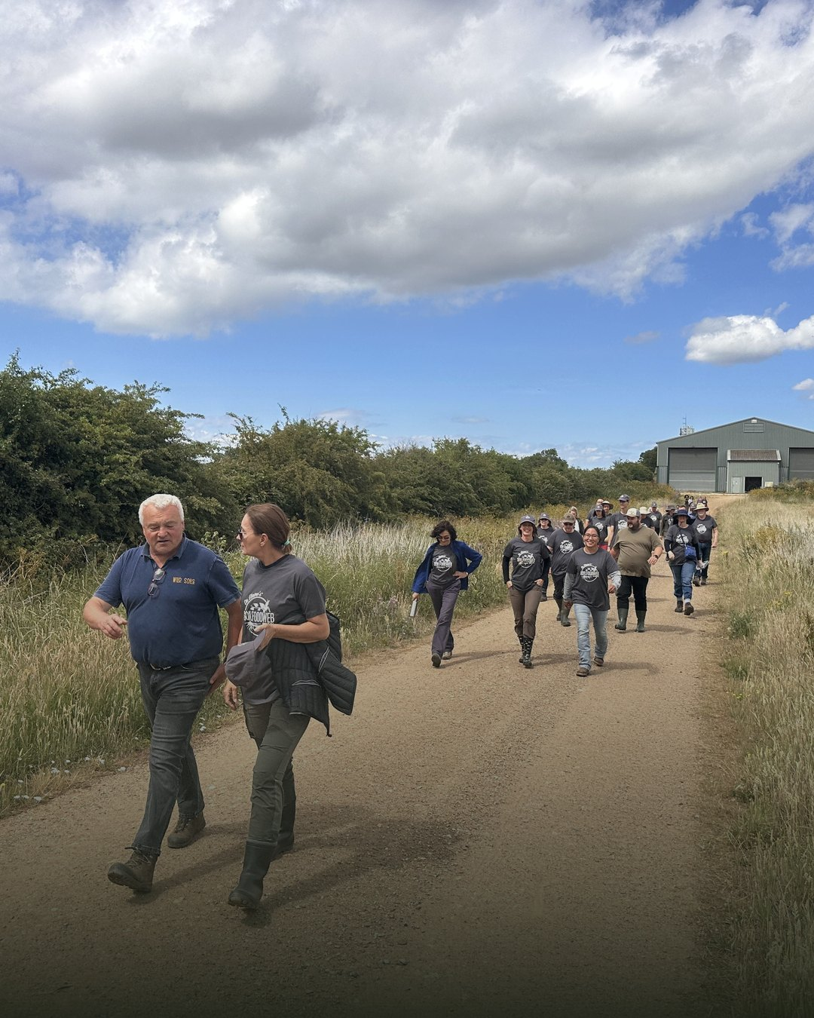

Be the mycelium
you want to see
in the world
We’re raising $100,000 for scholarships,
educational resources and research
Donate today

