Slide 1
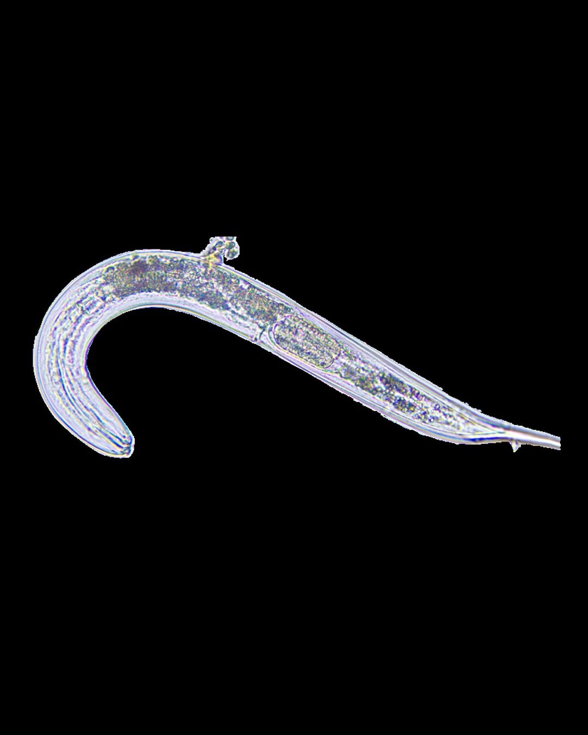


The most common animal on earth
440 quintillion nematodes
Photo: Soil Food Web Foundation

Slide 2
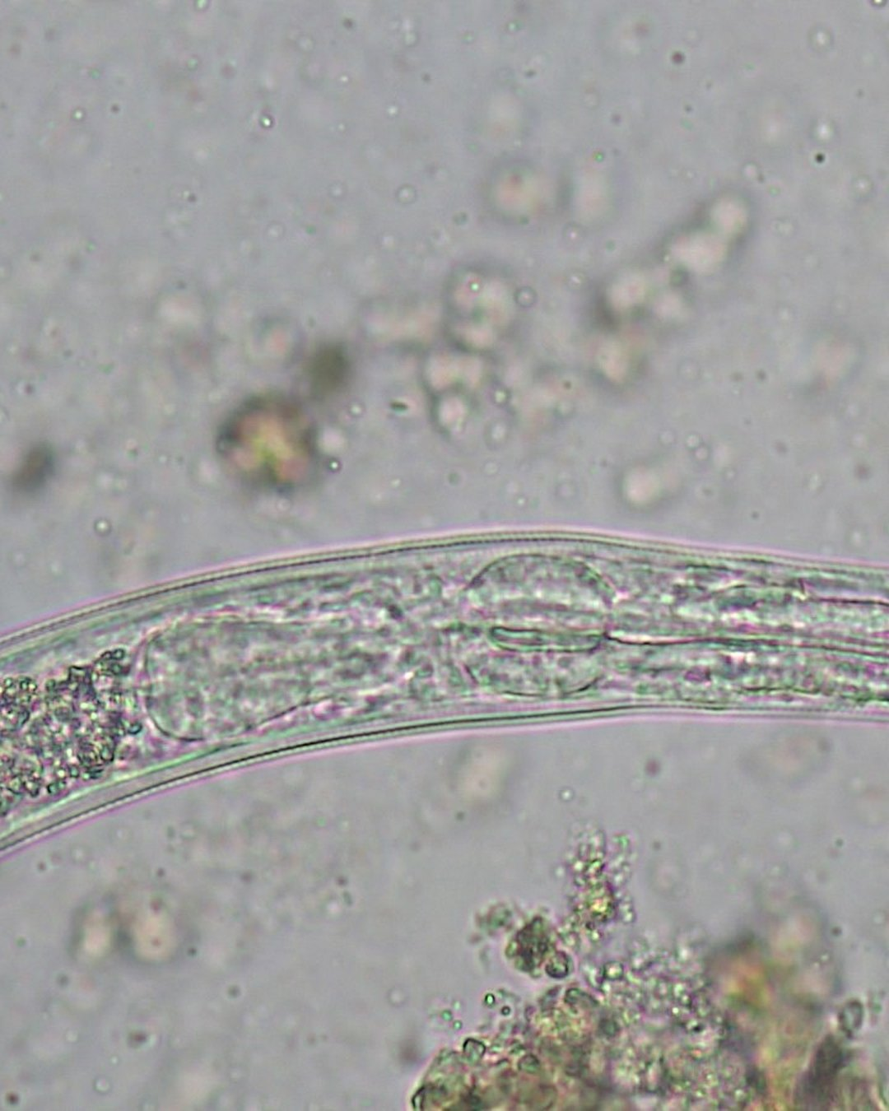


About 57 billion for every person alive
Photo: Johannes Veith

Slide 3
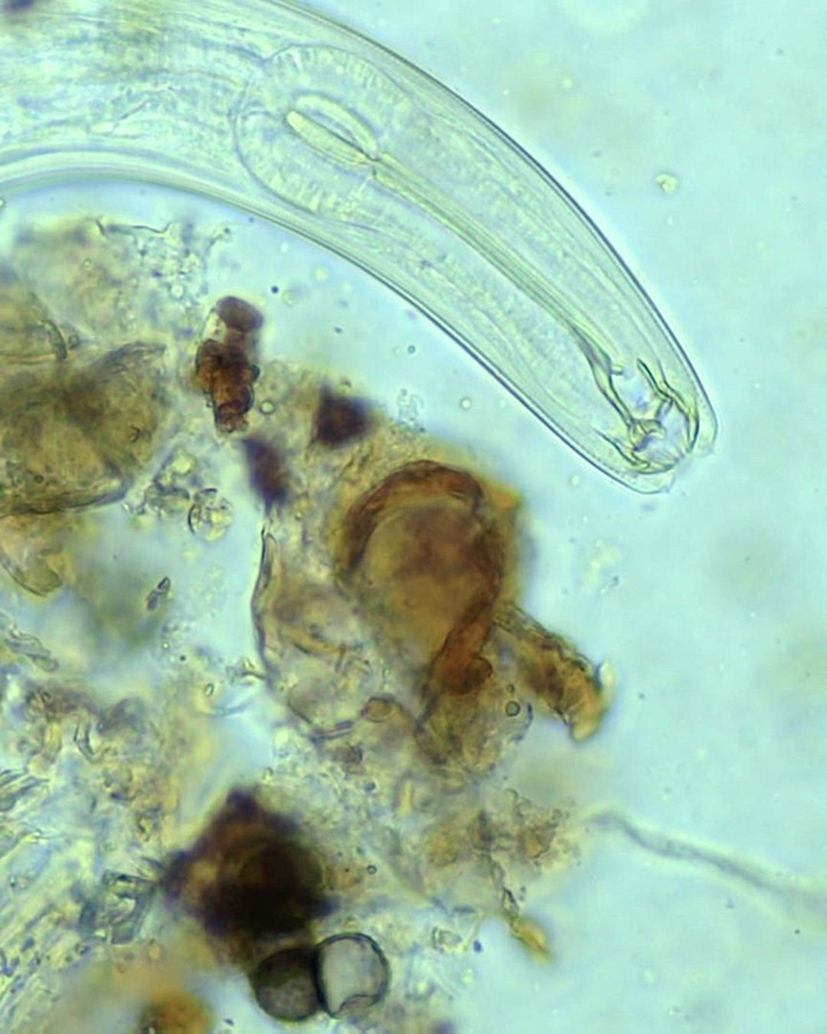
Most feed on bacteria and fungi
Photo: Keisha Wheeler

