Slide 1

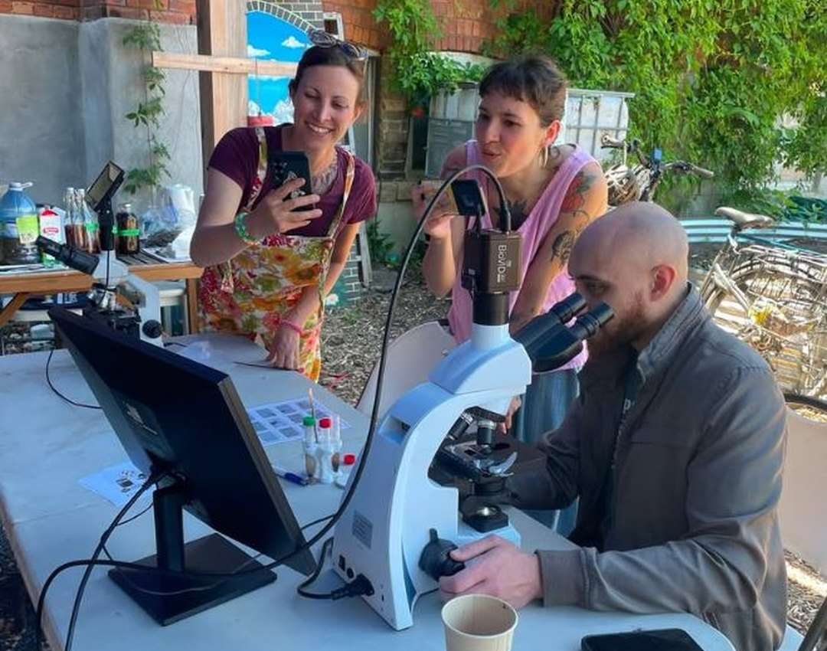

Happy Small Business Saturday
Meet Colleen Dempster of Rewild Soils

Slide 2
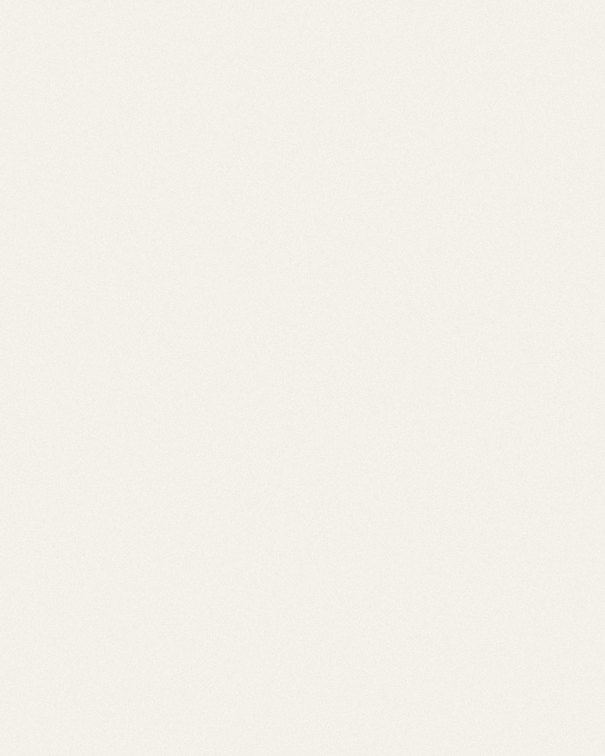
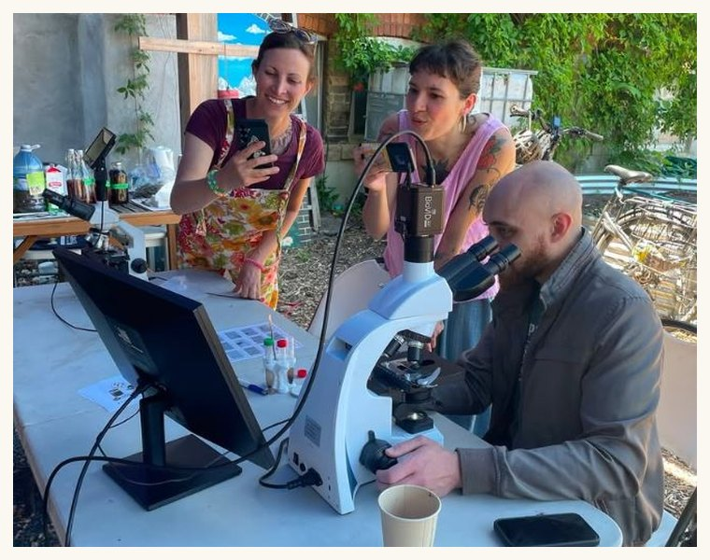

A Soil Food Web certified microscopy lab since 2022
Colleen has looked at hundreds of soil, compost and compost tea samples. Here she shows compost on the monitor at a Compost Toronto event.

Slide 3
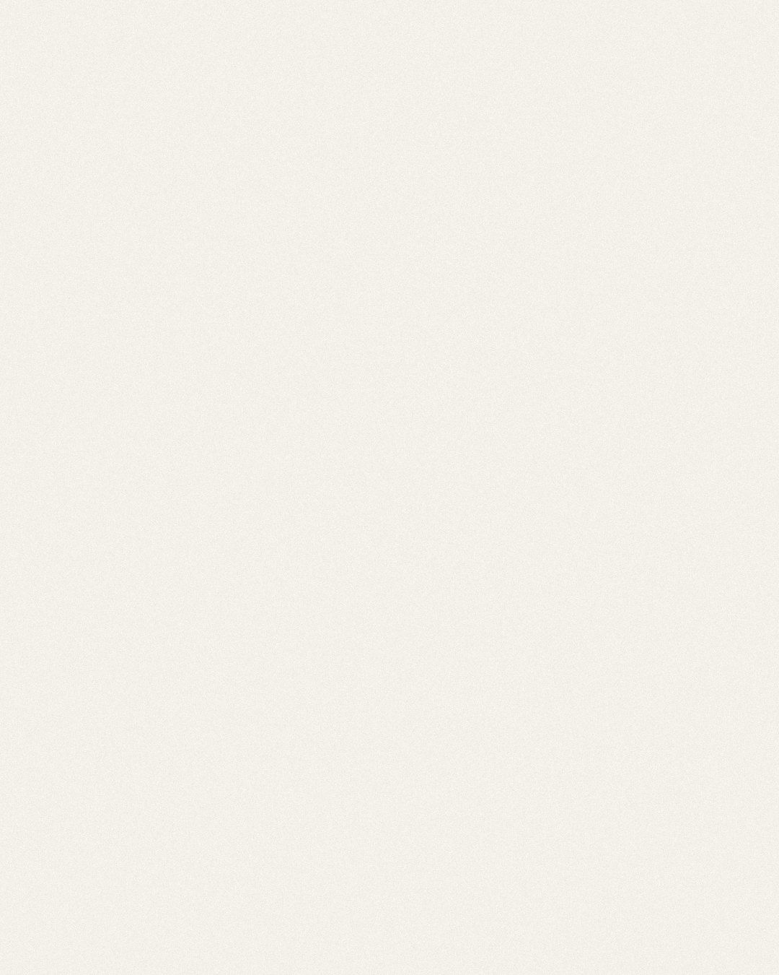
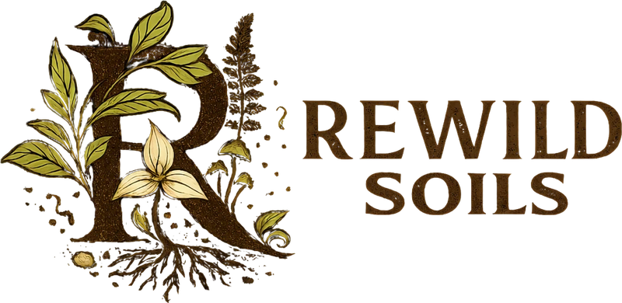

Meet Rewild Soils
Soil microscopy, consulting, workshops and Biologically Complete compost, from Uxbridge, Ontario
rewildsoils.com

