Slide 1

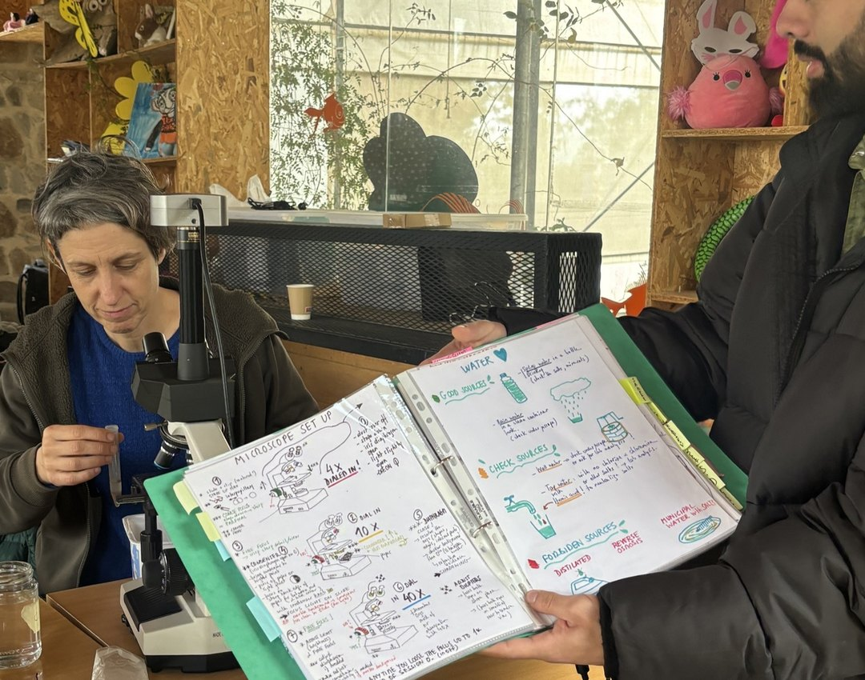

Cyber Monday
[DISCOUNT] off online courses
Nov 30 to Dec 4

Slide 2



Online courses in the sale
Foundation Courses
Compost Intensive
Permaculture Design Certificate
Complete Practicum
Advanced Programs
Intro to the Foundation Courses
[DISCOUNT] off, Nov 30 to Dec 4

Slide 3


Link in bio
Cyber Monday, Nov 30 to Dec 4

